Slide 1


Norton Juxta Kempsey C of E Primary
Transition Day
&
Parent Information
2026-2027
Oak Class

Slide 2
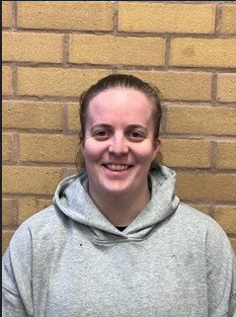
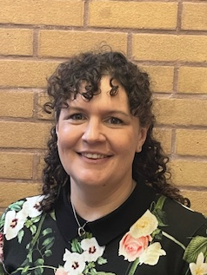
Welcome to Maple Class Year 5
Teaching Assistant
Miss Daniels
Class Teacher
Mrs Leeming

Slide 3

Typical Daily Routine
9.00 Registration and spelling practice
9.10-9.30 Collective Worship
9.30-9:45 Maths Fluency
9.45-10.45 Maths
10.45-11.00 Break time and snack
11.00-11.15 SPaG
11:15-12:00 English
12.00 -1pm Lunch & OPAL
1.00-1.20 – Quiet Reading including Accelerated Reader Quizzes
1.20 - 3.15 Afternoon Sessions either whole afternoon or split in 2
Geography, History, RE, Science, Guided Reading, P.E, D&T, Art, Music, Computing, French, handwriting.
To include ‘run a mile’ as a brain break.
3.30 End of day
Notes:
Afternoons – topic pe re

Slide 4
Geography and History Topics in year 3 2025/2026
Stone Age | Volcanoes and Earthquakes | Romans | Our European Neighbours | Victorians | UK Rivers and Mountains

Slide 5
Reading
Shared reading - during lessons, everyday, cross-curricular.
Guided reading - using books levelled using national book banding system and RWInc. Levels.
Accelerated reader – Change as often as you wish after AR quiz complete. Library is open every day. levels - These will be regularly reviewed throughout the year and communicated in the home school link books.

Slide 6
Maths
All aspects of maths are covered (place value, basic operations, shape, measure, time, calculations.)
All work is set at your child’s level
We complete oral, practical and written work
Children taught daily
Number fluency – Number Sense used for times tables
CPA maths policy (concrete, pictorial, abstract)
Mastery Approach
Mad Math Mondays to support problem solving.

Slide 7
Personal Skills and Learning Behaviours
Perseverance, Concentration, Commitment, Self Reliance and Team-Work.
Growth Mindset and The Power of Yet.
Positive feedback.
Houses and House Points.
Congratulations assembly on a Friday.
Good news cards.

Slide 8
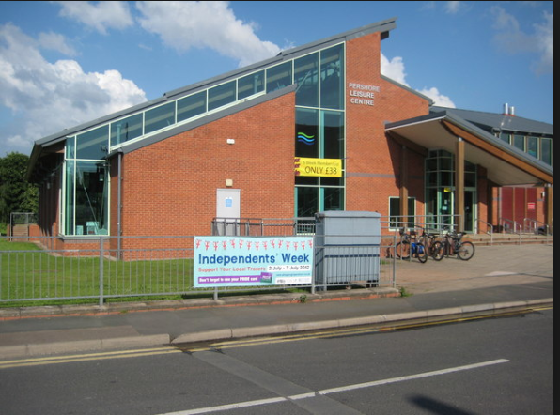

Swimming
Swimming on a Friday (dates TBC Autumn term).
Pershore Leisure Centre.
Children have half an hour in the pool.
Groups are sorted by the qualified swimming instructor.

Slide 9
Homework
Children should be reading daily for a minimum of ten minutes each day in key stage 2. The children should record what they read in their reading log.
Use knowledge organisers as a starting point for vocabulary development and key knowledge acquisition.
Weekly spellings. List sent home beginning of each term.

Slide 10
Uniform
Uniform list on website
PE kit –worn on PE days, PE hoodies or school jumper. Branded sports tops are not allowed. Winter kit-joggers.
Water bottles – kept in classroom with access at anytime
No jewellery and earrings must be removed or covered for PE. (please provide tape)
Welly’s kept in school for OPAL lunchtimes.

Slide 11
Together, with the love and joy of God, we will discover, develop and maximise our unique potential.

Slide 12
Communication
Home School link book. Specific communication pages and reading record pages.
School web site.
Text Messages.
Newsletters emailed.
Enquiries via school office.
Any worries – please make an appointment to speak to your child’s class teacher, in the first instance.
Daily Good News cards & weekly congratulations

Slide 13
School Christian Values
Love
Trust
Friendship
Respect
Compassion
Forgiveness
Courage

