Slide 1

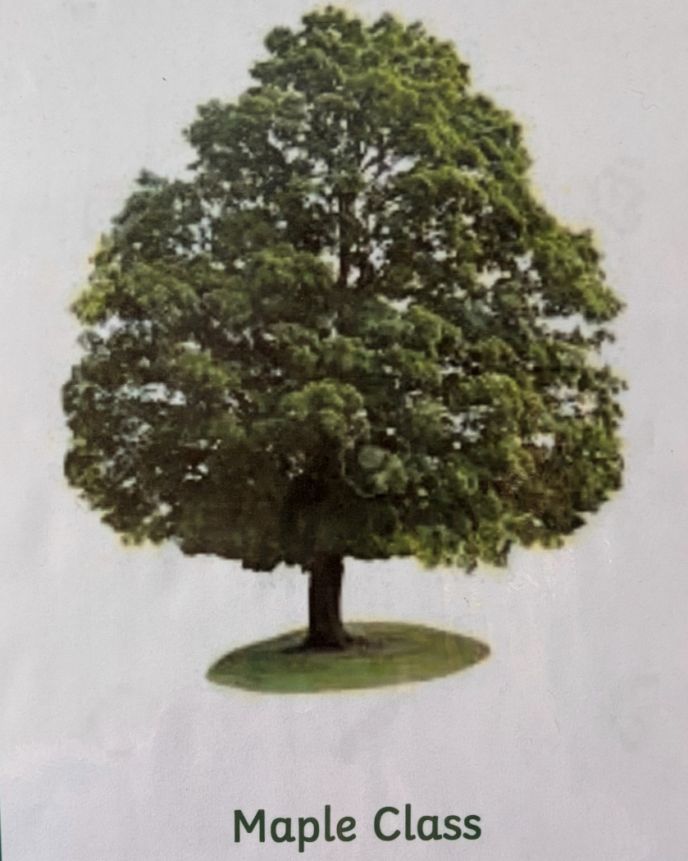
Norton Juxta Kempsey C of E Primary
Transition Day
&
Parent Information
2026-2027

Slide 2
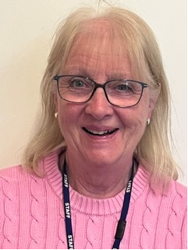
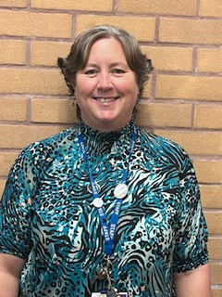
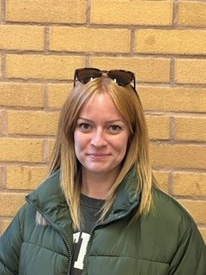
Welcome to Maple Class Year 5
Teaching Assistant
Mrs Askew
Class Teacher
Mrs Bilsland
1:1 Support
Miss Bent

Slide 3
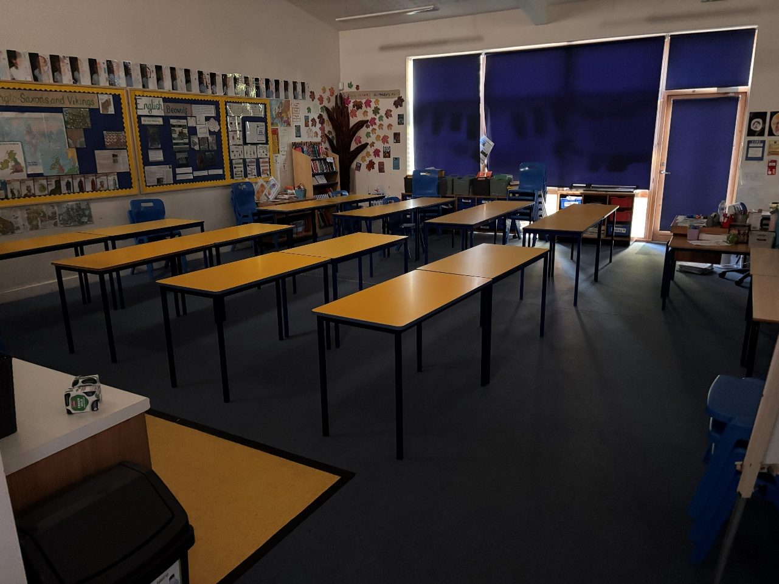
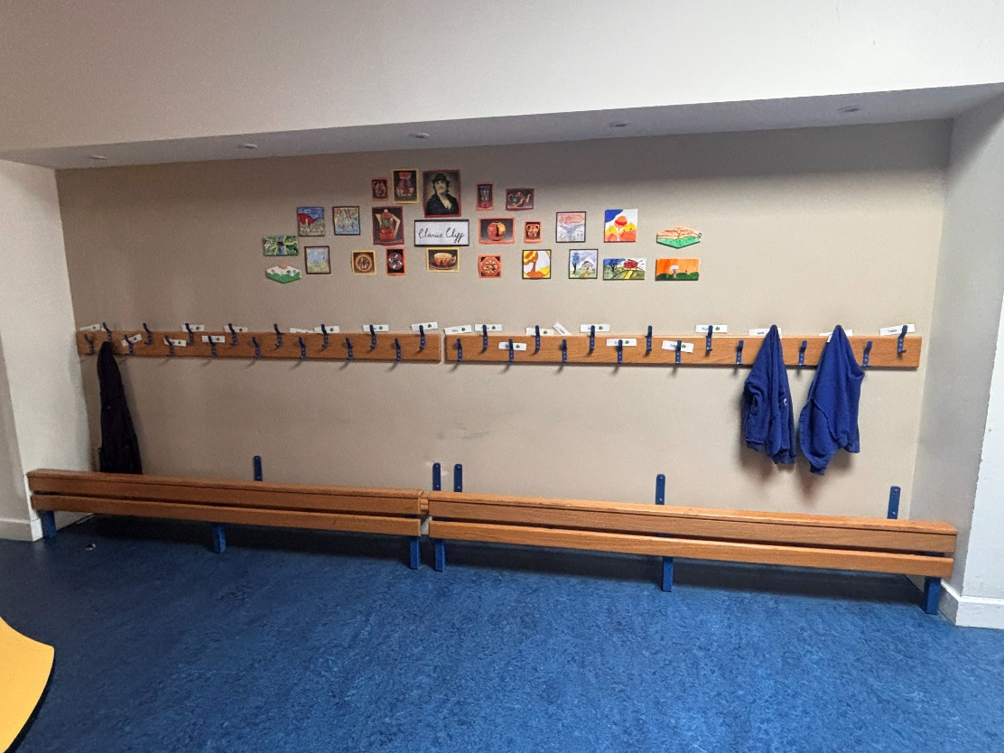
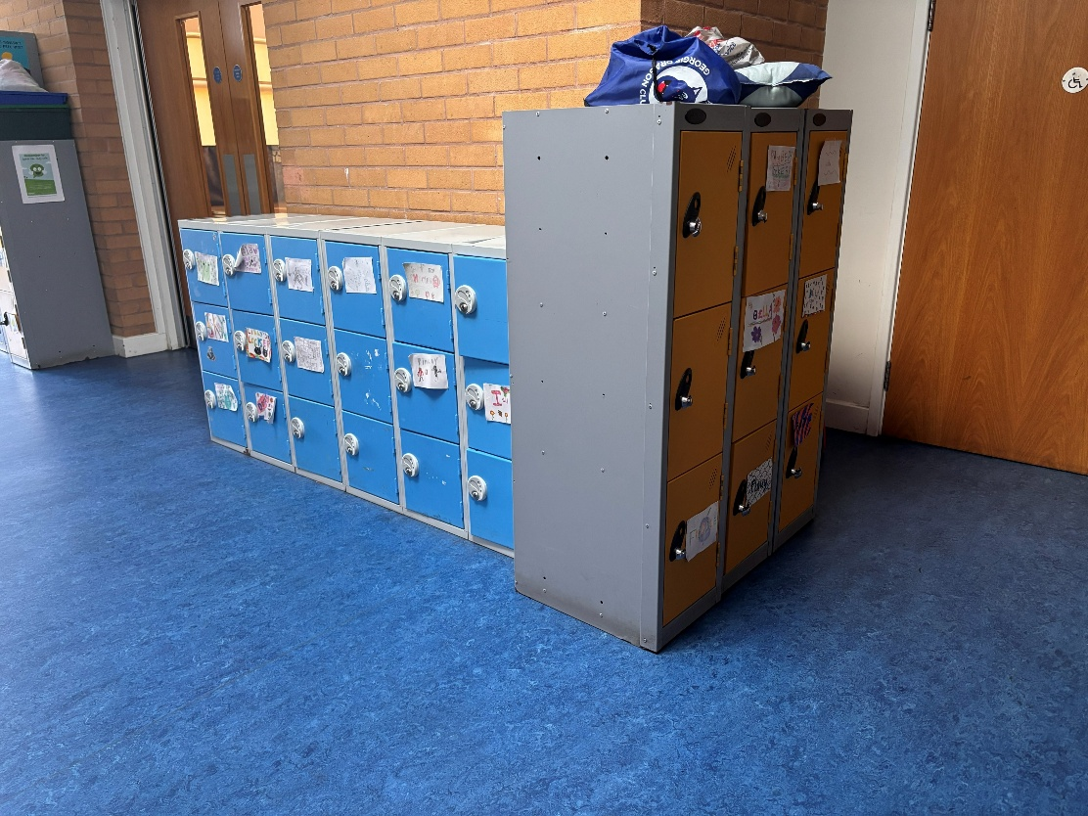
Year 5
UKS2
Our Classroom
& outdoor area

Slide 4

Typical Daily Routine
9.00 Registration and spelling practice
9.10-9.30 Collective Worship
9.30-9:45 Maths Fluency
9.45-10.45 Maths
10.45-11.00 Break time and snack
11.00-11.15 SPaG
11:15-12:00 English
12.00 -1pm Lunch & OPAL
1.00-1.20 – Quiet Reading including Accelerated Reader Quizzes
1.20 - 3.15 Afternoon Sessions either whole afternoon or split in 2
Geography, History, RE, Science, Guided Reading, P.E, D&T, Art, Music, Computing, French, handwriting.
To include ‘run a mile’ as a brain break.
3.30 End of day
Notes:
Afternoons – topic pe re

Slide 5
Geography and History Topics in year 5 2025/2026
Ancient Greeks
Britain at War – WW1
Galapagos – sustainability
Settlements over time
Vikings and Saxons

Slide 6
Reading
Shared reading - during lessons, everyday, cross-curricular.
Guided reading - using books levelled using national book banding system and RWInc. Levels.
Accelerated reader – Change as often as you wish after AR quiz complete. Library is open every day. levels - These will be regularly reviewed throughout the year and communicated in the home school link books.

Slide 7
Maths
All aspects of maths are covered (place value, basic operations, shape, measure, time, calculations.)
All work is set at your child’s level
We complete oral, practical and written work
Children taught daily
Number fluency – continuing to build on number sense times tables and operations.
CPA maths policy (concrete, pictoral, abstract)
Mastery Approach
Mad Math Mondays to support problem solving.

Slide 8
Personal Skills and Learning Behaviours
Perseverance, Concentration, Commitment, Self Reliance and Team-Work.
Growth Mindset and The Power of Yet.
Positive feedback.
Houses and House Points.
Congratulations assembly on a Friday.
Good news cards.

Slide 9
Personal Skills -Walking Home
In September we will be having PSHE sessions around road safety awareness and focus on the school expectations of being Respectful, Responsible and Safe to ensure a safe transition when the Year 5’s begin to be allowed to walk home.
The children WILL NOT be walking by themselves until later in the Autumn term, date TBC.
If you give permission and then feel it is not appropriate, then it can be relinquished or only be on set days if this is more appropriate.
Permission letters will be sent out at the beginning of the new school year.

Slide 10
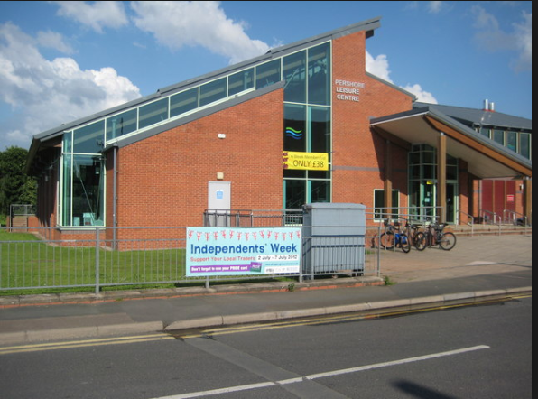

Swimming
Swimming on a Friday (dates TBC Summer term).
Focus on water safety
Pershore Leisure Centre.
Children have half an hour in the pool.
Groups are sorted by the qualified swimming instructor.

Slide 11
Assessment
On going teacher assessment, end of unit tests and termly written assessments.
These inform details for parents evening.
Progression to be ready for Year 6 statutory tests.
End of year reports.

Slide 12
Homework
Children should be reading daily for a minimum of ten minutes each day in upper key stage 2. The children should record what they read themselves, so it is their reading log.
Use knowledge organisers as a starting point for vocabulary development and key knowledge acquisition.
Weekly spellings. List sent home beginning of each term.
Alternating weeks of grammar or maths homework.

Slide 13
Uniform
Uniform list on website
PE kit –worn on PE days, PE hoodies or school jumper. Branded sports tops are not allowed. Winter kit-joggers.
Water bottles – kept in classroom with access at anytime
No jewellery and earrings must be removed or covered for PE. (please provide tape)
Welly’s kept in school for OPAL lunchtimes.

Slide 14
Together, with the love and joy of God, we will discover, develop and maximise our unique potential.

Slide 15
Communication
Home School link book. Specific communication pages and reading record pages.
School web site.
Text Messages.
Newsletters emailed.
Enquiries via school office.
Any worries – please make an appointment to speak to your child’s class teacher, in the first instance.
Daily Good News cards & weekly congratulations

Slide 16
Questions
Please email any specific questions or enquiries that have not been answered to: office@nortonprimary.worcs.sch.uk
Class webpage:
Pop by the classroom the first week back via the playground if you have any questions or just want to meet us.

Slide 17
School Christian Values
Love
Trust
Friendship
Respect
Compassion
Forgiveness
Courage

Slide 18
We look forward to working with you again and getting to know your child even better.

