Slide 1

Norton Juxta Kempsey CE Primary School
Parent Information
Ash Class - Year 4
2026 - 2027

Slide 2
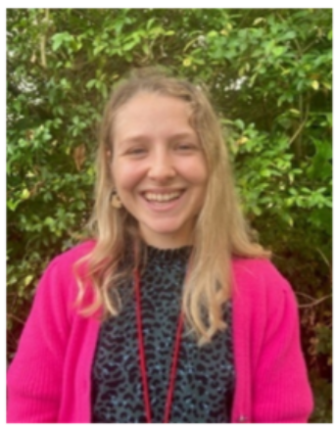
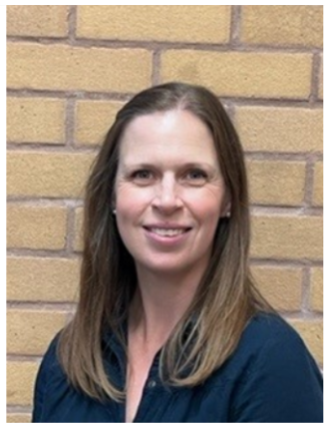
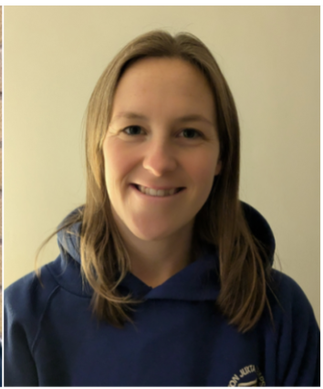
Welcome to Ash Class
Year 4
Mrs Greenstreet
Teacher Monday – Wednesday
Mrs Kingdon
Teacher Thursday – Friday
Mrs Eastwood
Teaching Assistant Monday - Friday

Slide 3
Daily Routine
9.00 – 9.10 | Registration and morning warm-ups
9.10 – 9.30 | Collective Worship
9.30 – 10.30 | Maths
10.30 – 10.45 | Maths fluency (including times tables)
10.45 – 11.00 | Breaktime
11.00 – 12.00 | English
12.00 – 1.00 | Lunchtime (lunch followed by OPAL)
1.00 – 1.30 | Reading or Spelling activity
1.30 – 2.30 | Afternoon Session 1
2.30 – 2.40 | Movement Break
2.40 – 3.20 | Afternoon Session 2
3.20 – 3.30 | Story Time
Afternoon Sessions: History or Geography R.E Science Art or D&T P.S.H.E Computing French Music P.E
Notes:
Afternoons – topic pe re

Slide 4
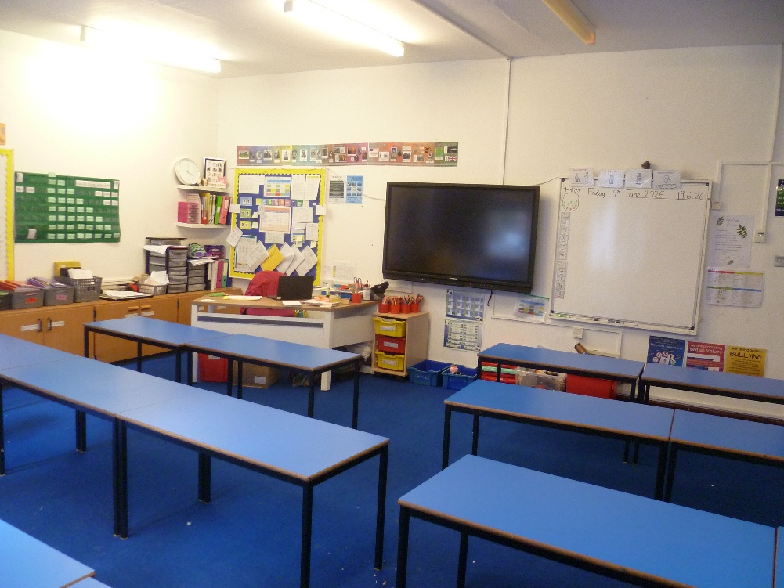
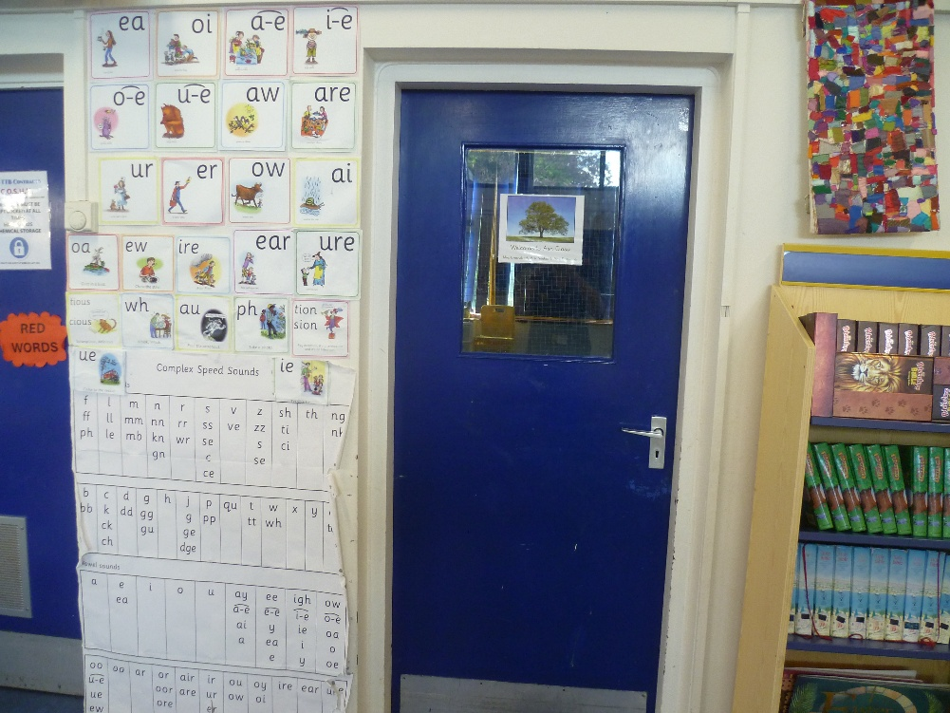
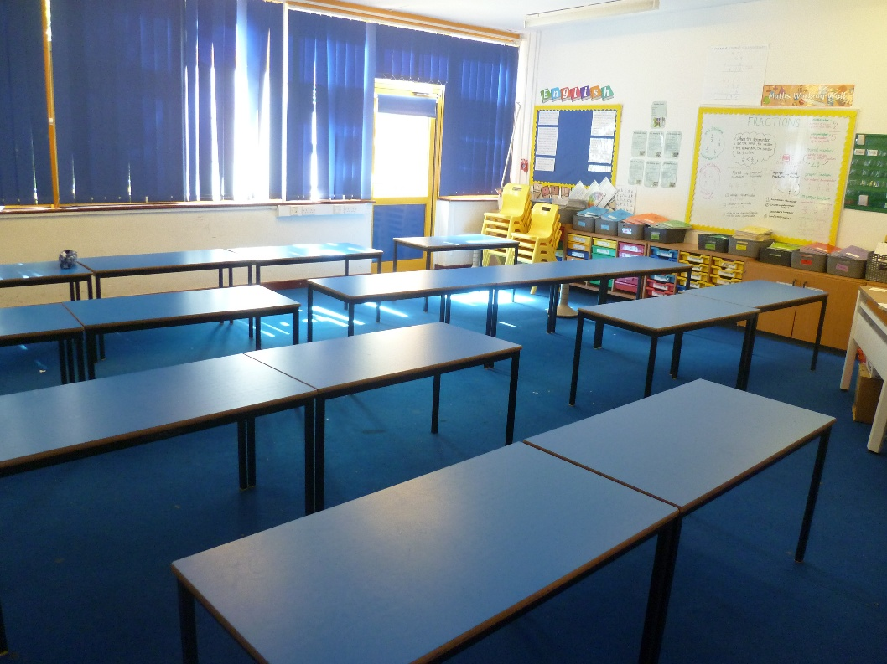
Our classroom*
*the furniture may move position from time to time

Slide 5
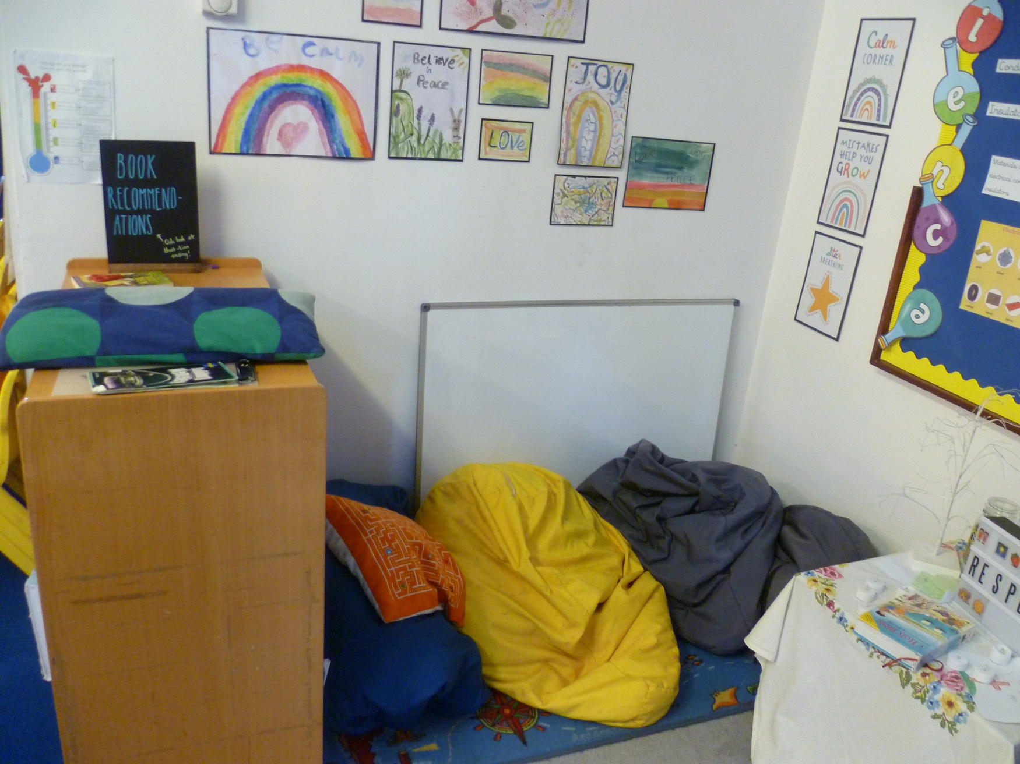
Our calm corner

Slide 6
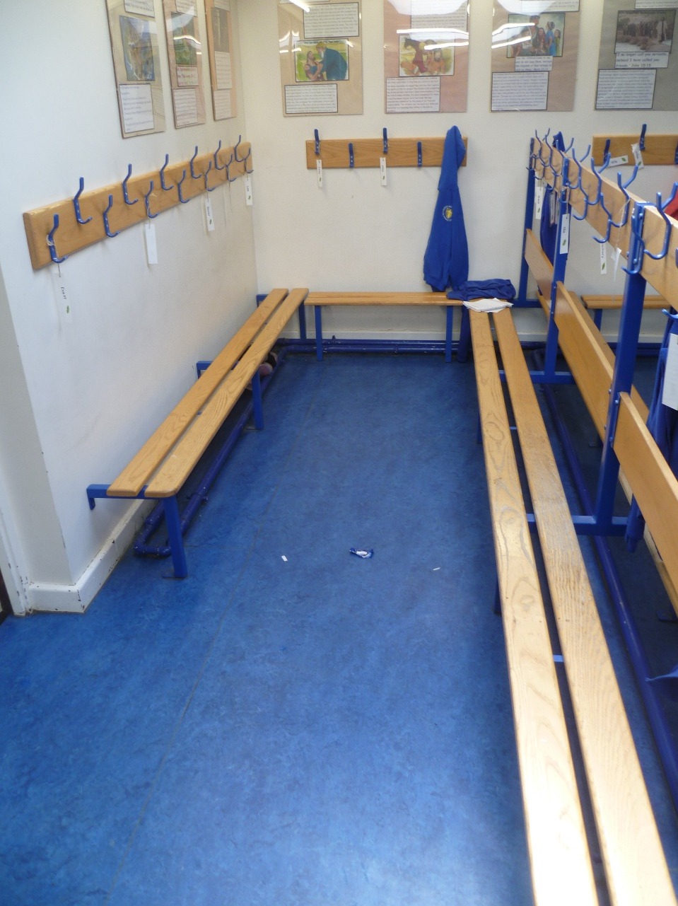
Our cloakroom – this will stay
the same as last year

Slide 7
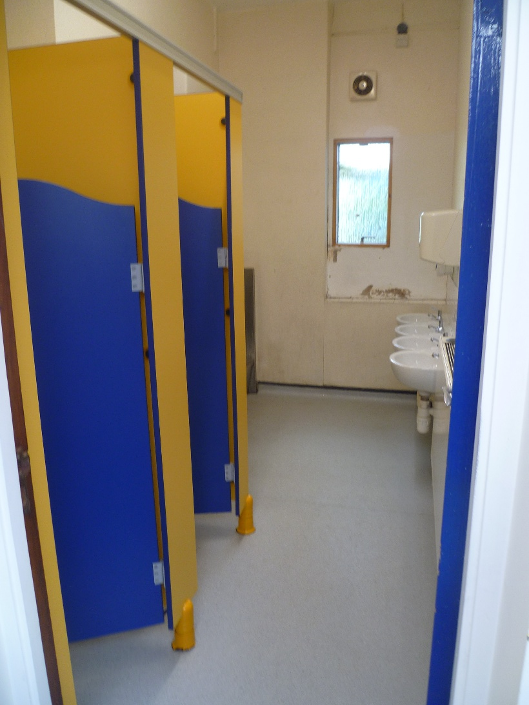
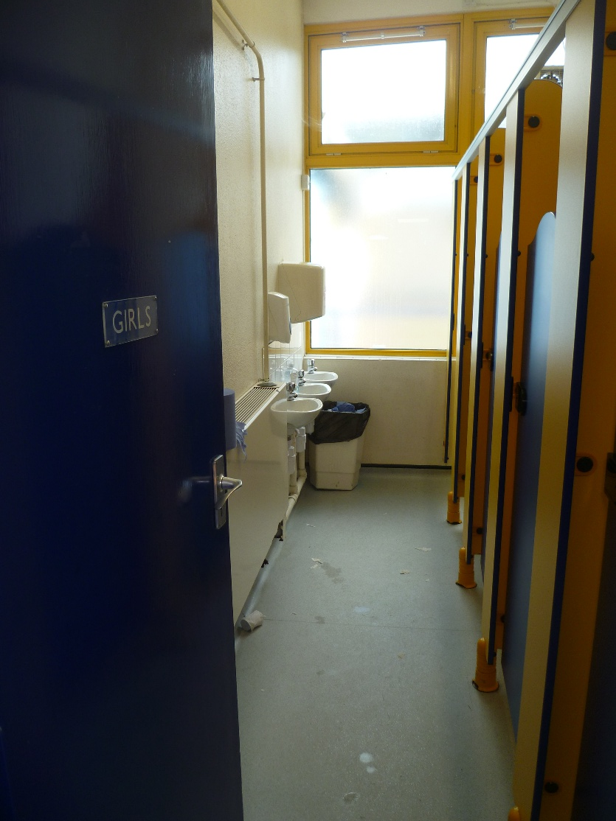
Our toilets - these will stay
the same as last year

Slide 8
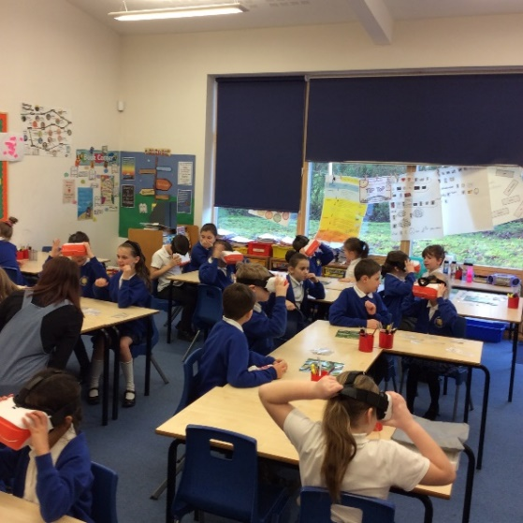
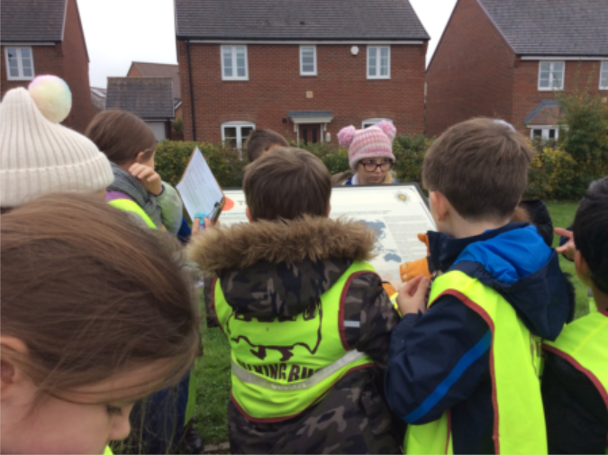
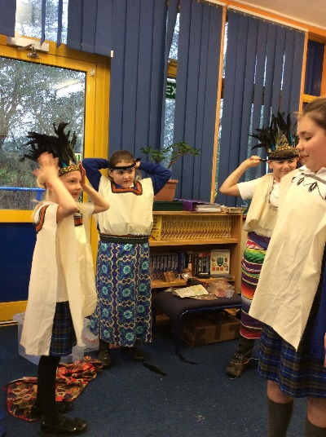
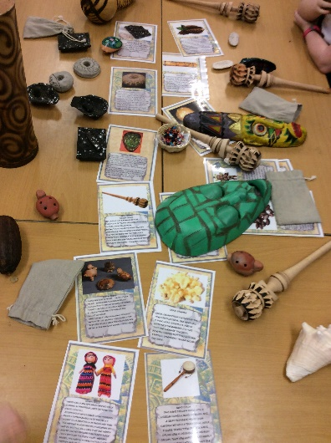
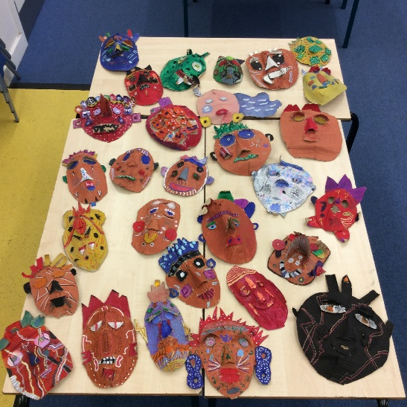
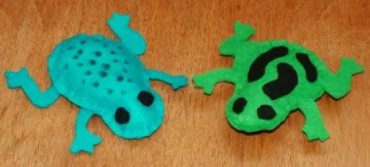
Curriculum
WOW days
Wow-ins – Hook into new topic
Wow-outs – End product Exhibitions

Slide 9
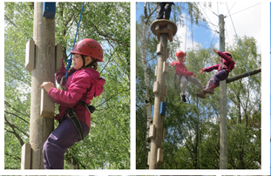
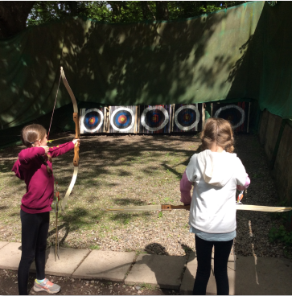
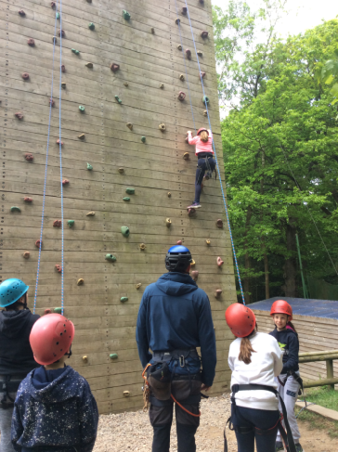
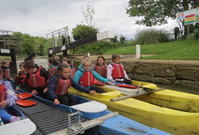
Trips
Adventure Residential
Norton Barracks walk
St James’ Church
Bell Boating
Multiple sporting activities

Slide 10
Topics in Year 4
Ancient Egyptians
Norton Local Study (The Barracks)
The Ancient Maya (South America – includes a D&T project Mayan mask-making)
Rainforests Rainforests (Includes a D&T sewing project)
Great Rivers (Severn and Amazon)
Britain from Above (Maps & Physical Features)

Slide 11
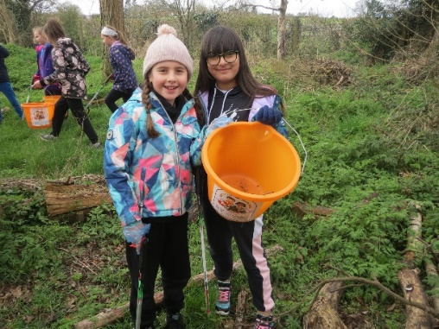
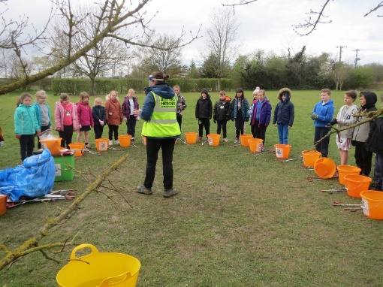
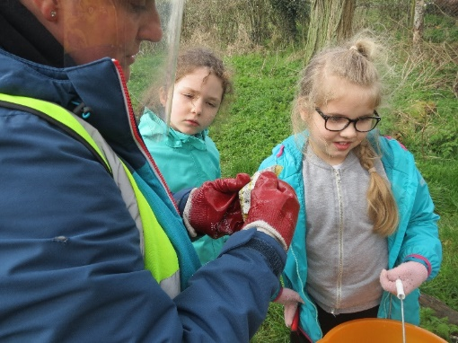
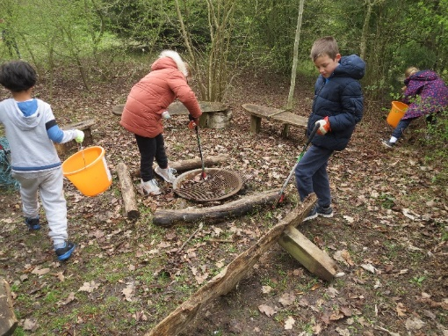
Taking responsibility for our world through being courageous advocates!
Environmental and Sustainable Citizenship

Slide 12
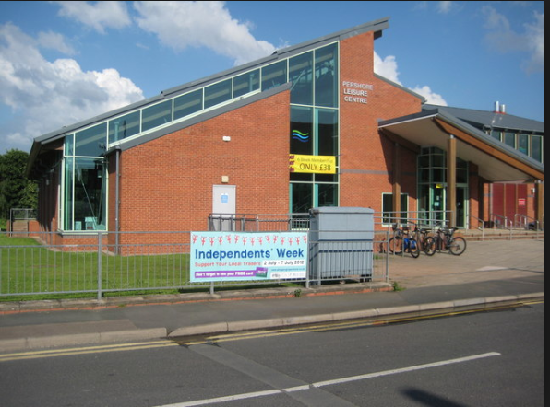

Swimming
Swimming on a Friday (dates TBC)
Pershore Leisure Centre
Children have half an hour in the pool 11.15 –11.45
Groups are sorted by the qualified swimming instructor at Pershore Leisure Centre

Slide 13
Reading
Shared reading – during lessons, every day, cross-curricular.
Home readers – Change as often as you wish, within your ZPD. Please read at home daily and record in your home school link book
AR ZPD – These will be regularly reviewed throughout the year and communicated in the home school link books.
Class Read – Read at the end of the day.

Slide 14
Maths
All aspects of maths are covered (place value, four operations, fractions, shape, measures, time etc.)
Problem solving (Problem Solving Fridays!)
We complete oral, practical and written work
CPA maths policy (concrete, pictorial, abstract)
Three part lesson structure (Do it, Secure it, Deepen it)
Mastery approach - learning approaches aim to ensure that all pupils have mastered key concepts before moving on to the next topic

Slide 15
School Christian Values
Love
Trust
Friendship
Respect
Compassion
Forgiveness
Courage

Slide 16
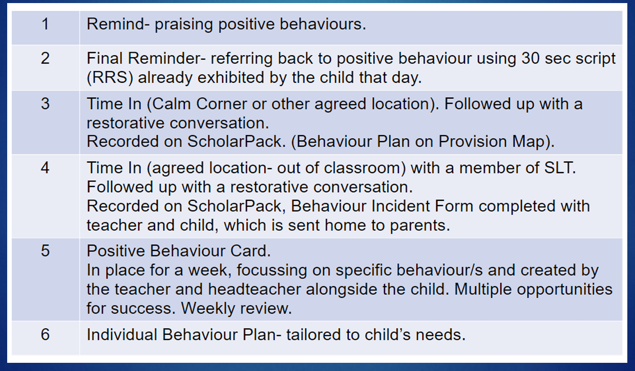
Behaviour Policy – a positive approach
Notes:
Introduction of stickers for bronze, silver, gold to reinforce good behaviour

Slide 17
Behaviour Policy – a positive approach
School expectations – RRS - Be Respectful, Be Responsible, Be Safe
Positive behaviour praised through:
  Good News Cards - children going above and beyond expectations - sent home on same day stating which behaviour being shown.
  Congratulations Cards
  House Points
  Jar of Joy – jar filled up every time the School Value is demonstrated for that half term. Class decides on reward once full
  Zones of Regulation- based on ‘Inside Out’ to help manage emotions
Notes:
Introduction of stickers for bronze, silver, gold to reinforce good behaviour

Slide 18
Assessment
Ongoing teacher assessment
Informs parents evening and mid-year conversations
Progression ready for Year 4 times table check in the summer
End of year reports

Slide 19
Homework
Please read every day and record in the home school link book. In Lower Key Stage 2 we encourage the children to record what they read themselves so it is their reading log.
Weekly homework activity alternating between Maths and English (Maths will be set on Purple Mash, English will be a page of a CGP grammar book)
Multiplication practice every week in school.
Weekly spelling review of spelling patterns and statutory year group words
Use knowledge organisers as a starting point for vocabulary development and key knowledge acquisition

Slide 20
Uniform
Uniform list on website
PE kit – wear named PE kit on PE days –TBC
  Winter kit – navy joggers, white t-shirt, school jumper/ hoodie
  Summer kit – navy shorts, white t-shirt, school jumper/ hoodie
  No jewellery and earrings must be removed or covered for PE. (please provide tape)

Slide 21
Pencil Cases and Stationery
If your child would like to, they can bring their own pencil
case* to Ash Class.
Key items to include are:
Pencil
Blue handwriting pen
Glue
Rubber and sharpener
Ruler
Colour pencils
We provide all stationery required for lessons, so please don’t worry if your child doesn’t have a pencil case.
*Pencil cases must be small enough to fit in their school tray!

Slide 22
Communication
- Home School link book. Specific communication pages and reading record pages.
- School web site
- Text Messages
- Newsletters emailed
- Other enquires via the school office
- Any worries – please make an appointment to speak to us, in the first instance.

Slide 23
Questions
Please email any specific questions or enquiries that have not been answered to: office@nortonprimary.worcs.sch.uk

Slide 24
We look forward to welcoming your child into Ash Class in September!

