Slide 1

Norton Juxta Kempsey CE Primary School
Parent Information 2025-26

Slide 2

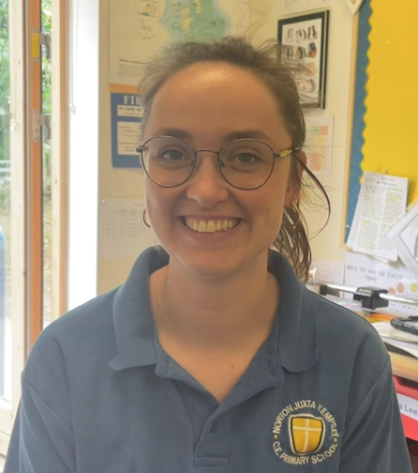
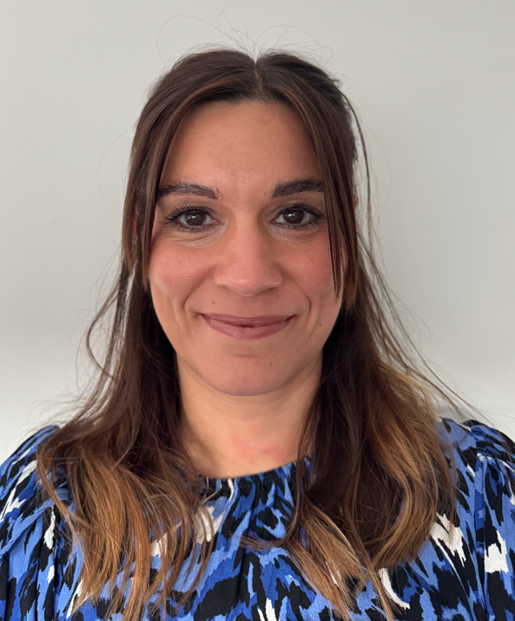
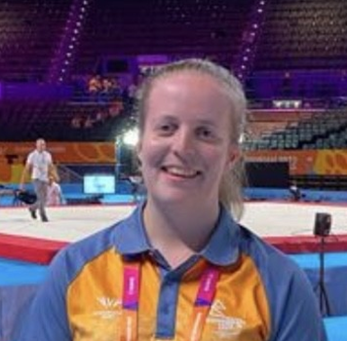
Welcome to Elm Class
Year 6
Mrs Clarke
Mrs Goddard
Miss Daniels

Slide 3
Daily Routine
9.00 – 9.10 Registration and morning activity
9.10 – 9.30 Collective Worship
9.30 – 9.45 Maths Fluency
9.30 – 10.45 Maths
10.45 – 11.00 Break time
11.00 – 12.00 English
12.00 – 1.00 Lunchtime
1.00 – 1.05 Registration
1.05 – 1.30 Spelling / Reading
1.30 – 2.20 Afternoon session 1
2.20 – 3.20 Afternoon session 2
3.20 – 3.30 Get ready to go home
Afternoon Sessions: ​
​
Science​
R.E​
P.E.
History / Geography
Art / D&T​
P.S.H.E​
Computing​
French ​
Music​

Slide 4
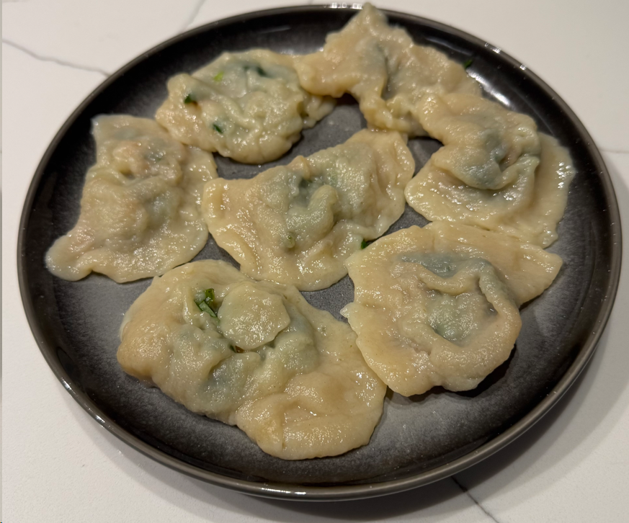
Curriculum Enrichment
Build a desert biome
Make and excavate a ‘fossil’
Construct an edible model of blood
Food / woodwork / textiles
Trips
Leadership opportunities:
- head pupil - school council
- house captain - eco council
- sports crew - worship crew

Slide 5
Topics in Year 6
Sahara (Hot & Cold Desert)
The Normans
The Shang Dynasty
Parliament and Democracy
WWII – The Blitz
Rivers and Coasts
Notes:
The topics that will be studied in Year 6 include: . We will endeavour to plan trips, visits and visitors throughout the year to further enhance pupils’ knowledge within the topics.

Slide 6




Reading
Shared reading - incorporated into the English curriculum, using books that are linked to the History / Geography unit as well as being age appropriate:
- Holes
- Anglo-Saxon Boy
- Stary River of the Sky
- Northern Lights
- Goodnight Mr Tom
- Journey to the River Sea
Accelerated reader - . Pupils will complete a quiz using the Accelerated Reader programme once they have completed a book, aiming to achieve a score of greater than 80% This will keep track of reading age and progress. Age-appropriate books are available in classroom reading area as well as in the school library.
Library– The library is open daily 08.45-9.00am. Pupils also have a timetabled library visit once a week and can access the library when they need a new book to read.

Slide 7
Maths
All aspects of maths are covered in Year 6 (Number, Geometry, Measurement, Statistics and Problem Solving)
All work is accessible at your child’s level through the CPA (concrete, pictorial, abstract) approach
Mastery approach - learning approaches aim to ensure that all pupils have mastered key concepts before moving on to the next topic
Additional approaches to supporting progress in maths:
- Mad Maths Monday - designed to support problem solving
- Problem Solver of the Week – work displayed on the wall
- daily arithmetic fluency – to support mental maths and recall speed
- UK Maths challenge
- Maths boosters

Slide 8
Behaviour Policy - Positive Approach
Three expectation – RRS – Be Respectful, Be Responsible, Be Safe​
Positive behaviour praised through:
- Public praise – this is our easiest and most effective tool in maintaining a positive ethos and encouraging good behaviour
- House points
- Good News Cards - sent home on the same day where “above and beyond” behaviour is shown
- Celebration Assemblies and Congratulations cards
- Jar of Joy - classes fill a jar linked to the term’s school value and once full, the class decide on the class reward
Reminder
Final Reminder
Time in (Calm Corner) Recorded on ScholarPack. (Behaviour Plan on Provision Map).
Time In (Nurture Base) Recorded on ScholarPack
Positive Report Card (PRC) and Behaviour Plan on Provision Map
Individual Behaviour Plan Recorded on Provision Map

Slide 9
SATs
The SATs (Standard Assessment Tests) are an end of Key Stage 2 assessment of the level that pupils are working at.
This assessment can help to inform the pupils’ next school of their attainment, so that they can start to form a picture of their new intake prior to pupils starting in September.
High Schools will also use the SATs results as a baseline for setting GCSE or other interim targets between Year 7 and Year 11.

Slide 10
Homework
Read every day and record in reading record
Weekly Maths homework linked to current learning
Weekly English homework – alternating reading comprehension and punctuation / grammar
Weekly History / Geography or Science
Weekly spelling activities
Seesaw to communicate homework tasks
Year 6 pupils are expected to complete 30 minutes of homework each night.

Slide 11
Uniform
School uniform
Tartan skirt/pinafore
Light blue and white checked summer dress
Grey trousers
Grey skirt/pinafore
Plain white blouse / shirt
Blue knitted jumper or blue cardigan with school logo
Blue school tie
White, grey or navy socks
Uniform should be smart and correct, with shirts tucked in.
PE Kit
Wear on PE days
Navy PE shorts / tracksuit bottoms
Navy skort
White t-shirt – plain or with school logo
PE hoodie with school logo (branded tops are not allowed)
White trainer socks or navy plain football socks
No jewellery except watches and earrings, which must be removed for PE.

Slide 12
Communication
Home School link book - specific communication pages and reading record pages.
School web site
Text Messages
Newsletters emailed
Email school office
Any worries – please make an appointment to speak to Mrs Clarke or Mrs Goddard in the first instance.
Notes:
School communications will continue to take the form of messages in the home-link book, text messages and emails plus the regular school newsletter. Should YOU have any worries or concerns then please do get in contact through the usual channels i.e. the home-link book or via email and where necessary, make an appointment to meet with me. However communications should not just be limited to worries or concerns, as I love to hear about pupils achievements outside of school and, particularly at this age, pupils are often less forthcoming with sharing their own achievements.

Slide 13
Questions
Please email any specific questions or enquiries that have not been answered to: office@nortonprimary.worcs.sch.uk
Class webpage:
https://www.nortonprimary.worcs.sch.uk/class- pages/
Notes:
I hope you have found this presentation helpful and that it has answered any questions that you have had. If you have any further questions that have not been answered, please do email the school office, where Mrs Cross will either answer directly or pass your question on to the relevant member of staff.

Slide 14
We look forward to working with you and getting to know your child even better.

