Slide 1

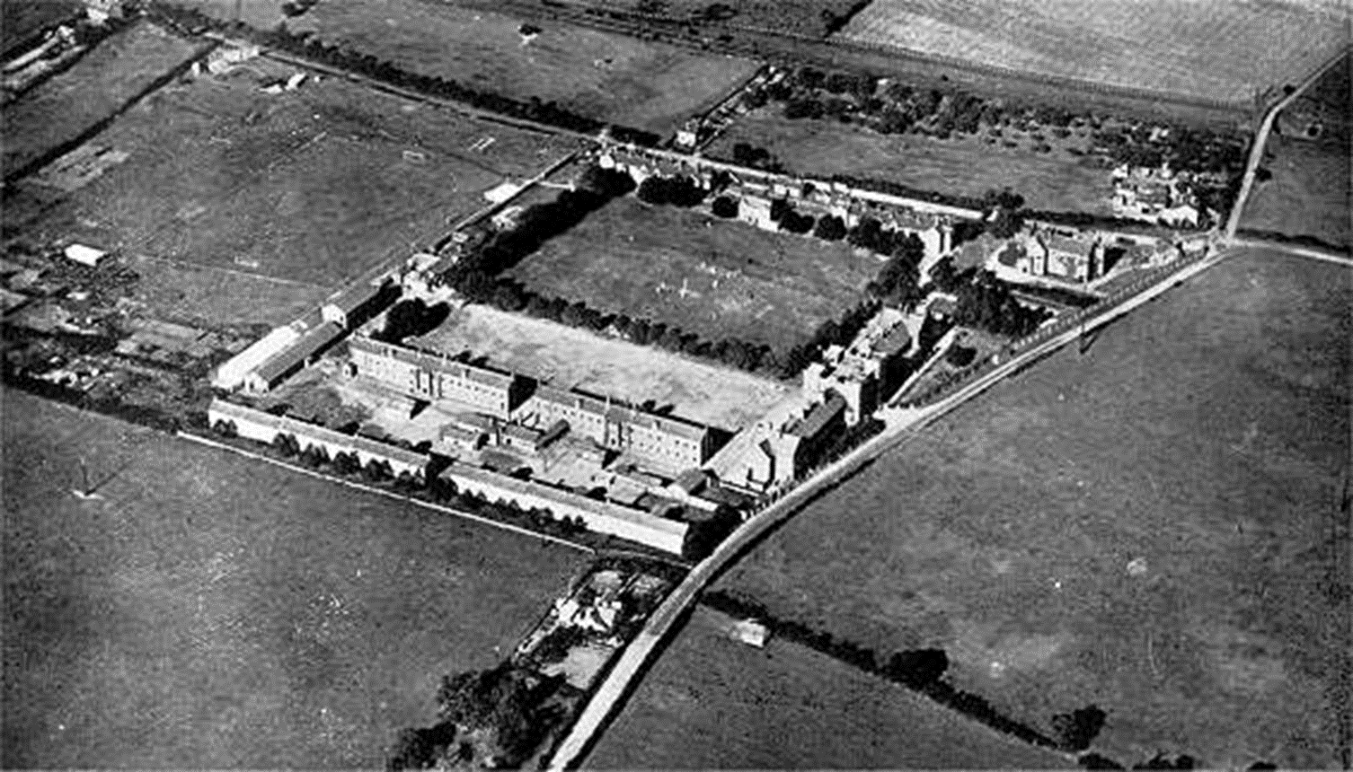
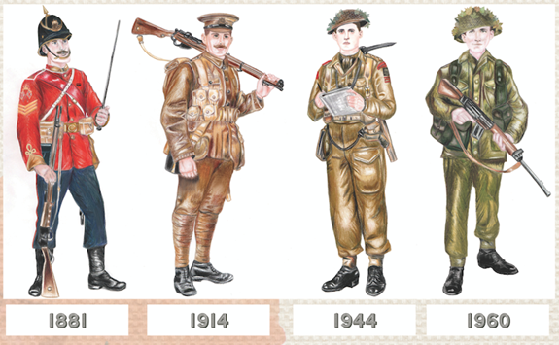
Year 4 Autumn 2
History
Local History – The Norton Barracks
Principle Aim: To understand the historical significance of a local landmark
Curriculum links
Art: Sketching
WOW day: Visit to The Norton Barracks
Key Questions:
What are the features of the Norton Barracks?
Can I use pictures and diagrams to identify how the barracks changed over time?
What does the term ‘infantry’ tell us about the soldiers?
Can I investigate the Worcester Regimental Badge?
Can I explain the significance of the Victoria Cross?
Historical Skills:
Chronology, Evidence and Interpretation, Historical significance, Cause and Consequence
Key words/terms
barracks, battalion, brigade, infantry, keep, regiment, sergeant, officer, soldier, Victoria Cross, Regimental Badge, Grade II listed building

