Slide 1


Welcome to
Norton Juxta Kempsey
CE
Primary School
Parent Information Evening
^{Monday 10th June 2024}
Links to documents also available on Willow Induction class page on the school website

Slide 2
Our Vision and Values
‘Together, with the love and joy of God, we will discover, develop & maximise our unique potential.’
The Father has loved us so much! He loved us so much that we are called children of God. And we really are his children. – 1 John 3:1 – ICB
Love | Courage | Respect | Forgiveness | Friendship | Compassion | Trust

Slide 3
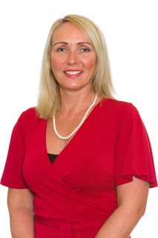
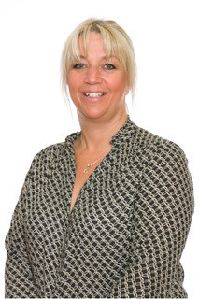
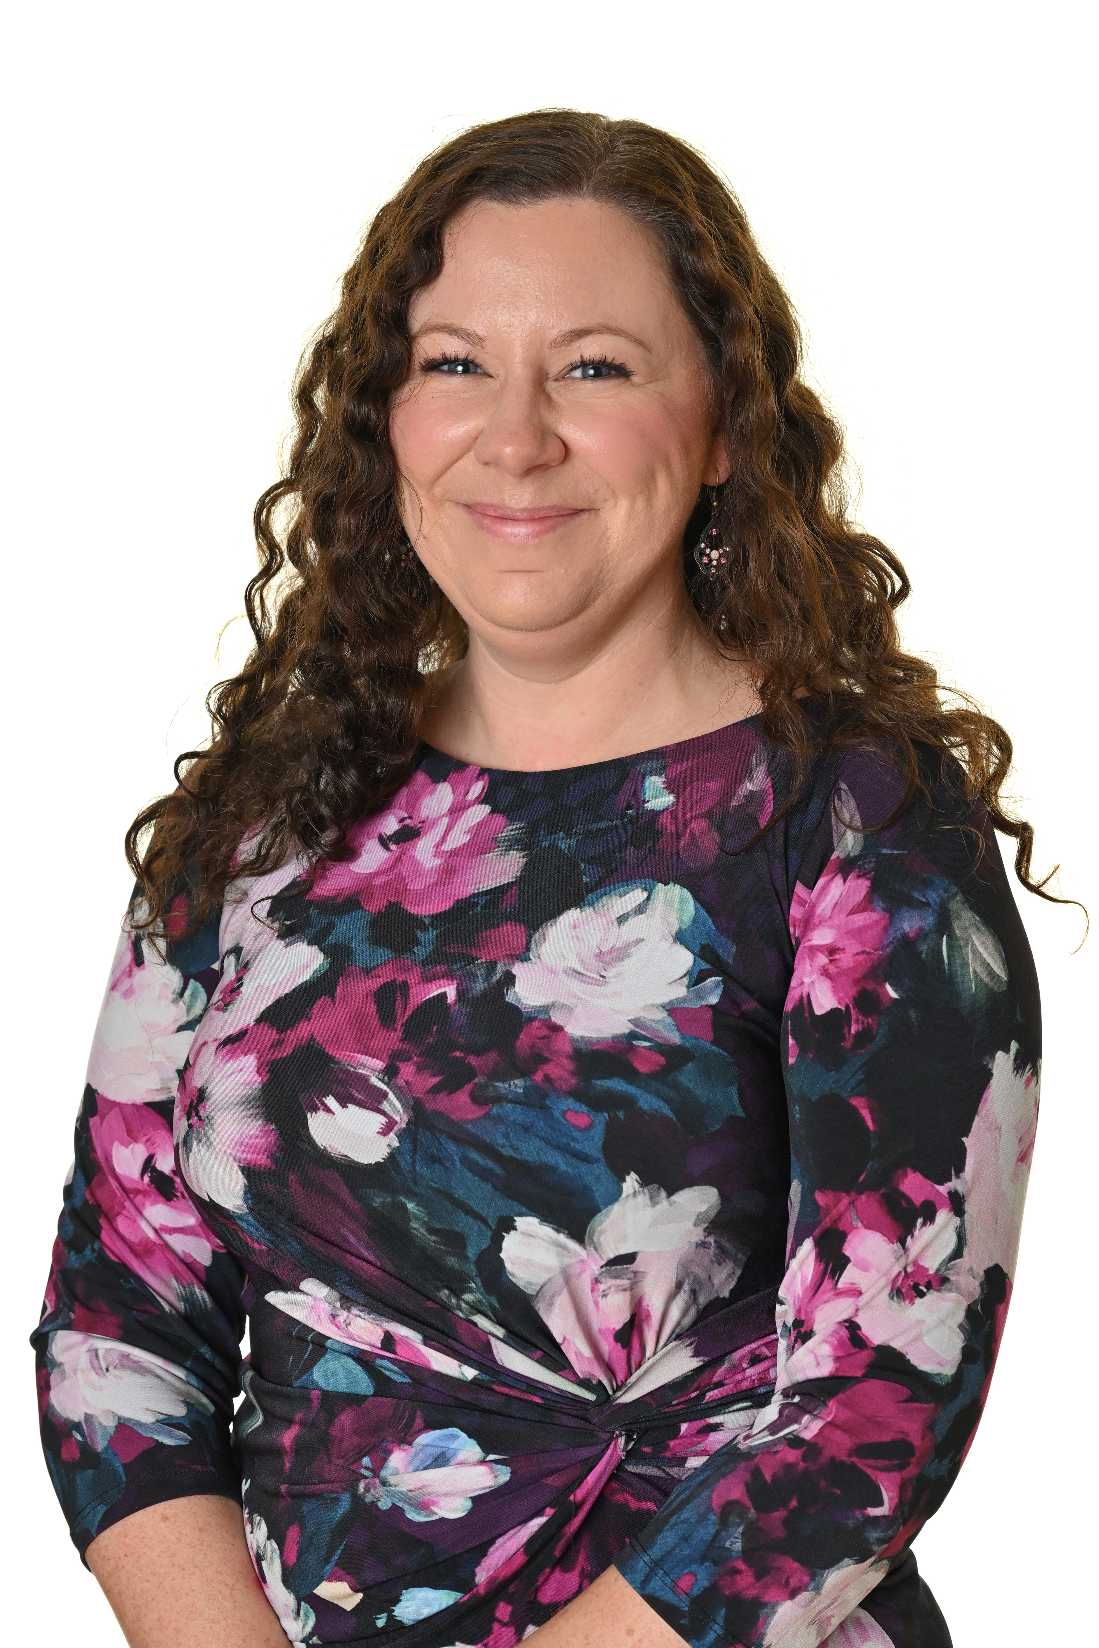
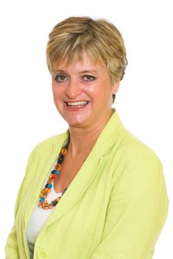
Key People
Mrs Dean Mrs Cross Miss Tarling Mrs Goode Head teacher School Willow Class Teacher Teaching Assistant DSL Administrator

Slide 4
Key People
Mrs. Sarah Marshall – Assistant Head Teacher and Deputy DSL
Mrs Sherie Baker- Thrive Practitioner
Mrs. Jackie Cross – School Administrator
Mrs Daisie – Chair of Governors

Slide 5
The School Day
7.45 | Breakfast Club starts
8.45 | Enter school by the main gates where Mrs Dean is waiting to greet you
9.00 | Welcome, put belongings away, registration
9.10 | Collective worship
9.30 | First learning session begins
10.15 | Snack time (Children can help themselves to water throughout the day)
10.30 | Play time (on own playground for first few weeks)
10.45 | Second learning session begins
12.00 | Lunch time/ play time (on own playground initially)
1.00 | Afternoon registration and afternoon learning session begins
3.15 | Story time and preparation for home
3.30 | Home time or hand over to after school club
5.30 | Last collection from after school club

Slide 6
Induction and Helping the Children to Settle
Drop in sessions
Induction morning
We spend first few weeks focusing on getting to know the children, allowing them to become familiar with new environment and routines as well as each other
Lots of games and activities designed to help the children get to know each other
Marvellous Me bags

Slide 7

Marvellous Me!
‘Marvellous Me’ bags will be sent to you later this term.
In the bag there will be an activity.
Can you please complete the ‘Marvellous Me’ activity with your child and return it to school at the start of the new term. These will be used to form the first part of your child’s learning journey with us and kick start our first topic.

Slide 8
Overview of the Year
Autumn 1 | Autumn 2 | Spring 1 | Spring 2 | Summer 1 | Summer 2
Me and My Community | Celebrations and Special Occasions | A Walk on the Wild Side | Castles, Dragons, Princesses and Knights | Jack and the Beanstalk | Minibeasts

Slide 9
What is the Early Years Curriculum?
The Early Years Foundation Stage (EYFS), is a series of guidelines on the learning and development of children up to five years old. The curriculum covers seven key areas of learning deemed essential for a child’s early years development. See web page for more information
We ensure children are active in their learning through play and a wide range of hands- on experiences. A mixture of adult led and child-initiated learning skills are taught and consolidation is both indoors and outdoors
The ‘Early Learning Goals’ summarise the knowledge, skills and understanding that all young children should have gained by the end of the Reception Year. See link on our website and information booklet in Autumn term.

Slide 10
How are Children Assessed?
On-going observations
Individual Learning Journeys
Comments made from the children
Adult initiated tasks
Input from other adults who work with the class
Input from home
Baseline, Speech and Language Assessment and Read Write Inc. assessments

Slide 11
How Do We Ensure Progress Is Made?
Evidence is gathered and kept in a class Learning Journey, this will include photographs, observations and any recorded work.
Progress is tracked and monitored across the school using an online tool (Insight)
We use assessment to inform our practice, plan for next steps and tailor the setting to provide suitably challenging activities and experiences.
We value our ‘Open Door’ policy
Please contact via Home School Link Book or email the office

Slide 12
How Will You Know How Well Your Child Is Progressing?
Learning Journey records.
Home school link books.
Parent teacher consultation evenings- two per year.
End of year report.
Congratulations assemblies, postcards and texts.
Notes from school.
Talking to your child.

Slide 13
Preparing for School
Recognise their name
Dress and undress themselves, including coats, socks/tights and shoes
Use the toilet independently and flush it
Wash and dry their hands
Tidy up after themselves
Understand that they must take turns and share
Open food packaging and drinks bottles
Use a spoon, knife and fork to eat
Hold a pencil to draw

Slide 14
Preparing for School- Uniform
Please ensure that names are in/on EVERYTHING including lunchboxes and water bottles!!!
Book bag and lunch box only, no big bags.
Send waterproof coats EVERYDAY-we like to get outside whatever the weather!
Sensible shoes, no jewellery, no excessive hair accessories.
NAMED P.E. kits (currently coming to school in kits on PE days)
NAMED wellies and waterproof suit to keep at school- we use our outdoor area daily, come rain or shine
Home Link Book will be looked at everyday; please use this as a first point of contact for non-urgent information or questions.

Slide 15
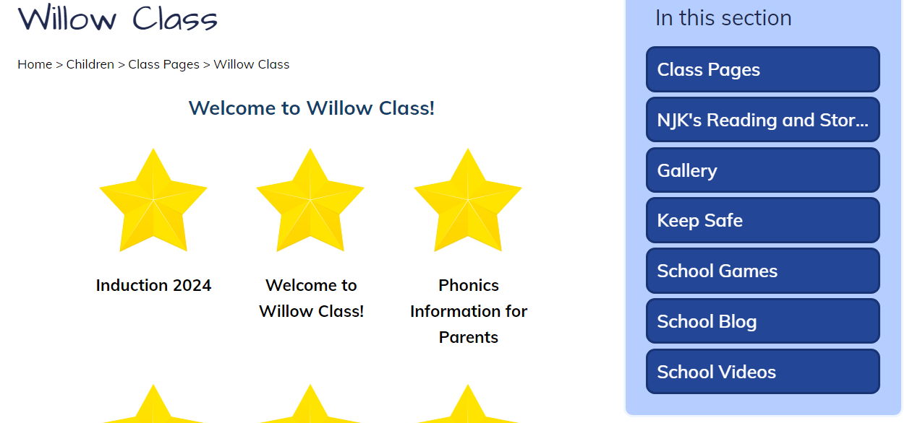
Willow Class Page on School Website

Slide 16
We look forward to working with you and meeting your children.
Staff are always happy to answer any questions you may have
so don’t hesitate to contact us.
Please check induction letter for the timetable of events.
Classroom Visit

