Slide 1

Norton Juxta Kempsey CE Primary School
Parent Information
2023-2024

Slide 2
Welcome to Rowan Class
Monday | Mrs Berry and Mrs Devlin
Tuesday | Mrs Berry and Mrs Morse
Wednesday | Mrs Pasmore and Mrs Morse
Thursday | Mrs Pasmore and Mrs Morse
Friday | Mrs Pasmore and Mrs Devlin

Slide 3
Daily Routine
(subject to change)
9.00 Registration and home link books
9.10-9.30 Collective Worship
9.30-10.30 RWInc
10.30-10.45 Break time and snack
10.45-12.00 Maths
12.00 -1pm –Lunch
1.00-2.00 Afternoon session 1
2.00-2.15 Playtime
2.15 – 3.10 Afternoon session 2
3.10 End of day
Notes:
Afternoons – topic pe re music pshe English - SCARF programme

Slide 4
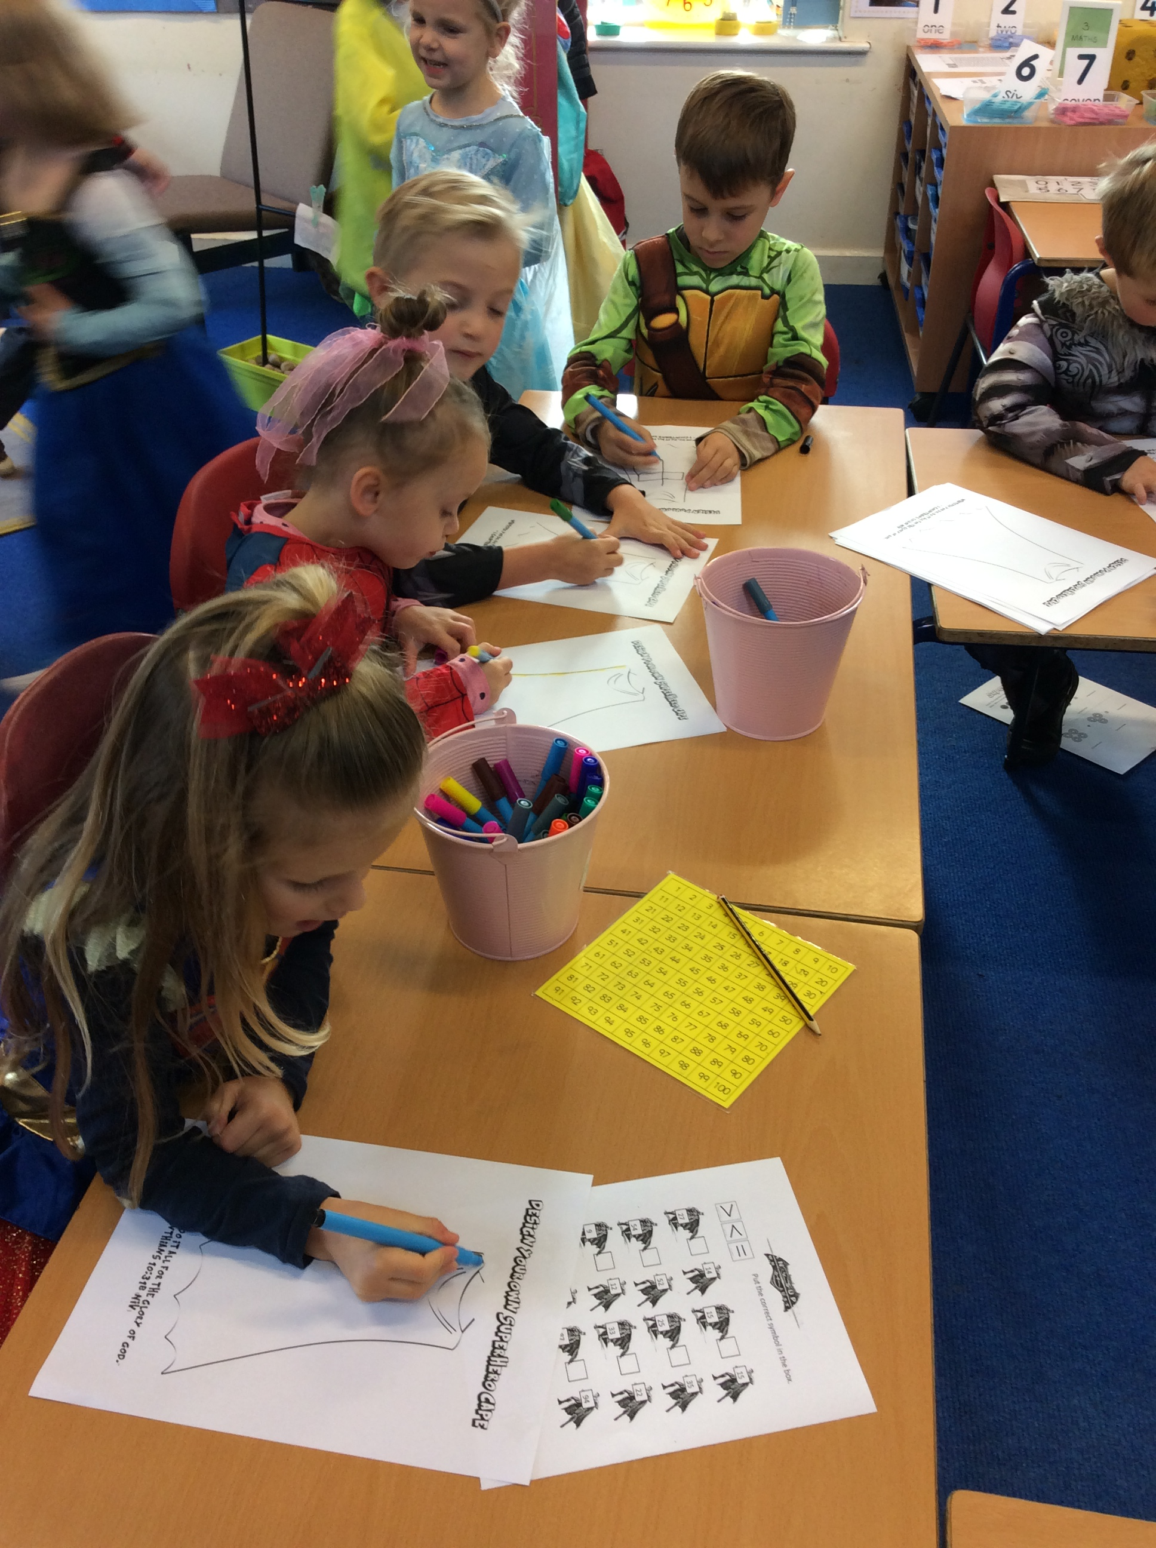
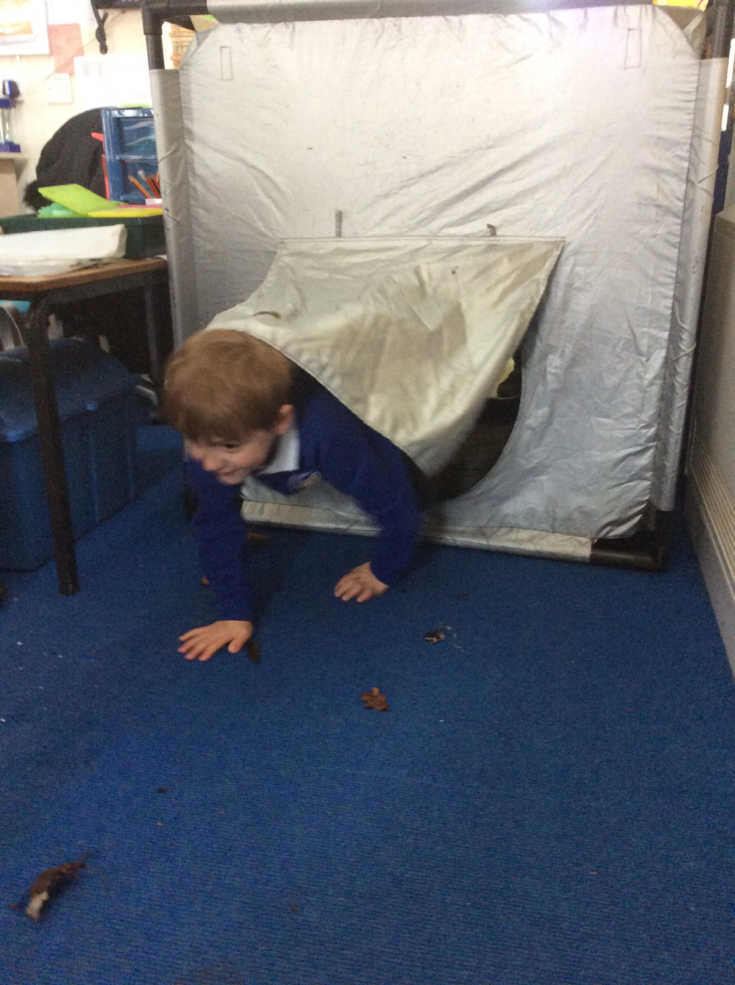
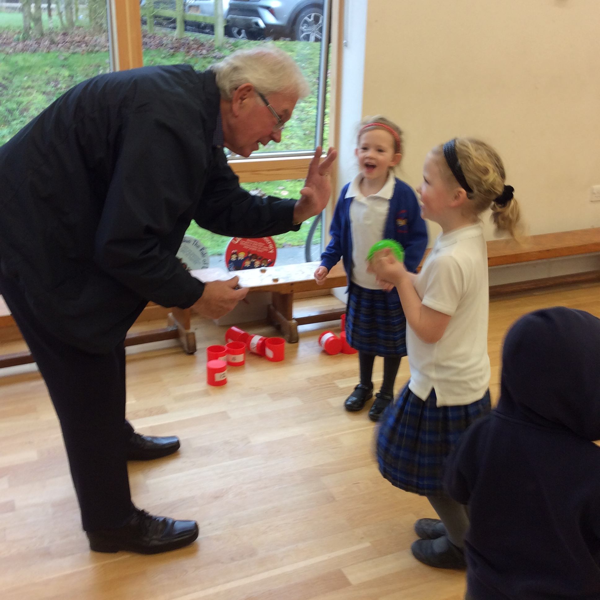
Curriculum
WOW days
Wow out - End product
Curriculum enrichment
Maths Café
Superhero Day!
Spaceship Mission
Notes:
Maths Café hasn’t happened due to covid but hoping this year

Slide 5
Themes and Topics in
Year 1
 | Autumn Term 1 | Autumn Term 2 | Spring Term 1 | Spring Term 2 | Summer Term 1 | Summer Term 2
 | This is me! | Baby its Cold outside! | Zoom Zoom Zoom we’re going to the moon! | How does your garden grow? | Life of the Farm | Me, my family and my school
Notes:
History and Geography links
Will send out knowledge organiser and fact sheets at the start of each term and will be displayed and referred to in the classroom

Slide 6
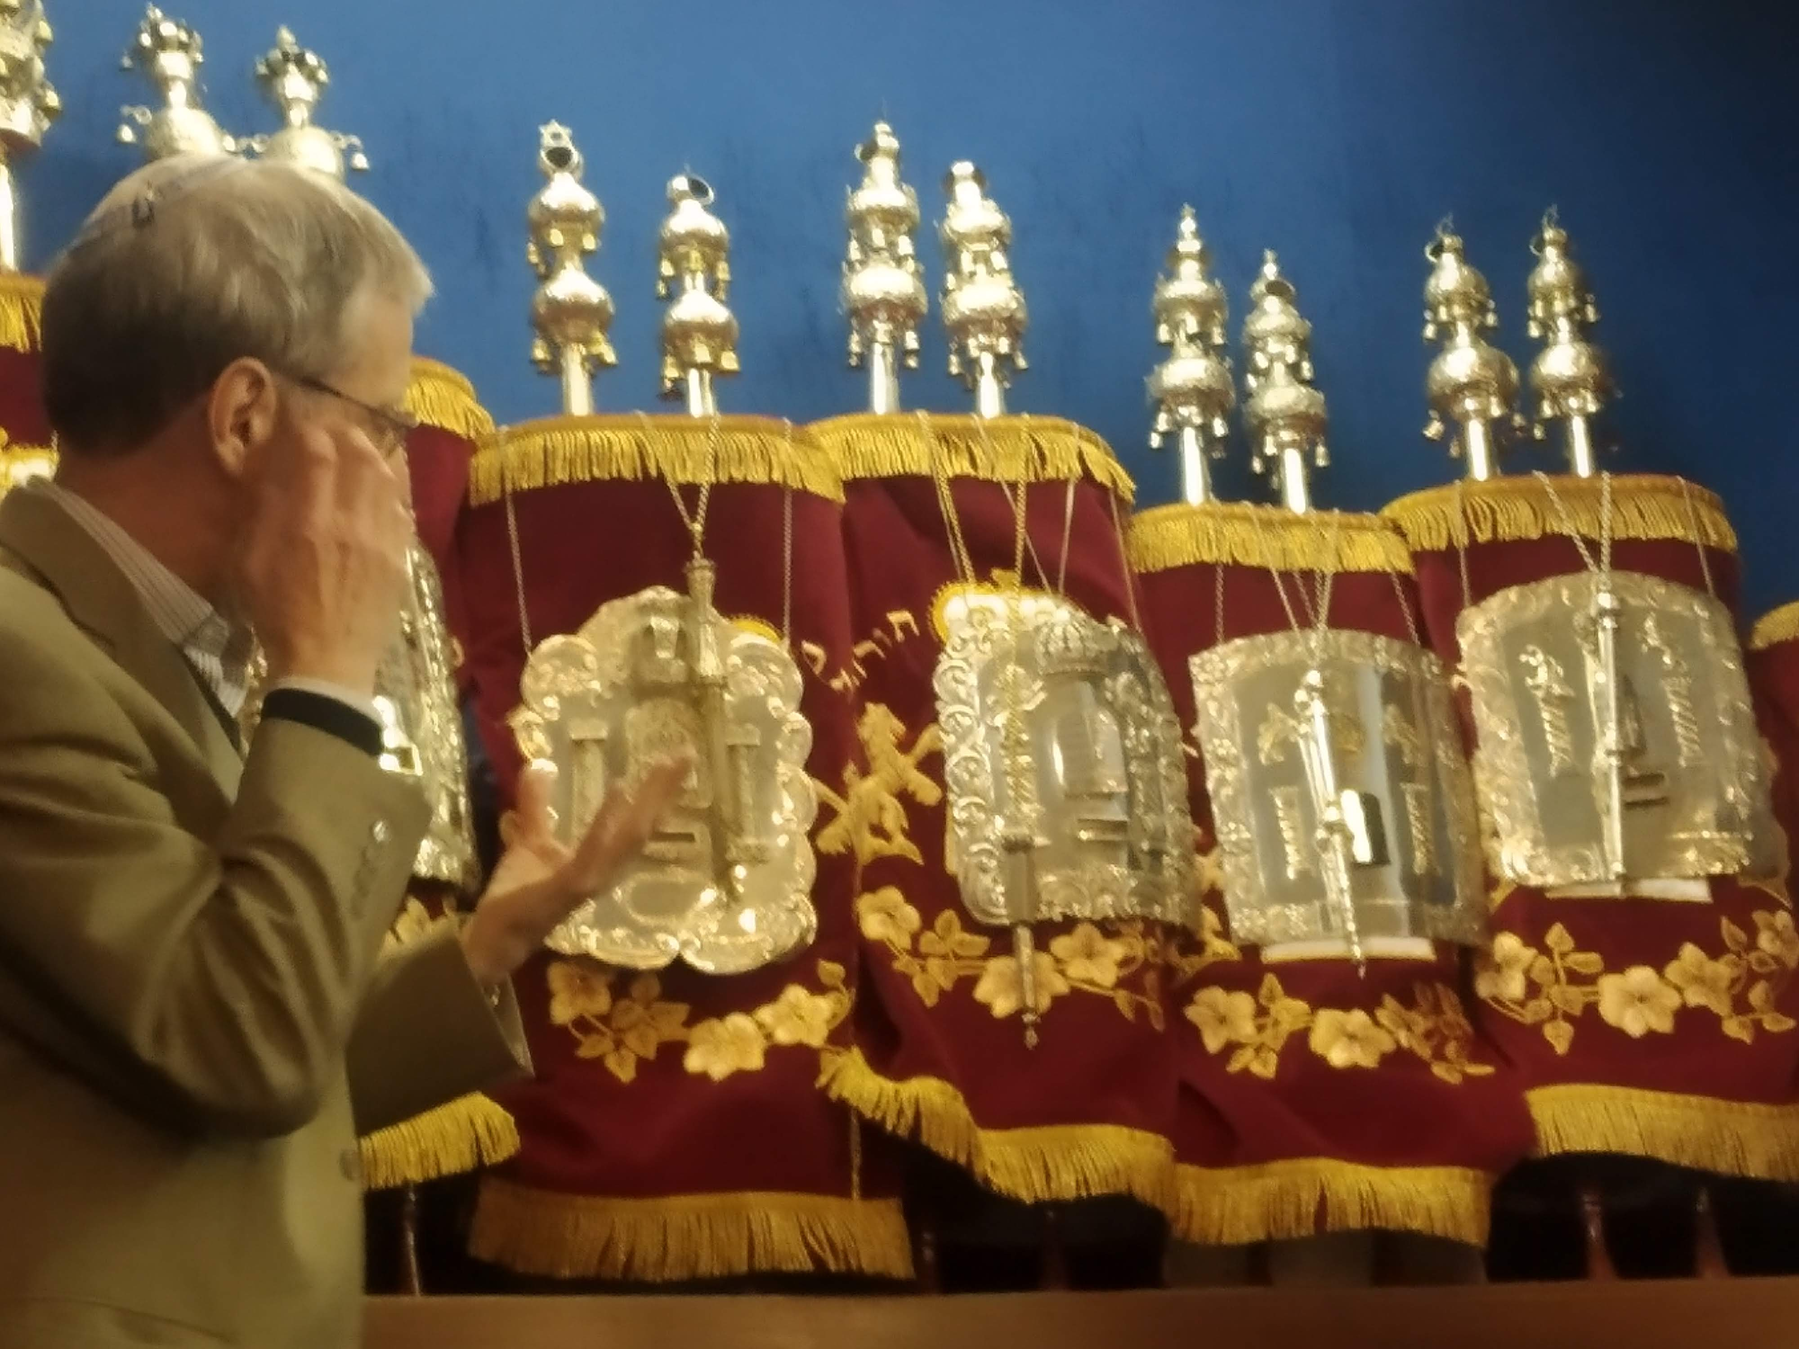
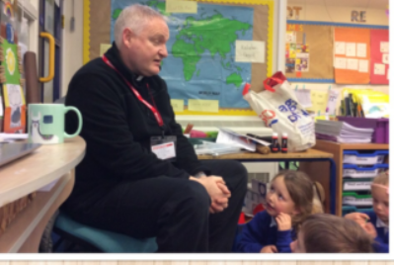

School Visits and Visitors
(subject to change)
Synagogue
Reverend Mark regularly visits.
Churchfields Visit
Notes:
Synagogue this year.... Subject to change

Slide 7
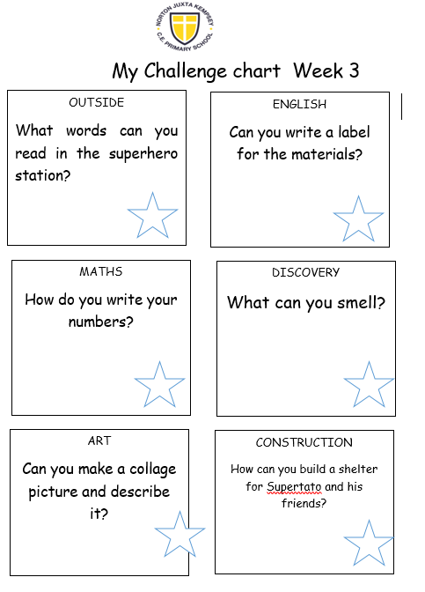
COOL Time!
Choose Our Own Learning
Autumn Term focus is on adult directed learning through COOL time!
Examples of activities set up across area of
Curriculum – Outside, English, Maths, Science,
Art, Construction
Children will be encouraged to complete all
challenges throughout the week.

Slide 8
Reading
Shared reading - during lessons, everyday, cross-curricular.
Home readers – changed weekly in library sessions
Reading book bands/RWInc. levels - These will be regularly reviewed throughout the year and communicated in the home school link books.
Reading at home
Record book title and write a response to the book they have read
Regular reading will be rewarded
Notes:
Explain reading sticker start at the back- every time a child reads at home they get a smiley face in the back of the book and then once complete will get a sticker

Slide 9
Maths
All aspects of maths are covered (Shape, measures, time, calculations, problem solving)
All work is set at your child’s level
We complete oral, practical and written work
Children taught daily
CPA (concrete, pictorial, abstract) maths policy
Mastery Approach
White Rose is followed

Slide 10
School Christian Values
Love
Trust
Friendship
Respect
Compassion
Courage
Forgiveness

Slide 11
Assessment
On going teacher assessment
Informs parents evening and midyear conversations
Year 1 – Phonics check – May/June
The check comprises of words with sounds that they will have learnt in phases 1 – 5
School pupil on line tracking system used to monitor progress and achievement.
End of year reports

Slide 12
Homework
Please read every day and record in the home school link book as per mentioned
Practise number facts using NumBots (use same login)
Learn RWInc sounds and read books sent home
Use knowledge organisers as a starting point for vocabulary development and key knowledge acquisition
Seesaw to communicate homework tasks from September 2023

Slide 13
Uniform
Uniform list on website
PE kit – named and worn on PE days (check pumps/trainers regularly)
Winter kit-joggers, long sleeved top
Named Water bottles
No jewellery and earrings must be removed or covered for PE. (please provide tape)
Notes:
Check PE days?!?!?!

Slide 14
Communication
Home School link book. Specific communication pages and reading record pages.
School web site
Text Messages
Newsletters emailed
Specific activity enquires only via Seesaw (other enquires via the school office)
Any worries – please make an appointment to speak to your child’s class teacher, in the first instance.

Slide 15
New Behaviour Policy
After consultation with staff, children and parents a new Behaviour Policy has been devised.
A restorative approach is being implemented from September to allow for the children to reflect more on their behaviour and take more ownership.
No zone boards from now on due to the “name and shame” being felt by staff and parents from the feedback.
Instead, the Policy will have 6 steps

Slide 16
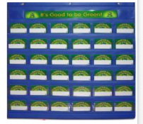
Personal Skills and Learning Behaviours
· Three new rules- RRS- Be Respectful, Be Responsible, Be safe
· Positive Behaviour Praised through:
- Green is Great chart (children devise behaviour focus for that day/lesson linked to rules or something the class need to work on) Green Card is given to the child’s name once the behaviour has been shown in class. Class celebrate once all achieved green card. We aim for all pupils name to be green by end of first session.
- Good News Cards- children going above and beyond expectations- sent home on same day stating which behaviour being shown
- Golden Table at lunchtime- to be implemented on Week 3 and Week 6 each half term by Mrs Marshall and Mrs Dean
- Congratulations Cards
- House Points
- Jar of Joy – jar filled up every time the School Value is demonstrated for that half term. Class decides on reward once full
Notes:
Introduction of stickers for bronze, silver, gold to reinforce good behaviour

Slide 17
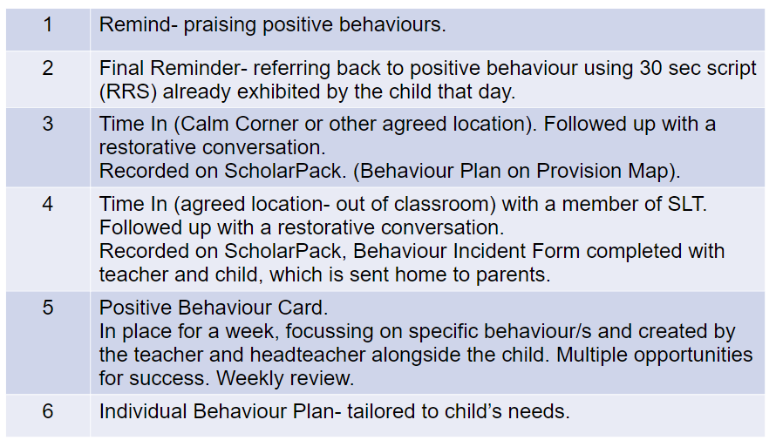
New Behaviour Policy

Slide 18
New Behaviour Policy
Step 1- Remind | Praise the positive behaviours Where behaviour does not meet your expectations, a reminder of the expectations for children of Responsible, Respect, Safe.
Step 2 - Final Reminder | The 30 second script, at the child’s level, involves a conversation with the pupil that goes to redress their behaviour in the first instance. The key to these conversations is framing the pupil in the positive light we know they can exhibit: I noticed you are having trouble with [state the behaviour you see to separate the behaviour from the child]. I am wondering if you are feeling [………….…]? You know we have a Ready, Respect, Safe rule in the classroom. It was the rule about [lining up / bringing toys into school / not allowing others to learn] that you broke. Do you remember when you [did that kind thing for……]? That is who I need to see today. When I come back in * minutes, I want to see your wonderful [………..…]. Thank you for listening. The 30 second script can go a long way to reduce the disruption in lessons, build a positive relationship and enable children to reset their behaviour. Praise in Public (PiP) and Remind in Private (RiP).

Slide 19
New Behaviour Policy
Step 3 - Time in (Calm Corner) Recorded on ScholarPack. (Behaviour Plan on Provision Map). | The child will be asked to go to the Calm Corner in the classroom where they will access a calm box containing items to support the child’s regulation. Items within the box will help the child to re-engage their prefrontal cortex, such as breathing and grounding techniques. The teacher will have a chance to speak to the child away from the class and will use WIN; ‘I am wondering, imagining, noticing…’. Boundaries are reset. Child is asked to reflect on their next step. Again, they are reminded of their previous positive behaviour for learning. Usually, after no more than 10 minutes the child is given the opportunity to re-engage with the learning and / or follow instructions. If this is at playtime, the child should have ‘time in’ by standing with the adult.
Step 4 - Time In (Nurture Base) Recorded on ScholarPack | A member of the SLT will escort the child from the classroom and give them time to regulate and reflect on their behaviour. They will be given the opportunity to complete their work in a designated place, decided by and arranged by the class teacher and appropriate to the child’s age and need (eg a quiet space, another classroom, with another member of staff). The length of time away from their base class will be decided by the class teacher and discussed with a member of the SLT, as appropriate. They may miss some playtime on that day (as deemed appropriate by the teacher). On their return to class, the final stage of the three Rs (repair- restorative conversation) will be discussed and a ‘clean slate’ approach will be used from that moment. Parents will be informed at the end of the day through a Behaviour Form filled in with child and teacher. Incident is logged as a Stage 3 on ScholarPack.

Slide 20
New Behaviour Policy
Step 5 - Positive Report Card (PRC) and Behaviour Plan on Provision Map | The Positive Report Card will support the child by setting a precise behaviour target that is achievable. The behaviour target will remain in place for a week, there will be 30 opportunities for success each recognised by a sticker. An achievement target (the number of stickers to be achieved) will be set by the Head Teacher, Class Teacher and Mentor in conjunction with the child. A review is held at the end of each week and a decision made as to the best course of action. A child must achieve 30 stickers 2 weeks running for it to be considered that the PRC is no longer needed for support. A mentor will be assigned to the child to offer support. The SLT member will determine a space appropriate to the school and the age of the child where the child will work for the remainder of the session or day depending on age and individual needs. They will not be able to access lunchtime or playtime, whichever is first, and the SLT member has the discretion to keep them off the playground if this puts other children at risk. A meeting with parents will be held with class teacher and member of SLT in order to discuss the triggers as noted on Provision Map and to seek a positive solution to avoid further negative behaviours from happening. The Head Teacher has the discretion to apply a fixed-term exclusion at this stage if it is deemed that removal from the playground or classroom will not regulate the behaviour or that the risk to other children and staff cannot be managed. Incident is logged as a Stage 4 on Scholar Pack
Step 6 – Individual Behaviour Plan Recorded on Provision Map | A child’s behaviour may deteriorate before it improves when an Individual Behaviour Plan is introduced. Rewards and reinforcements used to promote positive social behaviour must be immediate and at a high frequency in the early stages of an Individual Behaviour Plan for maximum success, especially with younger children. The Individual Behaviour Plan will include clear expectations for behaviour and targets that provide limited (maximum of three) unambiguous and, above all, achievable targets for the child’s behaviour. ‘To stay on task at all times’ is not a realistic target for any child. Specific targets will be identified through the Thrive assessment. This can only be given when a child has worked their way through Consequences. If there is an immediate situation that warrants exclusion, then a Fixed Term referral needs to be made by the class teacher to the Head Teacher. The decision to exclude lies with the Head Teacher. Fixed term and permanent exclusions must meet the statutory guidance as set out in DFE Exclusions from Maintained Schools and Academies and Pupil Referral Units (2017).

Slide 21
Questions
Please email any specific questions or enquiries that have not been answered to: office@nortonprimary.worcs.sch.uk
Class webpage:
https://norton-juxta-kempsey.secure-primarysite.net/class-pages/

Slide 22
We look forward to working with you and getting to know your child even better.

