Slide 1
LOVE HAS NO LABELS
https://youtu.be/PnDgZuGIhHs

Slide 2
A curriculum to help all children stay safe and thrive

Slide 3
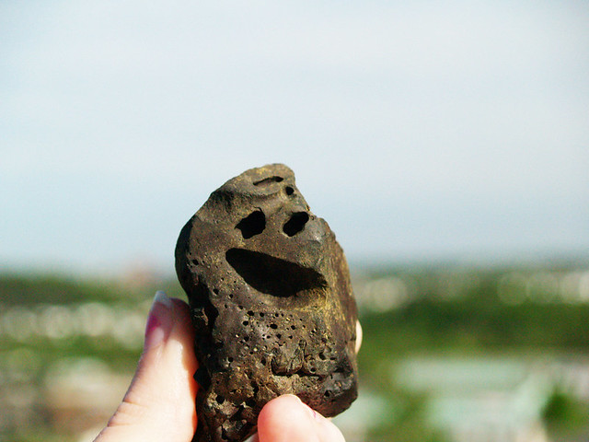
Ground Rules
R- Respectful
O- Openness
C- Confidential
K- Kind

Slide 4
What is Relationships and Sex Education (RSE)?
Relationships and Sex Education is a key aspect of Personal, Social, Health and Economic Education. (PSHE)
RSE is a key aspect of the spiritual, moral, social and cultural (SMSC) development in schools

Slide 5
Ice breaker
What was RSE like for you at school?

Slide 6

Questions to discuss…
What information did you get?
When did you get it?
Was it taught in schools?
What information did you get from friends?
What information did you get from magazines/elsewhere?

Slide 7
What topics are covered as part of RSE?
Me and My Relationships
Explores feelings and emotions, develops skills to manage conflict, helps identify our special people and equips children to recognise the qualities of healthy friendships and how to manage them.
Valuing Difference
Includes a strong focus on British Values, supports children to develop respectful relationships with others, recognise bullying and know their responsibilities as a bystander.
Keeping Myself Safe
Covers a number of safety aspects from statutory Relationships Education including being able to identify trusted adults in their lives, what to do when faced with a dilemma and recognising appropriate and inappropriate touch.

Slide 8
What topics are covered as part of RSE?
Rights and Responsibilities
Explores broader topics including looking after the environment, economic education and the changing rights and responsibilities children have as they grow older.
Being My Best
Includes a focus on keeping physically healthy, developing a growth mindset to facilitate resiliency, setting goals and ways to achieve them.
Growing and Changing
Has age-appropriate plans to cover the physical and emotional changes that happen as children as they grow older, including changes at puberty and how to approach this with confidence. Age-appropriate lessons on relationships and sex education are also included.

Slide 9
RSE should ensure that all children…
• flourish
• live and learn safely in the modern world
• gain the knowledge, skills and confidence to make their own positive, healthy and safe choices
• develop their own values, attitudes and opinions
• safeguard and care for themselves and others
• develop resilience to cope with life’s ups and downs
• get help if they need it
• RESPECT themselves and others, and build positive relationships

Slide 10
In Church of England schools, and in all schools, we want young people to flourish and to gain every opportunity to live fulfilled lives. For Church schools, RSE is about the emotional, social and physical aspects of growing up, healthy relationships, sex, human sexuality and sexual health. It is also about the spiritual and moral aspects of relationships within a context of a Christian vision for the purpose of life.”
Church of England Education Office Response to a Call for Evidence on RSE Curriculum

Slide 11
What is the government guidance?
Policy
Science
Keeping Children Safe
Oftsed

Slide 12
Policy
All maintained schools are required to have an up to date Relationships and Sex Education (RSE) policy that describes the content and organisation of RSE where it is taught outside the Science curriculum.
All schools are required to have this information available on their school website.

Slide 13
Science
It is compulsory for all maintained schools to teach the parts of sex education that fall under National Curriculum Science which must be taught to all pupils of primary and secondary age.

Slide 14
RSE in the Curriculum
Key Stage 1 (age 5-7years)
Year 1 pupils should be taught to:
Identify, name, draw and label the basic parts of the human body and say which part of the body is associated with each sense
Year 2 pupils should be taught to:
Notice that animals, including humans, have offspring which grow into adults Describe the importance for humans of exercise, eating the right amounts of different types of food, and hygiene

Slide 15
RSE in the Curriculum
Key Stage 2 (age 7-11years)
Year 5 pupils should be taught to:
Describe the life process of reproduction in some plants and animals Describe the changes as humans develop to old age
Year 6 pupils should be taught to:
Recognise that living things produce offspring of the same kind, but normally offspring vary and are not identical to their parents

Slide 16
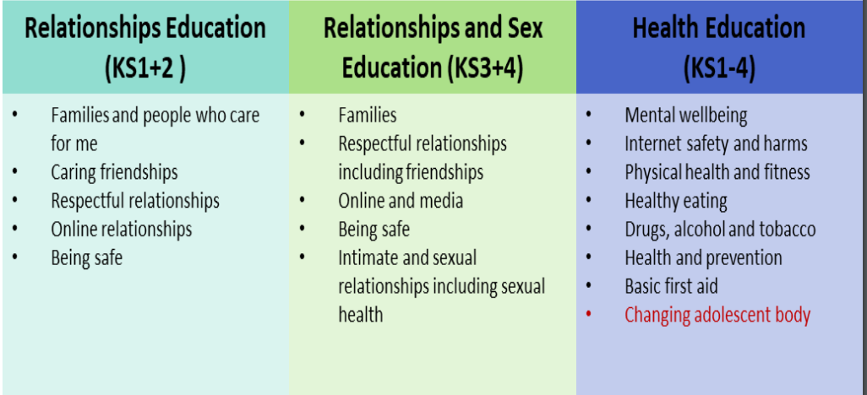

Slide 17
Keeping Children Safe
Ofsted inspectors will always have regard for how well children and learners are helped and protected so that they are kept safe. Inspectors will also look at the safe-guarding in a school when determining overall grade. Effective RSE it pivotal to this.

Slide 18
Ofsted
‘Pupils can explain accurately and confidently how to keep themselves healthy. They make informed choices about healthy eating, fitness and their emotional and mental well-being. They have an age-appropriate understanding of healthy relationships and are confident in staying safe from abuse and exploitation.’
Outstanding criteria from new framework

Slide 19
Latest RSE Guidance 2020
It highlights 2 main areas to be covered in school:
Relationships Education | Physical Health and Mental wellbeing RSE
Families and people who care for me Caring friendships Respectful relationships Online relationships Being safe | Mental Well being Internet Safety and harms Physical health and fitness Healthy Eating Drugs, alcohol and tobacco Health and Prevention Basic first aid Changing adolescent body

Slide 20
How RSE links to the Curriculum at NJK
RSE is taught through PSHE lessons that are timetabled in over the half term
Long Term Plan shows coverage from EYFS to Year 6
Each activity is build upon throughout the school
Feel free to look at some example lesson plans on how each lesson is delivered linked to the SCARF programme that the school uses at the end of the workshop

Slide 21
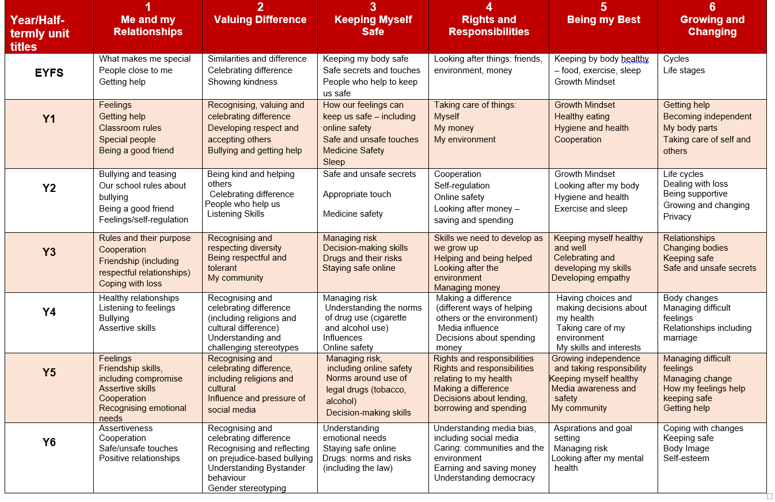

Slide 22
Protective Characteristics
Protected Characteristics across SCARF (coramlifeeducation.org.uk)
Age
Gender
Race
Disability
Religion or belief
Sexual orientation
Gender reassignment
Marriage or civil partnerships
Pregnancy and maternity

Slide 23

Inclusion Week
Book | Year Group
The Family Book | Reception
What type of family are we? | 1
My family, your family | 2
This is me disability | 3
Blanket bears | 4
The girl with 2 dads | 5
My name is not refugee | 6

Slide 24
Where do children and young people learn about RSE related issues?
TV Magazines Radio
Music videos (e.g. Grand theft auto)
Parents Siblings Peer
School Internet Disney Films

Slide 25
Interesting watch- your part in RSE as parents!
https://youtu.be/FNSXxf-luKM

Slide 26
Valuing All Gods Children
Valuing Gods children is produced by the Church of England Education Office Summer 2019.
It highlights guidance on how CoE schools challenge homophobic, biphobic and transphobic bullying
It also stresses importance on
“If any school is not educating pupils to understand the rights of all people to live freely within their sexual orientation or gender identity without discrimination they would be failing in their duty to prepare their pupils to live in modern Britain.”
(Valuing All God’s Children, Church of England 2019 p12)

Slide 27
Valuing All Gods Children
“We must avoid, at all costs, diminishing the dignity of any individual to a stereotype or a problem. Church of England schools offer a community where everyone is a person known and loved by God, supported to know their intrinsic value.”
(Valuing All God’s Children, Church of England 2019, Foreword by The Most Revd and Rt Hon Justin Welby, Archbishop of Canterbury, p.1)

Slide 28
Valuing All Gods Children
“…schools should ensure they provide an inclusive curriculum that addresses sexuality, gender, gender identity and LGBT issues in age appropriate ways. Sensitively addressing LGBT issues will help to create a culture of respect towards LGBT pupils and will actively contribute to the prevention of bullying.”

Slide 29
Weblink to access Valuing all Gods Children
https://www.churchofengland.org/sites/default/files/2019-07/Valuing%20All%20God%27s%20Children%20July%202019_0.pdf

Slide 30
Parent support for RSE at home
https://www.lil-lets.co.uk/school-programme
http://www.becomingateen.co.uk/home
https://learning.nspcc.org.uk/research-resources/schools/making-sense-relationships/?_ga=2.15364789.2077147087.1539275204-1058785487.1536844631
https://www.parentkind.org.uk/Parents/Relationships-Education-and-Relationships-and-Sex-Education-RE-RSE
https://www.sexeducationforum.org.uk/
https://www.thinkuknow.co.uk
https://www.coramlifeeducation.org.uk/ the curriculum we use at NJK
LGBT+ Books & Educational Resources | Pop'n'Olly (popnolly.com)
https://www.coramlifeeducation.org.uk/rse-for-Y6-and-P7

Slide 31

Questions?

