Slide 1
A curriculum to help all children stay safe and thrive

Slide 2
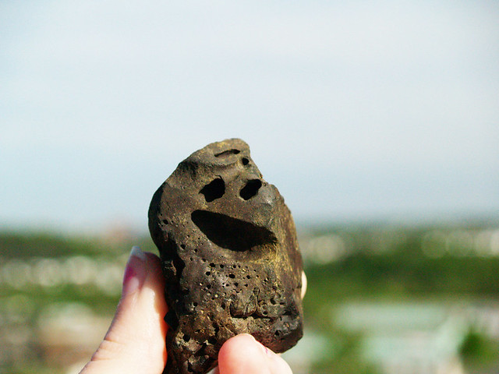
Ground Rules
R- Respectful
O- Openness
C- Confidential
K- Kind

Slide 3
What is Relationships and Sex Education (RSE)?
Relationships and Sex Education is a key aspect of Personal, Social, Health and Economic Education. (PSHE)
RSE is a key aspect of the spiritual, moral, social and cultural (SMSC) development in schools

Slide 4
Ice breaker
What was RSE like for you at school?

Slide 5

Questions to discuss…
What information did you get?
When did you get it?
How was it delivered?

Slide 6
What topics are covered as part of RSE?
Me and My Relationships
Explores feelings and emotions, develops skills to manage conflict, helps identify our special people and equips children to recognise the qualities of healthy friendships and how to manage them.
Valuing Difference
Includes a strong focus on British Values, supports children to develop respectful relationships with others, recognise bullying and know their responsibilities as a bystander.
Keeping Myself Safe
Covers a number of safety aspects from statutory Relationships Education including being able to identify trusted adults in their lives, what to do when faced with a dilemma and recognising appropriate and inappropriate touch.

Slide 7
What topics are covered as part of RSE?
Rights and Responsibilities
Explores broader topics including looking after the environment, economic education and the changing rights and responsibilities children have as they grow older.
Being My Best
Includes a focus on keeping physically healthy, developing a growth mindset to facilitate resiliency, setting goals and ways to achieve them.
Growing and Changing
Has age-appropriate plans to cover the physical and emotional changes that happen as children as they grow older, including changes at puberty and how to approach this with confidence. Age-appropriate lessons on relationships and sex education are also included. Years 5 and 6 parents notified on content in Summer Term 2.

Slide 8
RSE should ensure that all children…
• flourish
• live and learn safely in the modern world
• gain the knowledge, skills and confidence to make their own positive, healthy and safe choices
• develop their own values, attitudes and opinions
• safeguard and care for themselves and others
• develop resilience to cope with life’s ups and downs
• get help if they need it
• RESPECT themselves and others, and build positive relationships

Slide 9
What is the government guidance?
Policy
Science
Keeping Children Safe in Education
Ofsted

Slide 10
Policy
All maintained schools are required to have an up-to-date Relationships, Sex and Health Education (RSHE) policy that describes the content and organisation of RSE where it is taught outside the Science curriculum.
Find this on the website: RSHE | Norton Juxta Kempsey

Slide 11
Science
It is compulsory for all maintained schools to teach the parts of sex education that fall under National Curriculum Science which must be taught to all pupils of primary and secondary age.

Slide 12
RSE in the Curriculum
Key Stage 1 (age 5-7 years)
Year 1 pupils should be taught to:
Identify, name, draw and label the basic parts of the human body and say which part of the body is associated with each sense
Year 2 pupils should be taught to:
Notice that animals, including humans, have offspring which grow into adults Describe the importance for humans of exercise, eating the right amounts of different types of food, and hygiene

Slide 13
RSE in the Curriculum
Key Stage 2 (age 7-11years)
Year 5 pupils should be taught to:
Describe the life process of reproduction in some plants and animals. Describe the changes as humans develop to old age
Year 6 pupils should be taught to:
Recognise that living things produce offspring of the same kind, but normally offspring vary and are not identical to their parents

Slide 14
Keeping Children Safe in Education (KCSIE)
Ofsted inspectors will always have regard for how well children and learners are helped and protected so that they are kept safe. Inspectors will also look at the safe-guarding in a school when determining overall grade. Effective RSE is pivotal to this.

Slide 15
Ofsted
‘Pupils can explain accurately and confidently how to keep themselves healthy. They make informed choices about healthy eating, fitness and their emotional and mental well-being. They have an age-appropriate understanding of healthy relationships and are confident in staying safe from abuse and exploitation.’
Outstanding criteria from new framework
The inspection framework also directs inspectors to look at how the school supports the needs of distinct groups of pupils, such as ‘girls or lesbian, gay, bisexual or transgender pupils’ and those with lesbian, gay, bisexual and transgender parents or carers. It expects to see ‘an inclusive environment that meets the needs of all pupils, irrespective of age, disability, gender reassignment, race, religion or belief, sex or sexual orientation, and where no discrimination exists.’
OFSTED, School Inspection Handbook, April 2024, Section 326, [Internet] Available at :School inspection handbook - GOV.UK (www.gov.uk) Section 326

Slide 16
RSE Guidance
It highlights 2 main areas to be covered in school:
Relationships Education | Physical Health and Mental wellbeing RSE
Families and people who care for me Caring friendships Respectful relationships Online relationships Being safe | Mental Well being Internet Safety and harms Physical health and fitness Healthy Eating Drugs, alcohol and tobacco Health and Prevention Basic first aid Changing adolescent body

Slide 17
How RSE links to the Curriculum at NJK
RSE is taught through PSHE lessons that are timetabled in over the half term
Long Term Plan shows coverage from EYFS to Year 6
Each activity is built upon throughout the school
Feel free to look at some example lesson plans on how each lesson is delivered linked to the SCARF programme that the school uses at the end of the workshop

Slide 18
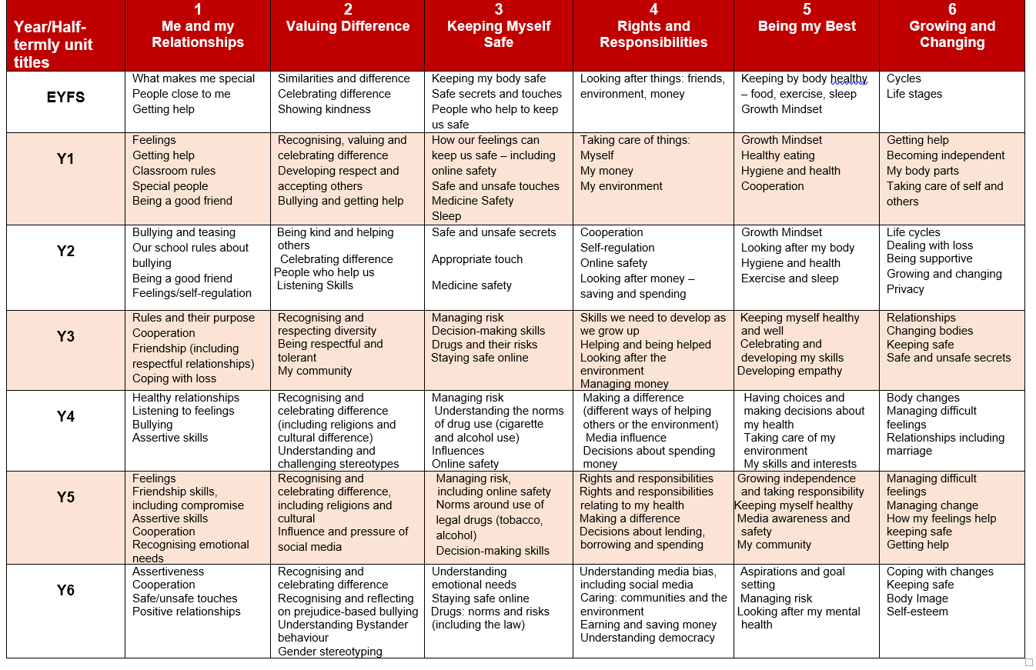

Slide 19
Protective Characteristics links to the Equality Act 2010
Protected Characteristics across SCARF (coramlifeeducation.org.uk)
Age
Gender
Race
Disability
Religion or belief
Sexual orientation
Gender reassignment
Marriage or civil partnerships
Pregnancy and maternity

Slide 20

Inclusion Week
Book | Year Group
The Family Book | Reception
What type of family are we? | 1
My family, your family | 2
This is me disability | 3
Blanket bears | 4
The girl with 2 dads | 5
My name is not refugee | 6

Slide 21
Interesting watch- your part in RSE as parents!
https://youtu.be/FNSXxf-luKM

Slide 22
Flourishing for All: Anti-bullying Guidance for Church of England Schools (2024)
“ Schools play a critical role in educating children and young people about hate and acceptance, as well as how to live well together with people who may not share the same ways of life or beliefs as they do. The consequences of not doing so stands in opposition to flourishing for all in the modern world. Everyone deserves to live in a world free from fear. Therefore, schools should support all pupils to know their worth so they can protect themselves or know how to find the support they need.”
These are age/cohort appropriate and in line with our PSHE/RSE Curriculum and Policies.

Slide 23
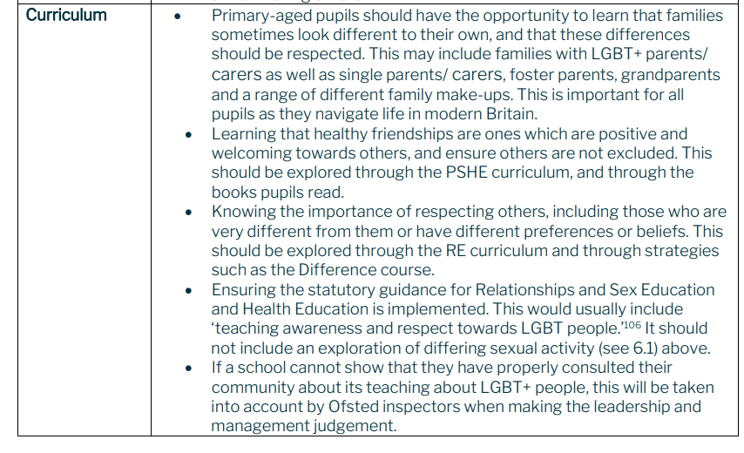
Flourishing for All: Anti-bullying Guidance for Church of England Schools (2024)

Slide 24
Flourishing for All: Anti-bullying Guidance for Church of England Schools (2024)
“It is extremely important to recognise that Church of England schools educate those of all faiths and none, including those with very varied understandings of Christian teaching on a range of subjects. In order to do this, a school will need to teach pupils how to respect different viewpoints, disagree well in their interactions and understand that families and individuals can hold beliefs that differ from one another yet still live together well. “

Slide 25
Flourishing for All: Anti-bullying Guidance for Church of England Schools (2024)
nse-flourishing-for-all-final-for-publication-april-2025-inc-parts-ab-c.pdf

Slide 26
Parent support for RSE at home
https://www.lil-lets.co.uk/school-programme
http://www.becomingateen.co.uk/home
https://learning.nspcc.org.uk/research-resources/schools/making-sense-relationships/?_ga=2.15364789.2077147087.1539275204-1058785487.1536844631
https://www.parentkind.org.uk/Parents/Relationships-Education-and-Relationships-and-Sex-Education-RE-RSE
https://www.sexeducationforum.org.uk/
https://www.thinkuknow.co.uk
https://www.coramlifeeducation.org.uk/ the curriculum we use at NJK
LGB Books & Educational Resources | Pop'n'Olly (popnolly.com)
Helping your children understand changes at puberty

Slide 27
Family S.C.A.R.F
Click for access: Family SCARF
“Find out how the SCARF values of Safety, Caring, Achievement, Resilience, Friendship can help your child to be their best - both at school and at home.”
“Choose from the menu of family activities or support and find out how to build positive relationships and help your child be a confident learner”
Accessed via Family SCARF

Slide 28

Questions?

