Slide 1
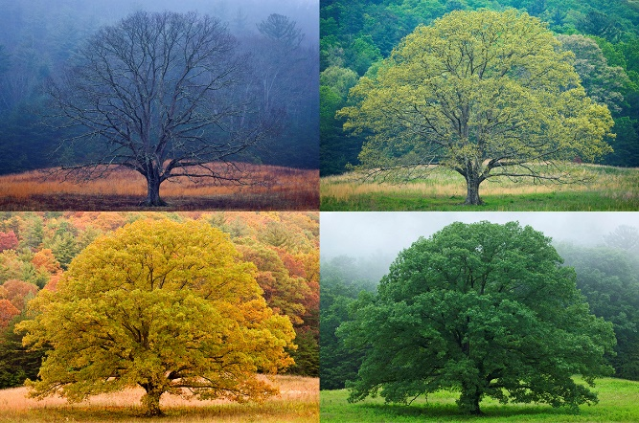
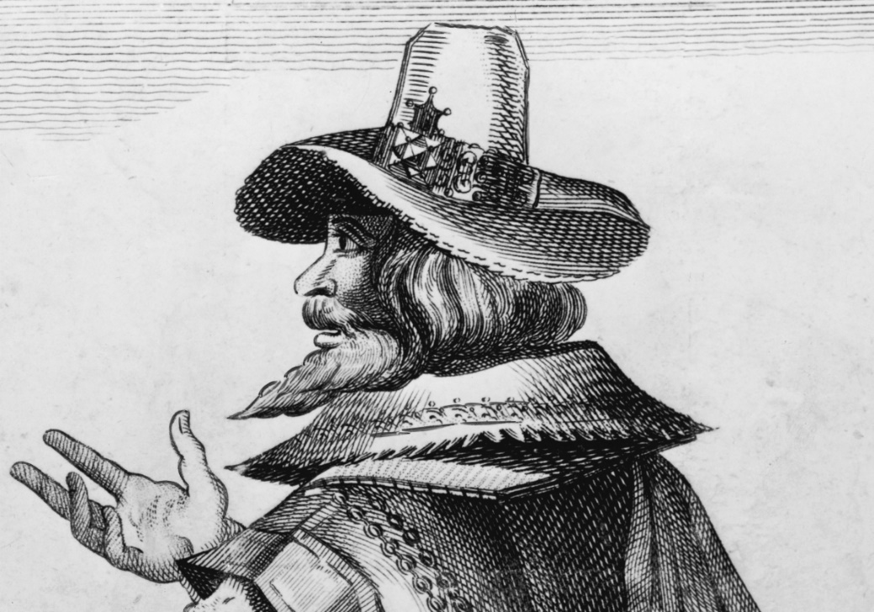
Topic Fact Sheet- Baby it’s cold outside!
Where do the leaves go in Winter?
Why can’t a meercat live in the North Pole?
Key Terms
Seasons | Winter, Autumn, Spring, Summer
Weather | the state of the atmosphere at a particular place and time as regards heat, cloudiness, dryness, sunshine, wind, rain, etc.
Direction | North, South, East and West; near and far
Places | Equator, North Pole, South Pole
Temperature | Physical quantity that is hot or cold. Temperature affects us in many different ways and around the world in different places.
Famous People from the past
WeatherSeasons
Seasons-
There are 4 seasons through the year with varying weather. Is it the same for all countries?
Weather- There are many types of different weather- rain, sunshine, hail, snow, cloud, dryness, snow, wind, temperature
Seasons and Weather can affect people in different locations such as by the beach, coast, forest, hill, mountain and valley, It can affect the soil and vegetarian and how people live.
Bonfire Night- Guy Fawkes was a man who wanted to blow up Parliament and we remember him by celebrating Bonfire Night on 5th November.

