Slide 1
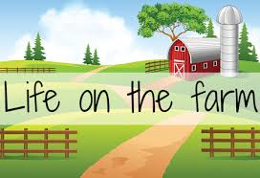
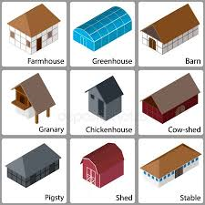
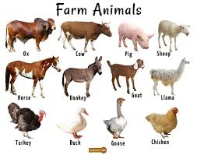
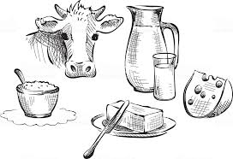
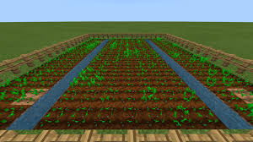
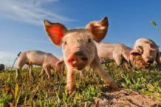
Topic Fact Sheet- Life on the farm
On the farm you might see……
Key Terms
Vertebrates | animals that have a backbone
Invertebrate | animals with no backbone
Mammals | give birth to live young usually have hair or fur warm-blooded cannot breathe underwater
Carnivore | animals that feeds on other animals
Herbivore | animals that feed on plants
Omnivore | human or animal that eats plants & other animals
Farm | an area of land, together with the buildings on it, that is used for growing crops or raising animals
Arable | land suitable for growing crops
Crops | a cultivated plant that is grown on a large scale commercially, especially a cereal, fruit, or vegetable.
Dairy | place on a farm where milk and cream are kept and cheese and butter are made,
Farm diversification | farm tries new ideas to make money (Churchfields – make ice cream)
Buildings – farm house, pig sty, hen house, dairy, shop
Animals - cows, chickens, sheep, pigs, goats and horses on a farm
Plants and crops – wheat, potatoes, corn
Food produce – eggs, milk, cheese

