Slide 1
Problem Solving Monday
(Mad maths Monday)

Slide 2
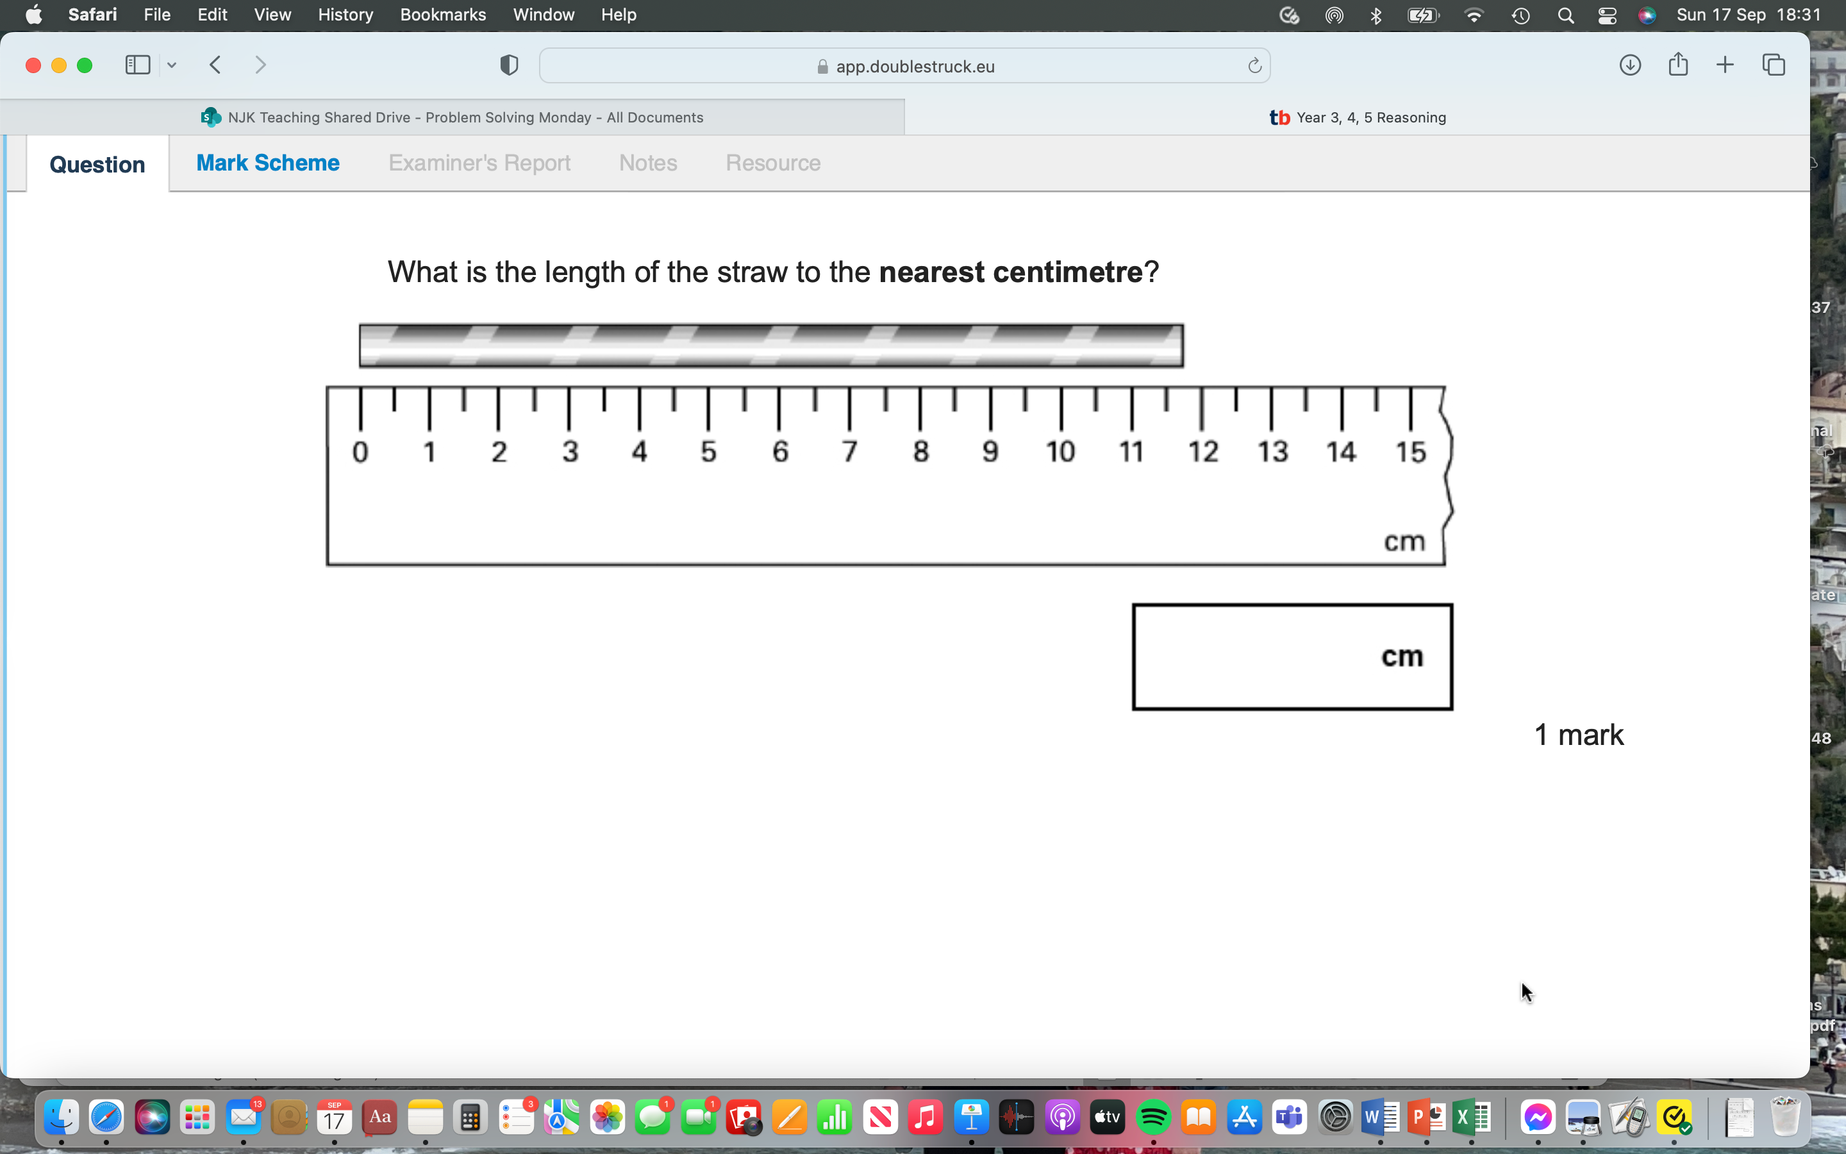
Spot the Difference

Slide 3
What could the Question be?

Slide 4
Original Problem

Slide 5
Prove the answer
12

Slide 6
Small Differences
Estimate the exact length of the straw.

Slide 7
More Small Differences
Are all the straws the same length? Does it matter that the scales are different? Explain.

Slide 8
New Problem Same Picture
How many 2cm mini-straws could you cut?
Can you show a calculation to prove this?

Slide 9
New Problem Same Picture
How many straws would you need to measure 1 meter?
Can you show a calculation to prove this?

Slide 10
Invent your own problem, again!
Now you’ve had lots of practise, can you think of an even better problem to go with the picture?
Be as creative as you can!

