Slide 1
Problem Solving monday

Slide 2
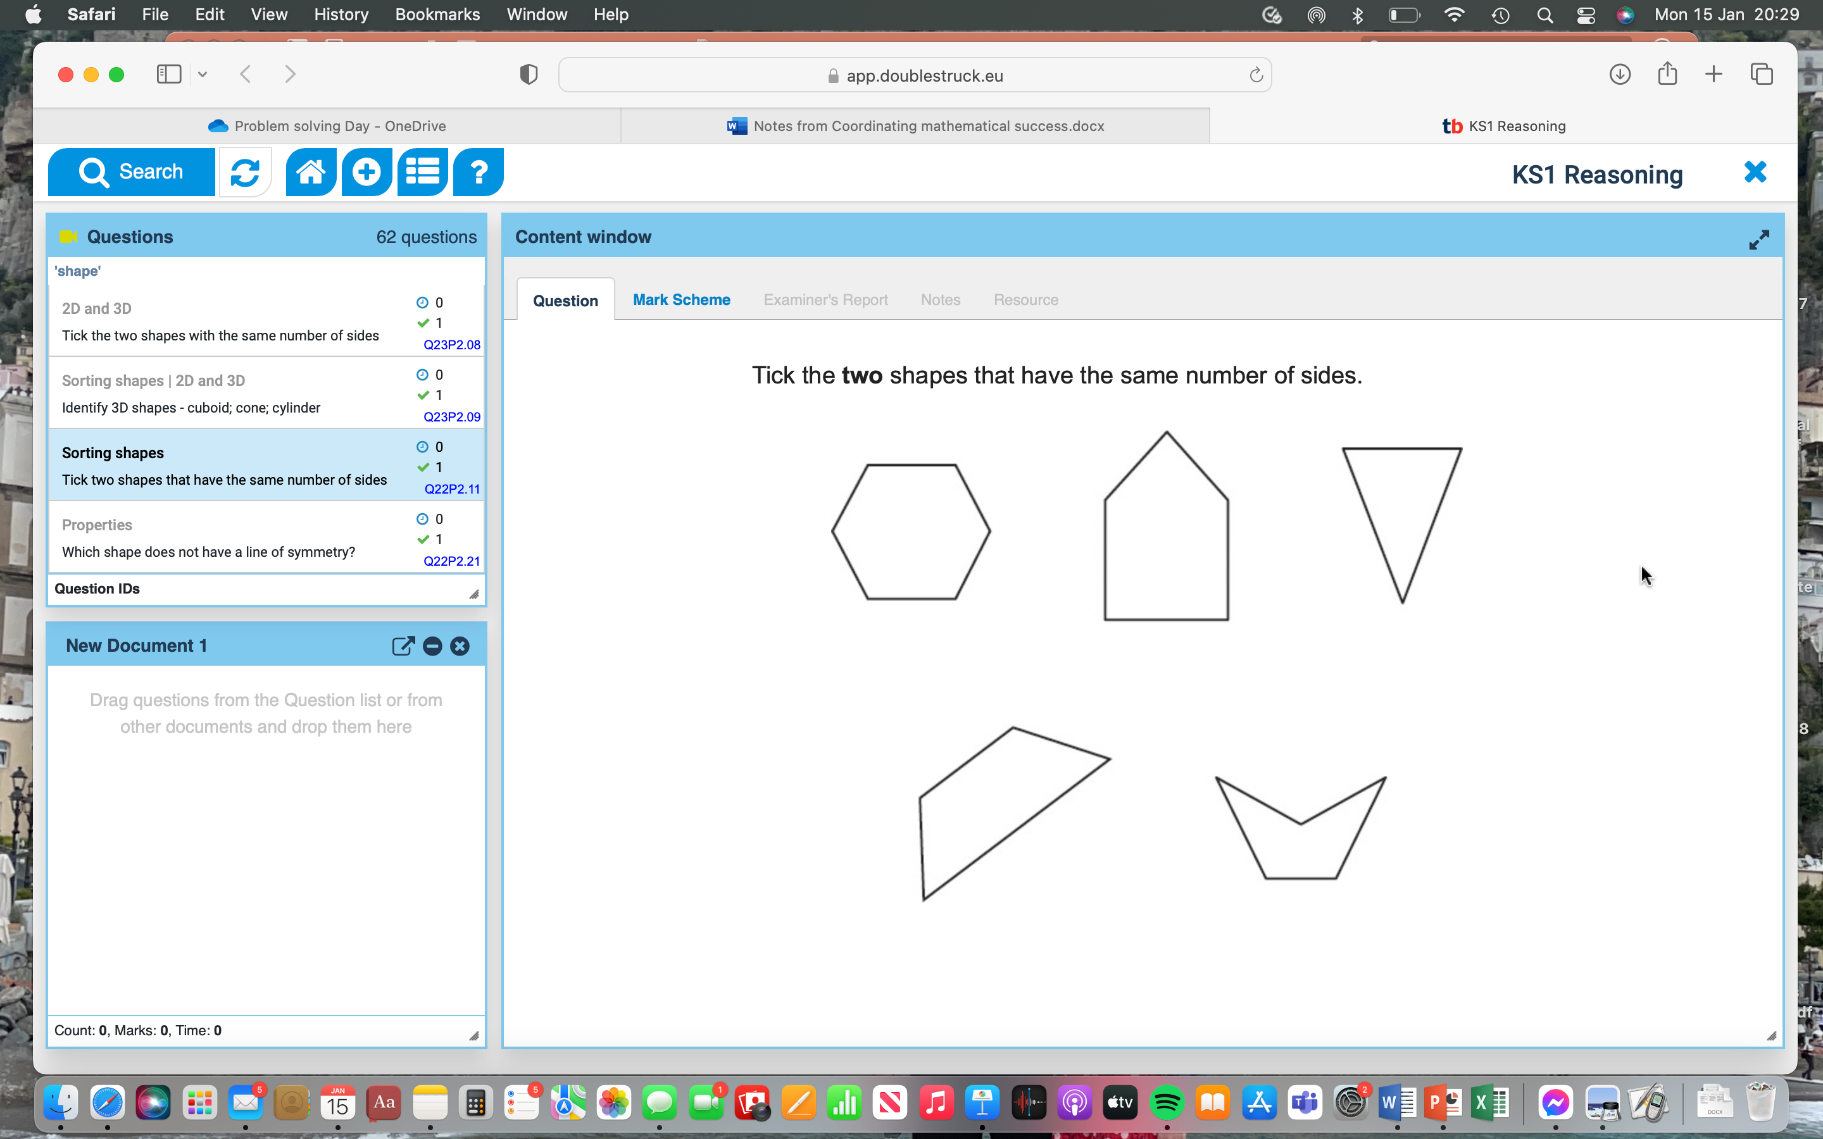
Spot the Difference
Look at these representations. What do you notice?

Slide 3
What could the Question be?
What questions could be written for this representation? Be inventive!

Slide 4
Original Problem
Who was closest to the original problem...?

Slide 5
Prove the answer
Convince me why this is the answer.
Imagine you’re explain it to another child.
✔️
✔️

Slide 6
Small Differences
There is a small difference in the question from the last one…
What is it and how does it change the answer?
Tick the two shapes that have an even number of sides.

Slide 7
Rank by Difficulty
Can you order these from easiest to hardest?

Slide 8
New problem Same picture
A completely different question but the same picture… Can you solve it?
Label the shapes.

Slide 9
Missing Quantities
Solve what the missing parts are for this problem
The properties of the shapes have been listed, but some are missing. Complete the missing amounts.
3 vertices
3 sides
___ sides
6 vertices
__ sides
___vertices
______ ________________
______ ________________
4 ________
4 ________

Slide 10
How many ways
How many ways can you group these shapes?

Slide 11

Slow Reveal
What could these shapes be?

Slide 12
Non-examples
How many wrong answers can you come up with? How do you know?
Not a triangle | Not a quadrilateral | Not a hexagon

