Slide 1
Teaching Reading at NJK
Let’s start at the very beginning!

Slide 2
Why is reading so important?
Numerous studies have shown that strong oral language skills are the basis for literacy development. When children learn to read at an early age, they have greater general knowledge, expand their vocabulary and become more fluent readers. They also have improved attention spans and better concentration.

Slide 3
Notes:
This is the aim for the majority of children by the end of their reception year

Slide 4
Notes:
Skills, knowledge and understanding we aim to teach children

Slide 5
Notes:
Government guidelines

Slide 6
Notes:
Covered mostly in nursery and pre-school settings
Recapped during term 1.1

Slide 7
Notes:
Taught first

Slide 8
https://www.youtube.com/watch?time_continue=31&v=bSafwbjJbHI

Slide 9
Notes:
We also aim to teach phase 4 in the last half-term and this is then revisited at the start of YR1

Slide 10
Discrete daily teaching of phonics- following a systematic structured approach
Daily application in shared reading and writing
Daily application across the curriculum
Application in guided reading
(Application in guided writing)

Slide 12
Daily
Use flashcards to teach children the letter-sound correspondence
Practise, practise, practise until children can quickly identify each letter and say the correct sound
ORALLY blend sounds to make words
Then apply this letter-sound recognitions and skill of blending to read words
Teach tricky words

Slide 13
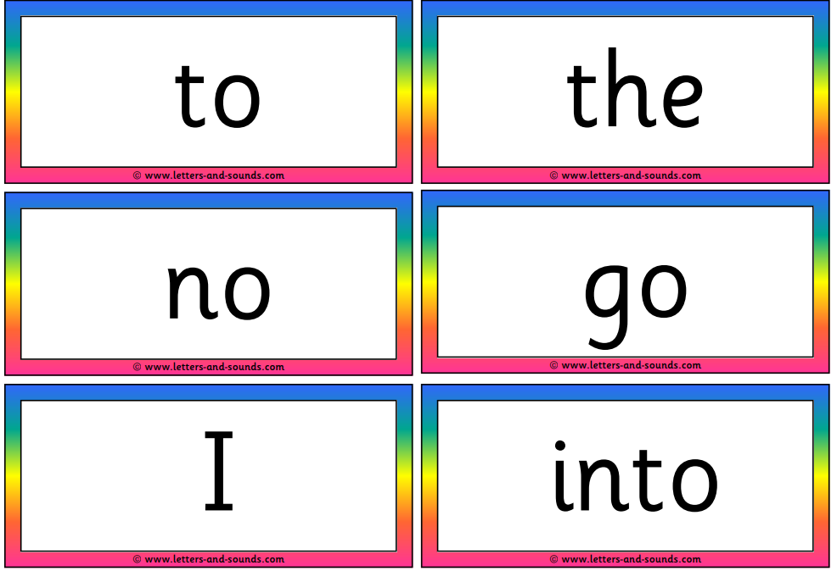
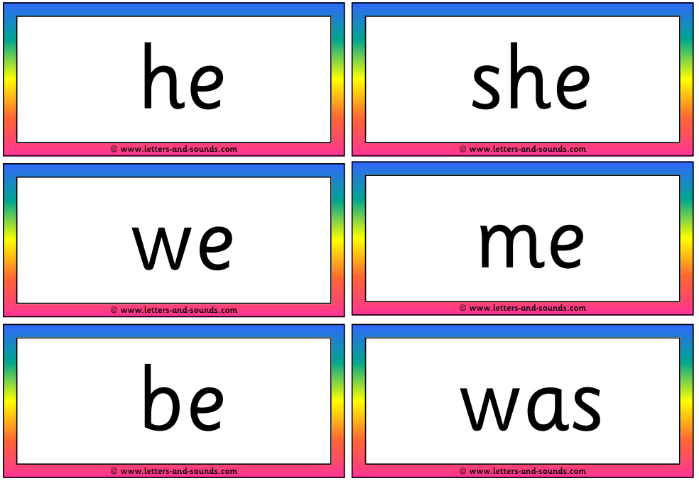
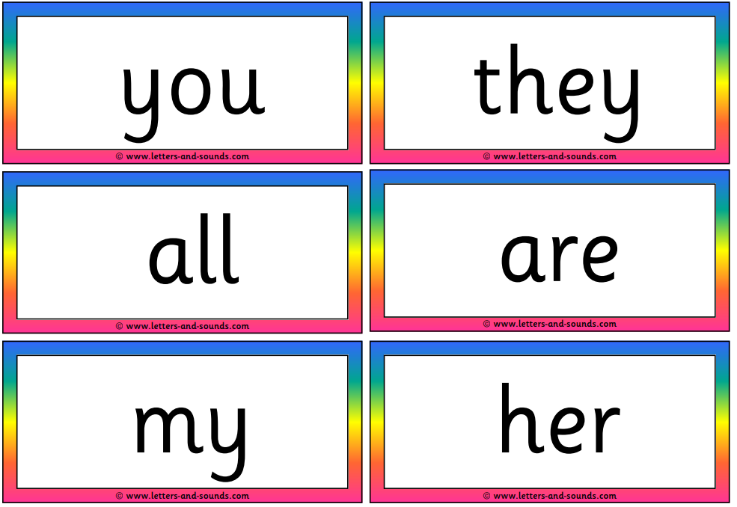
Phase 2
Phase 3

Slide 18
https://www.youtube.com/watch?v=3ovJIxTQpsU
www.oxfordowl.co.uk
www.phonicsplay.co.uk
www.epicphonics.com

Slide 19


Slide 20


