Slide 1

EYFS Curriculum Meeting
8.11.19
Together With Love and Joy
we discover, develop
and maximise potential

Slide 2

Developing the whole child

Slide 3
What is Stay and Play?
An opportunity to see inside the classroom
An opportunity for things your child has mentioned to make more sense
Time to experience first hand your child interacting in their new school environment, with new friends
Get to know the EYFS staff better
An informal opportunity to talk to staff
Quality time discussing your child's leaning with them – learning journeys and next steps

Slide 4
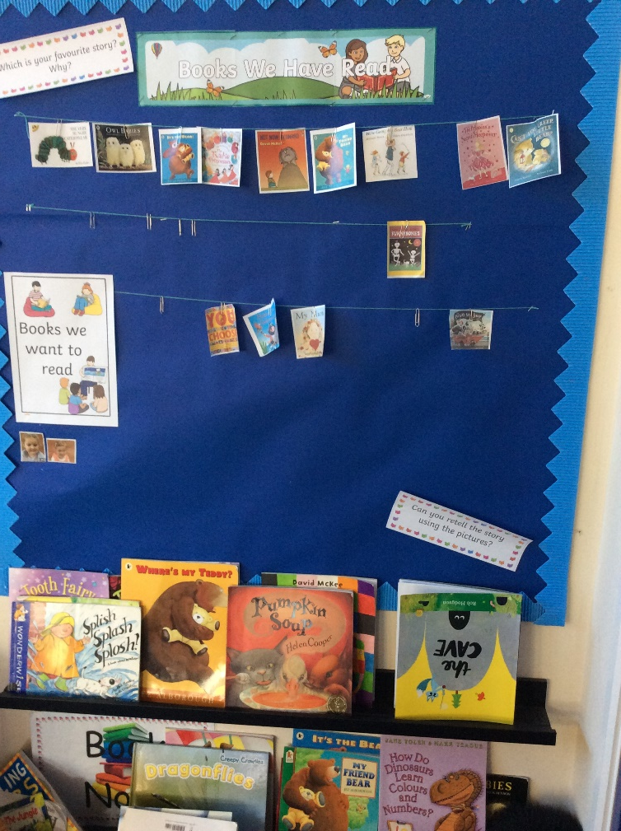
Book corner and voting station
Quality texts
Age appropriate
Texts to share
Texts that are read to your child
Texts that should become familiar and they can retell

Slide 5
Weekly vote
Move own name
Can be moved more than once
Changed every Wednesday
Book voting station photo removed due to children’s names being displayed

Slide 6
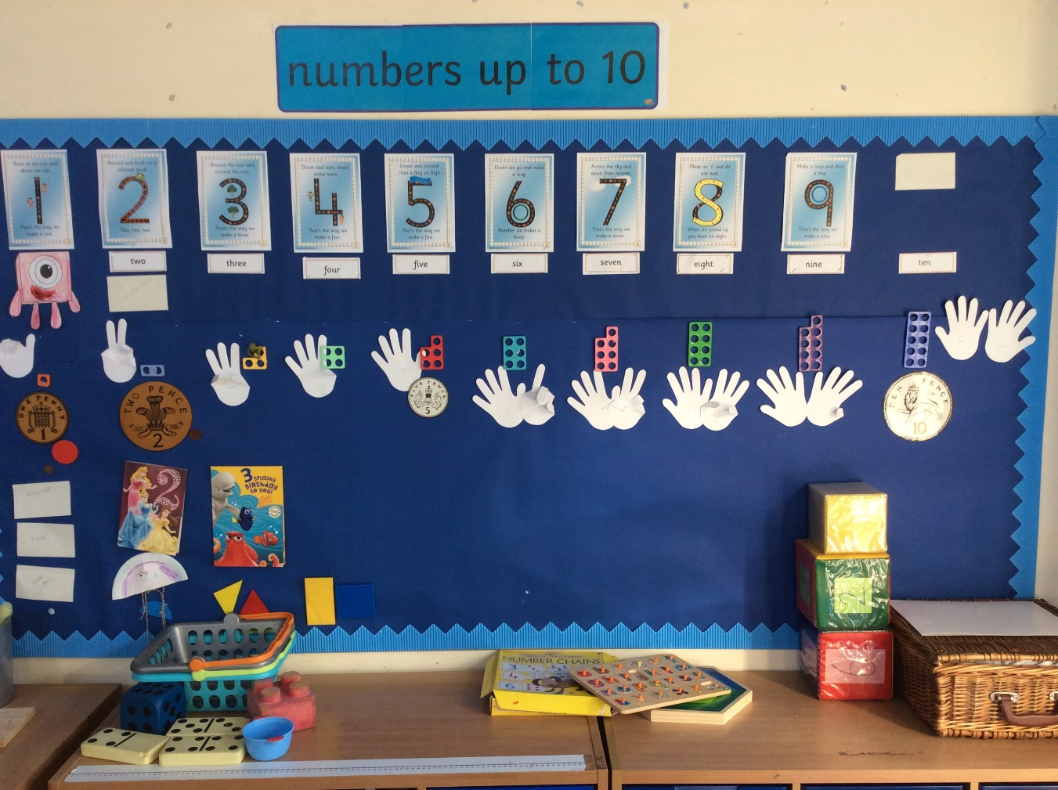
Number per week
Bring in examples to add the display
What do they know about this number?
Correct formation of digits

Slide 7
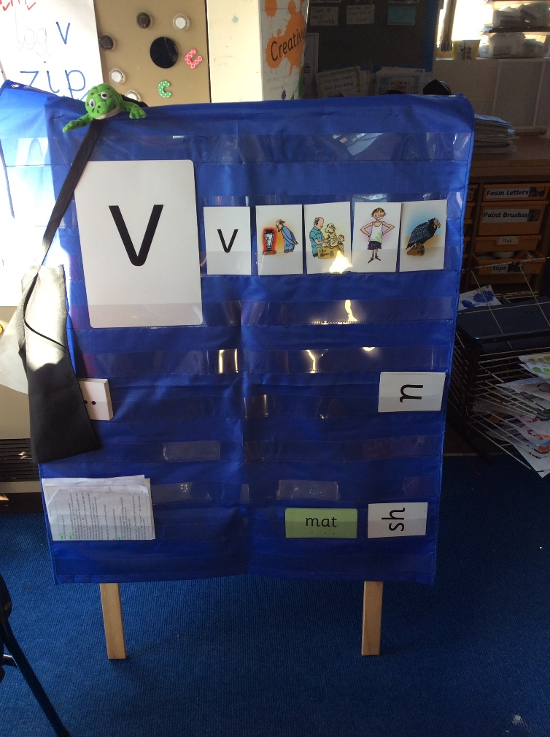
Read Write Inc
Sound of the day
1 sound per day
Eye spy
Sounds in words with the sound (vet, van, vest)
What are the pictures (all v)
Practise correct letter formation of sound of the day (letter formation mats)

Slide 8
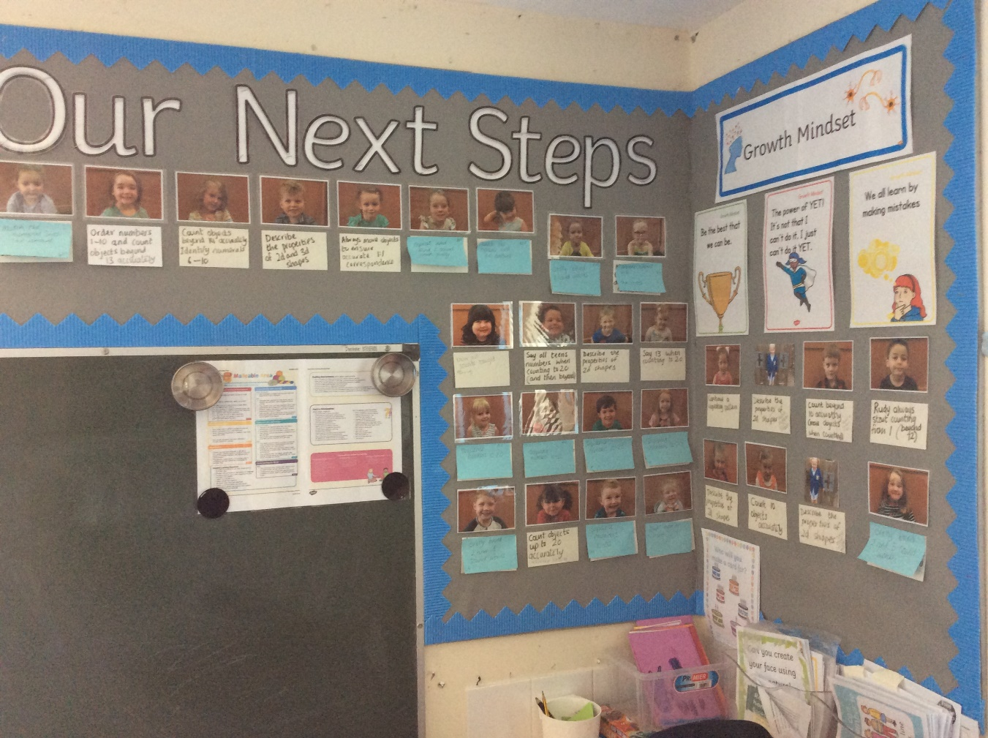
Next steps in your own child’s learning

Slide 9
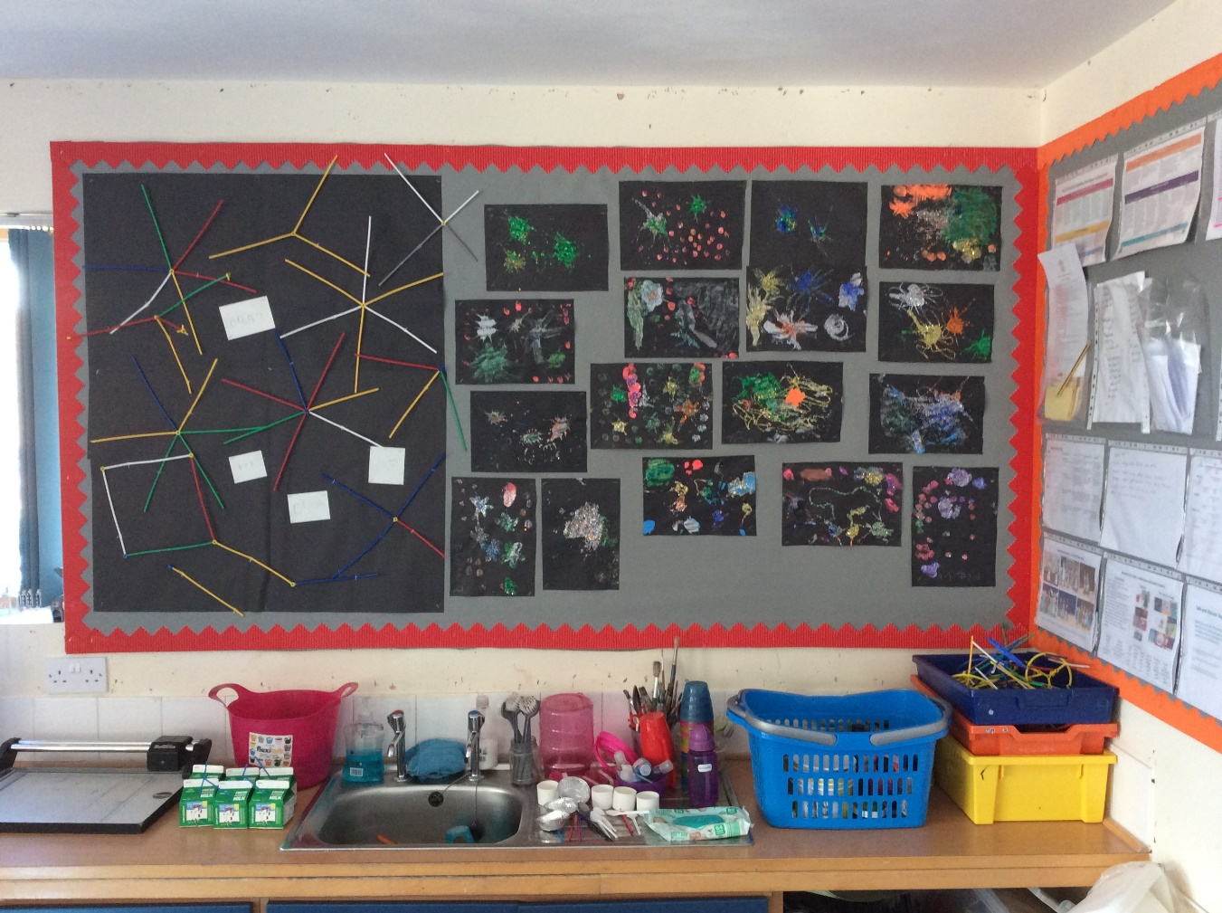
Current topic…

Slide 10
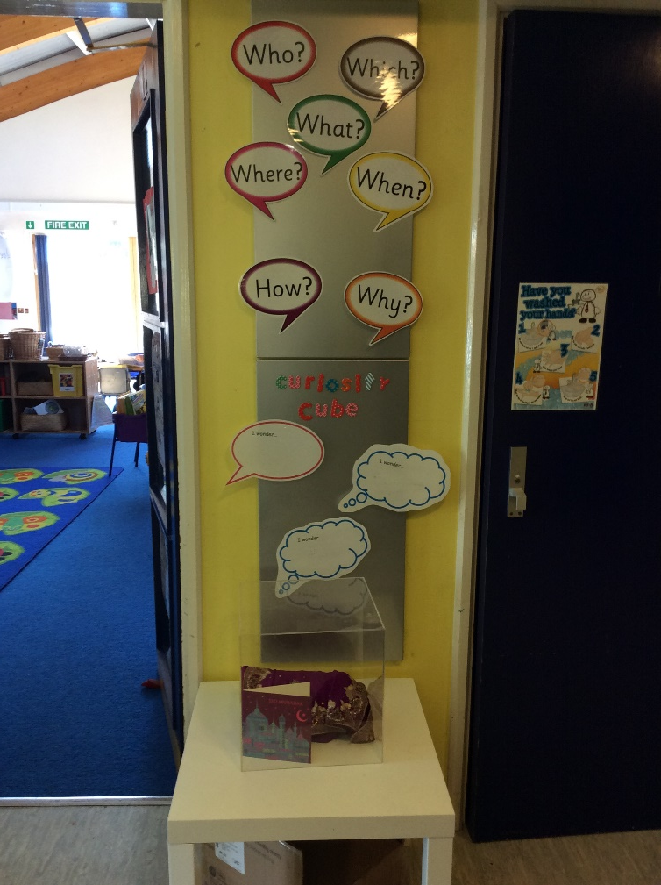
The Curiosity Cube
I wonder…
Question words…
Thinking over outcome

Slide 11
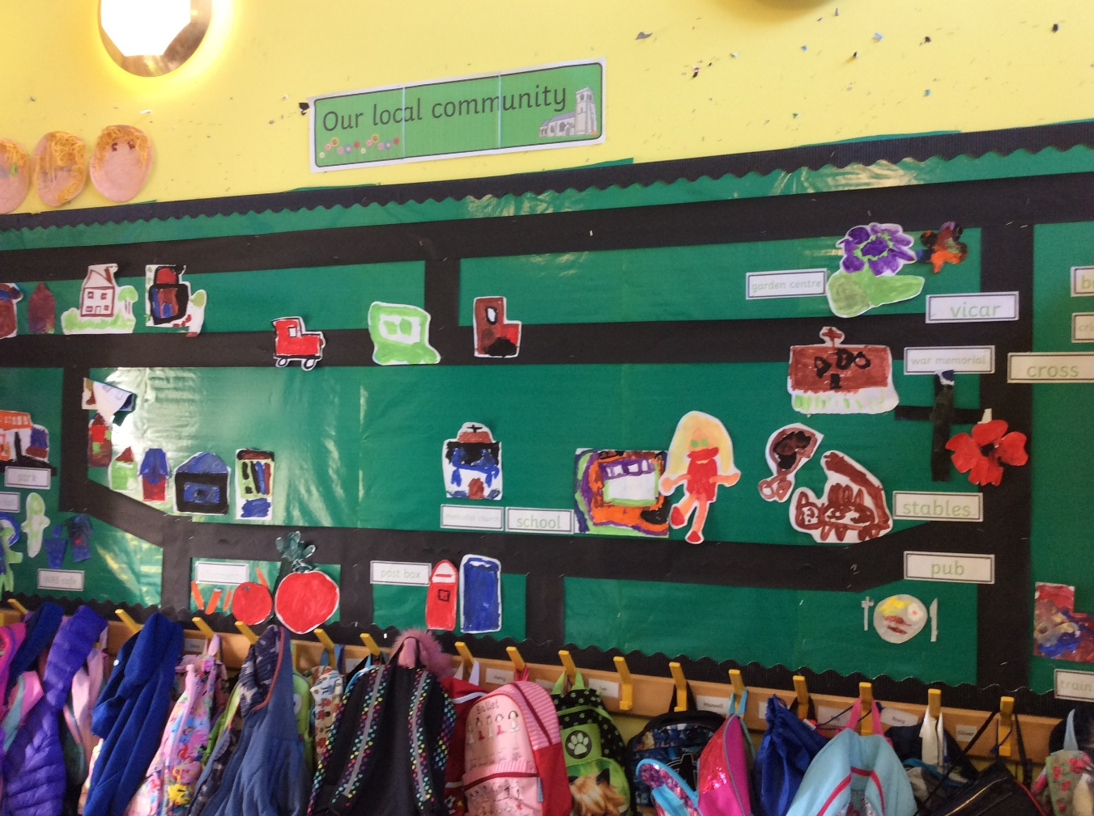
Adding to ever changing displays

