Slide 2
Behaviour Workshop

Slide 3
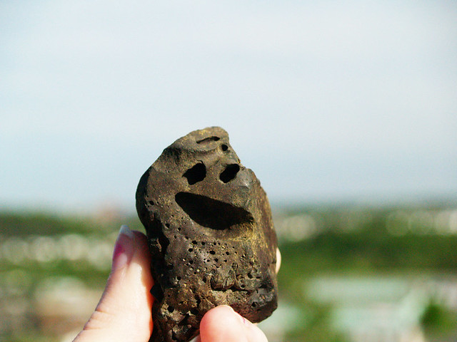
Ground Rules
R- Respectful
O- Openness
C- Confidential
K- Kind

Slide 4
Ice breaker
What was Behaviour Management like for you at school?

Slide 5

Questions to discuss…
What went well?
What didn’t go well?
Why was this?

Slide 6

What are the 3 expectations at NJK?

Slide 7
RRS
Be Responsible
Be Respectful
Be Safe

Slide 8
We expect pupils to…
Follow the expectations at all times
Work to the best of their abilities, and to allow others to do the same
Treat others with respect
Co-operate with adults and other children
Take care of property and the environment in and out of school
Reflect on the values introduced during Collective Worship and apply them to everyday life

Slide 9
We expect staff to…
Treat all children fairly, recognising their individuality and needs
Raise children's self-esteem and develop their full potential
Provide a challenging, interesting and relevant curriculum
Create a safe and pleasant environment, physically and emotionally
Use rules and sanctions clearly and consistently

Slide 10

How is behaviour
REWARDED in NJK?

Slide 11
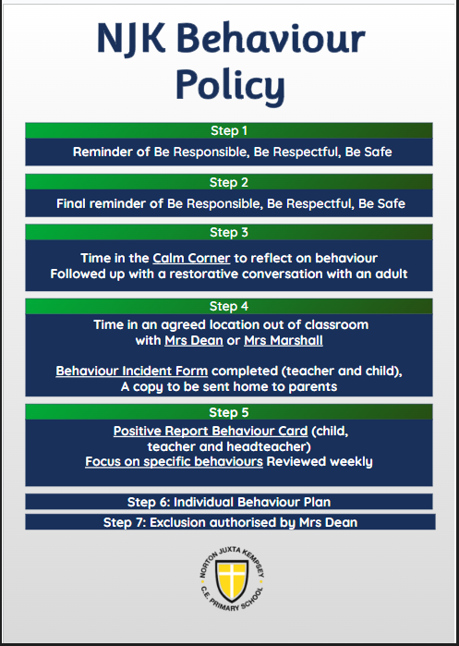
How is behaviour managed at NJK?

Slide 12
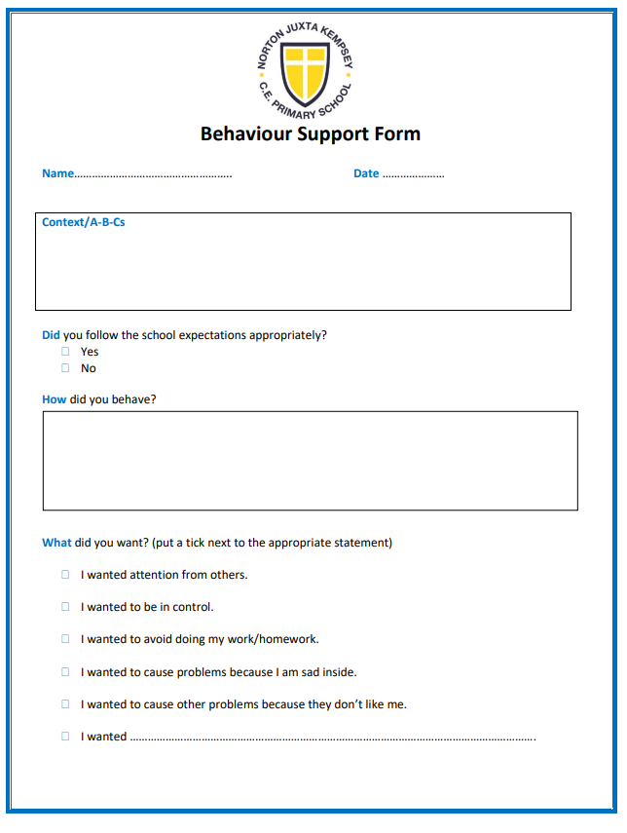

Slide 13
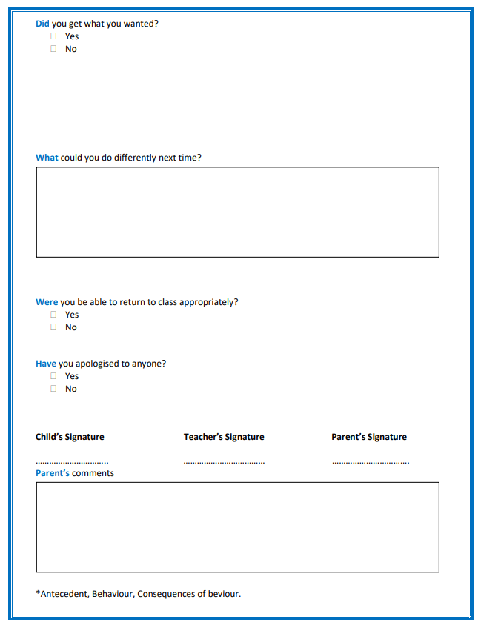

Slide 14
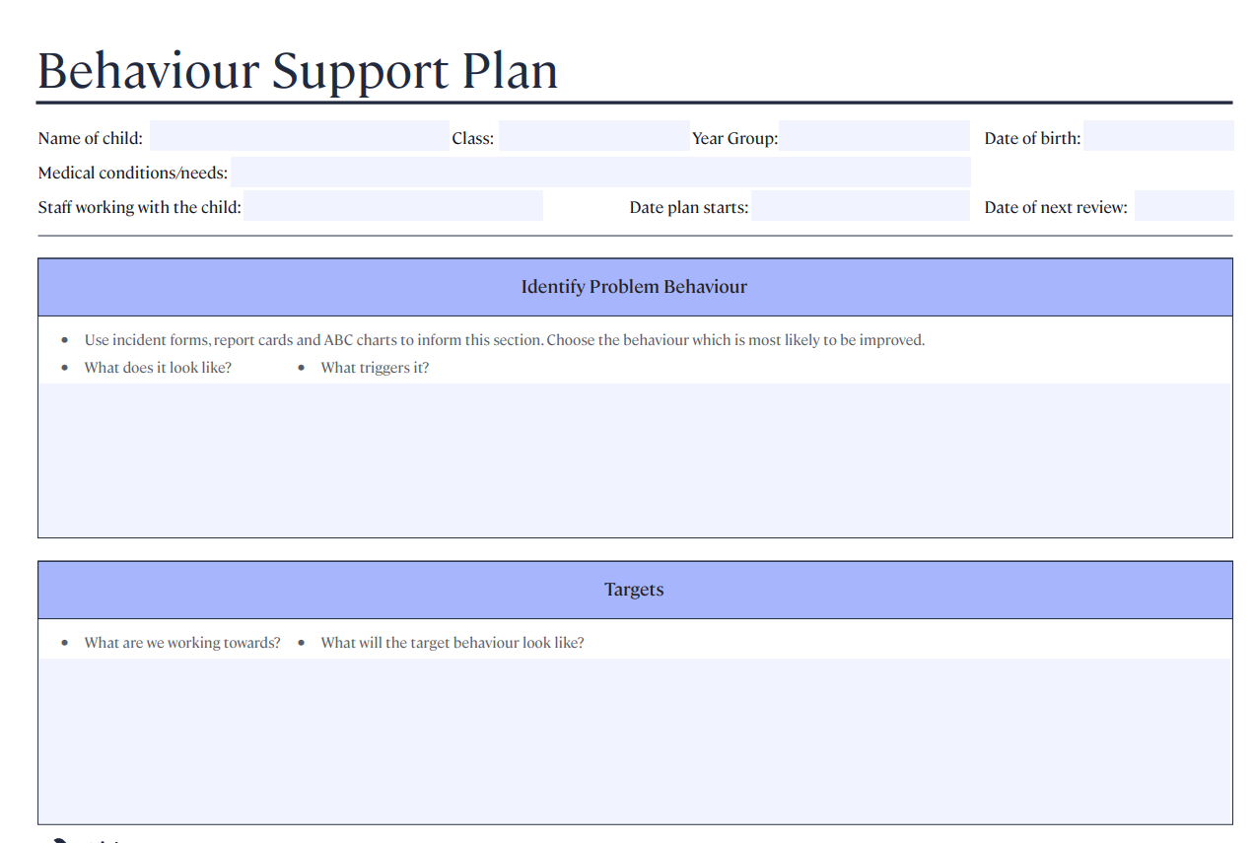

Slide 15
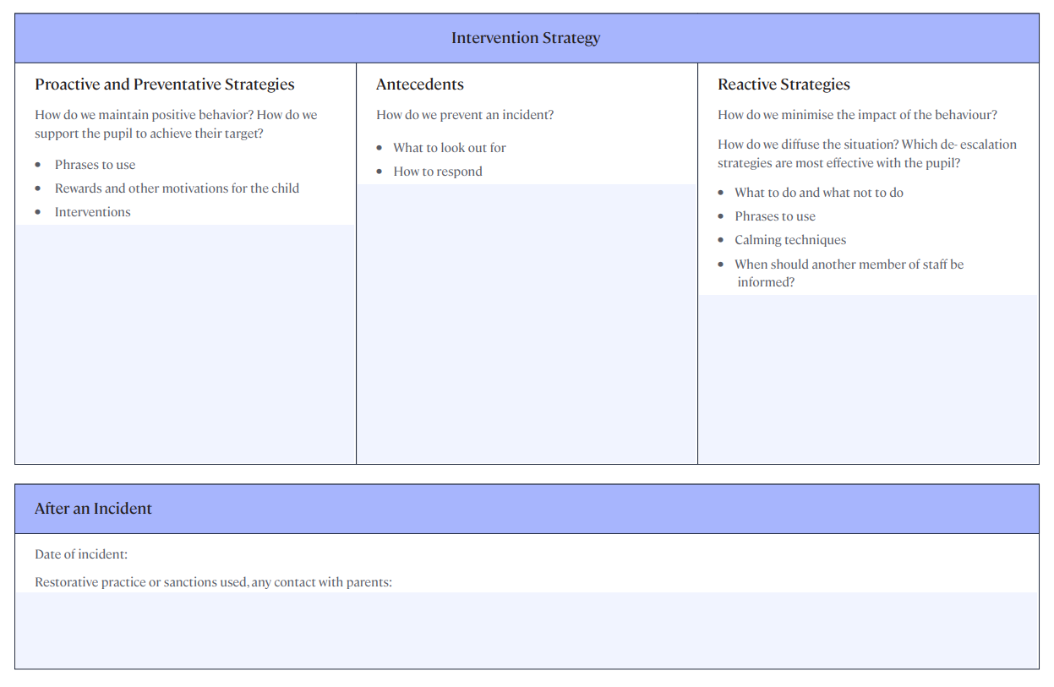

Slide 16
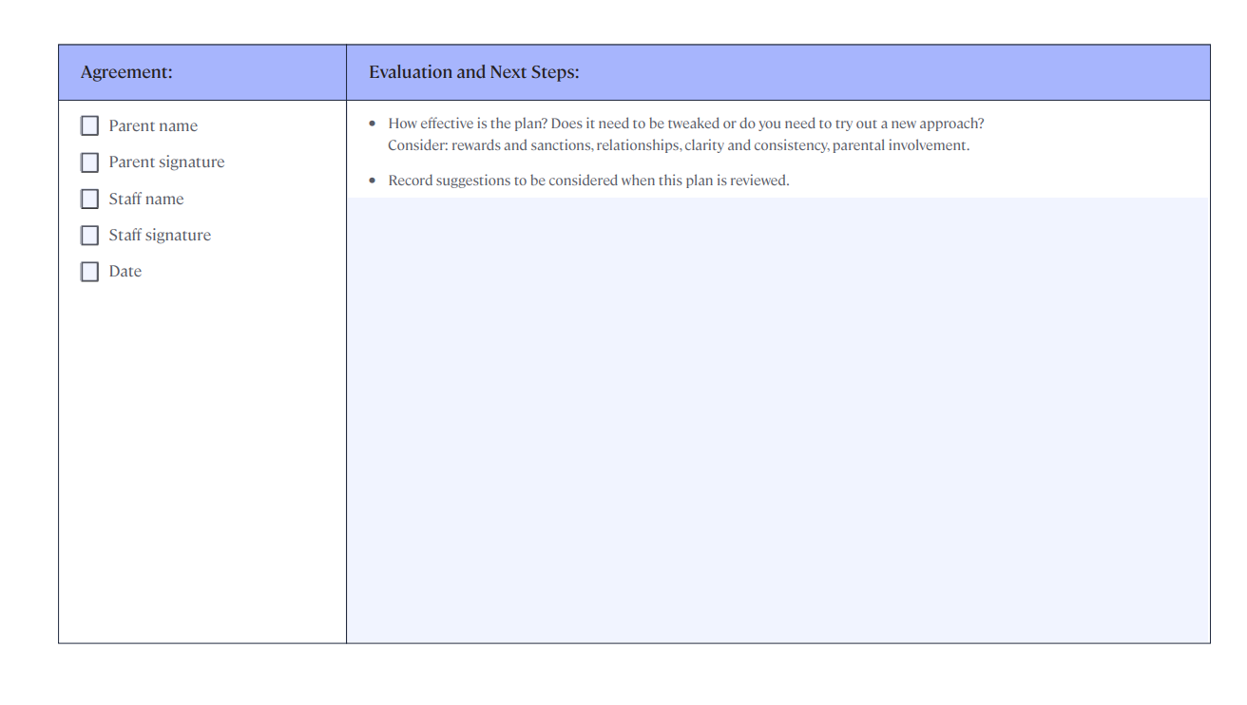

Slide 17
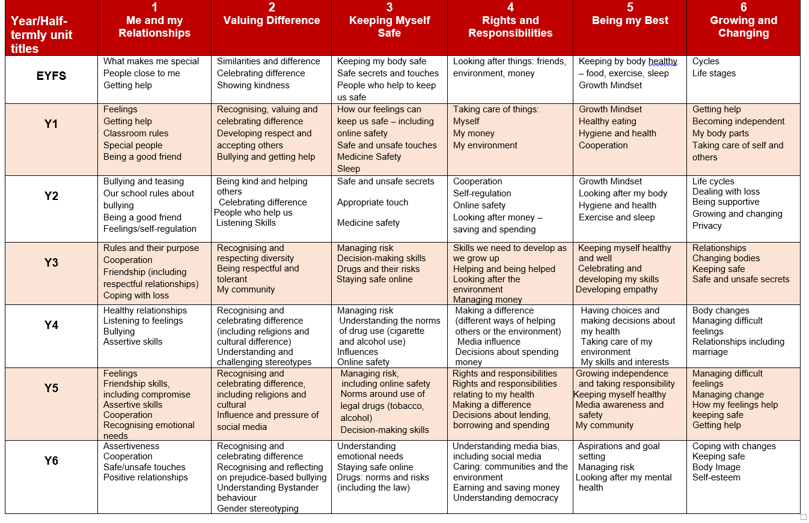
PSHE Curriculum that promotes good behaviour

Slide 18
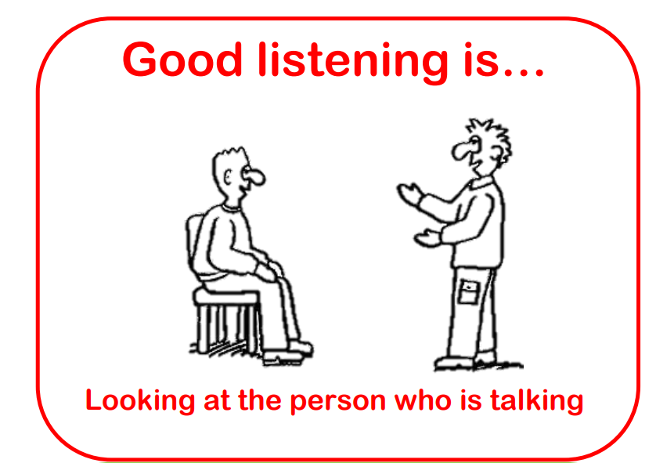
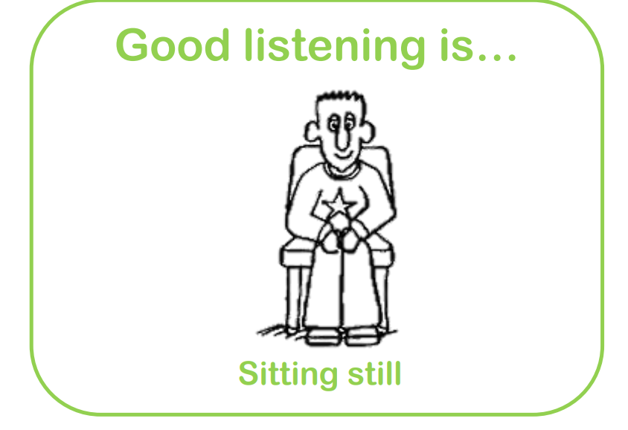
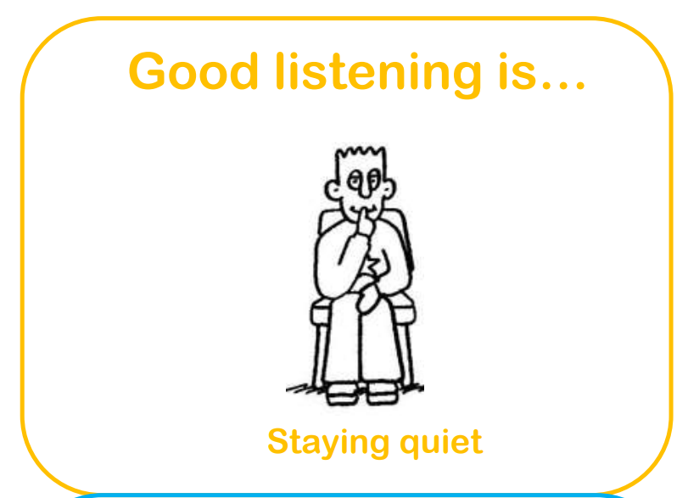
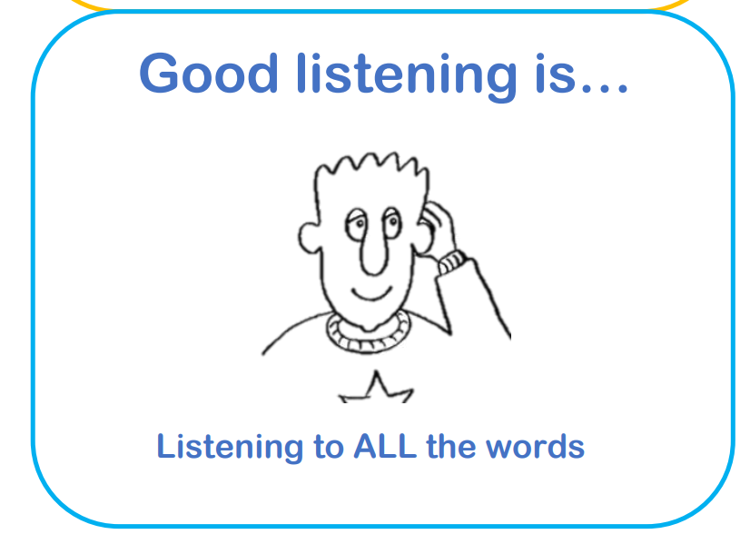
Teaching Children how to Listen

Slide 19


Neuroscience and Behaviour

Slide 20
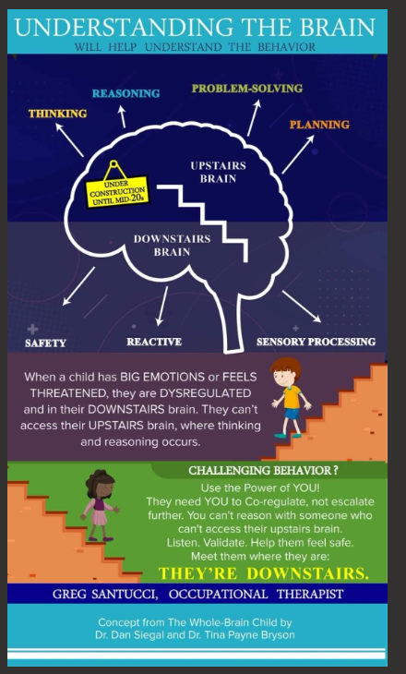

Slide 21
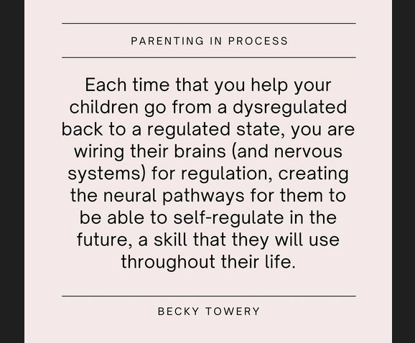

Slide 22
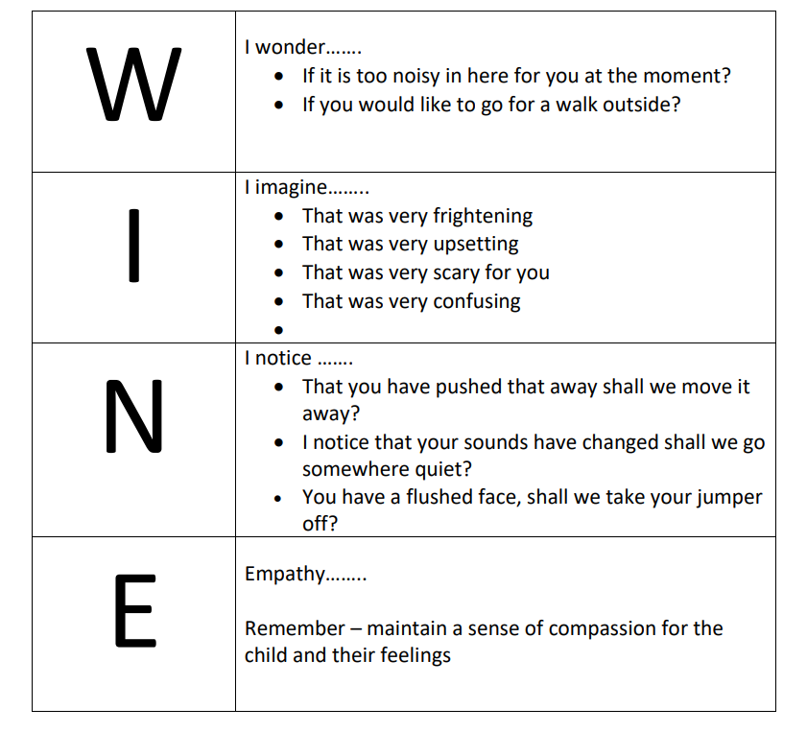

Slide 23
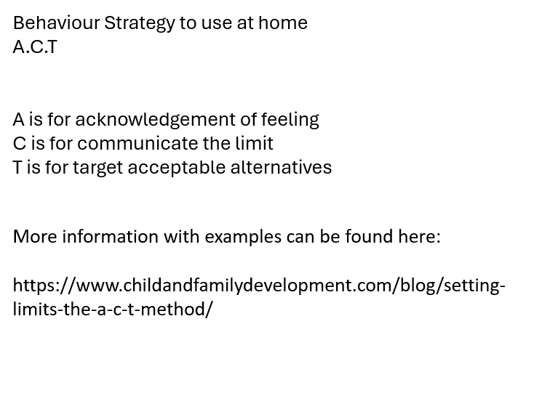
How to help with behaviour at home?

Slide 24
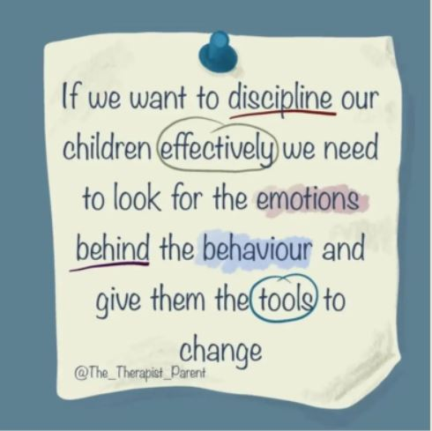

Slide 25
Strategies to use at home
Stickers
Random acts of kindness - to feel a sense of responsibility and happiness- Kindness Jar
Special jobs – helping in the kitchen in safe ways – sweeping, helping to wash veg, making others a sandwich.
Tidying up – who can pick up the most…?
Appropriate rewards for specific behaviour – watch 1 TV program, half an hour on a tablet, half an hour playing lego, ten minutes playing a game with the child.
Set the amount of time and help them understand how long that is – kitchen timer, iphone shutdown

Slide 26
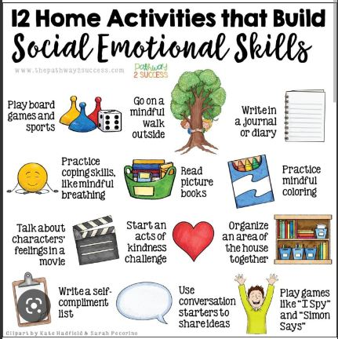
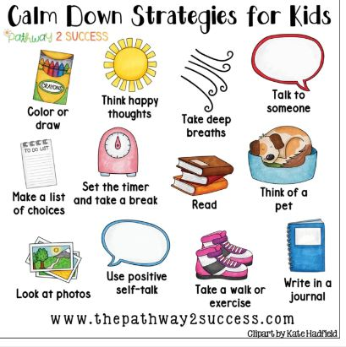
Strategies to use at home

Slide 27
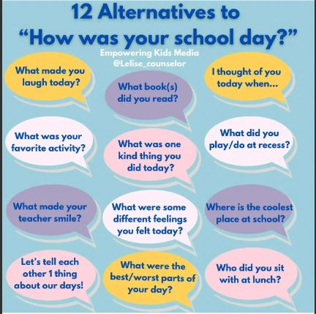
How was your day alternatives?

Slide 28
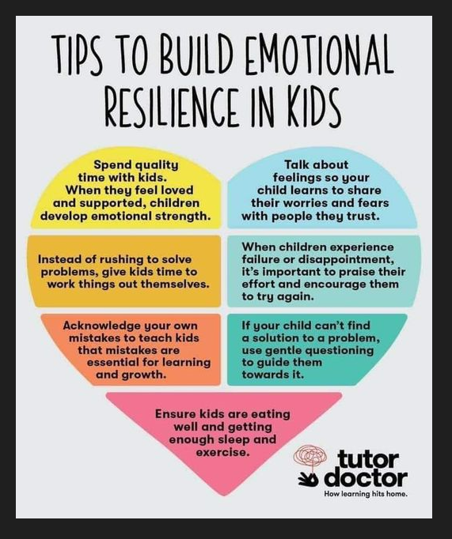

Slide 29
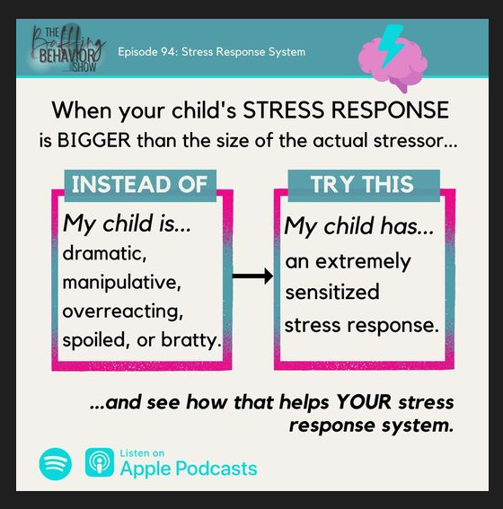

Slide 30


Slide 31
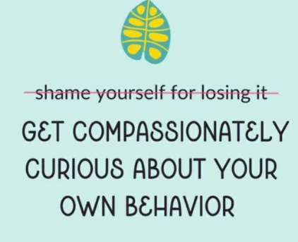

Slide 32
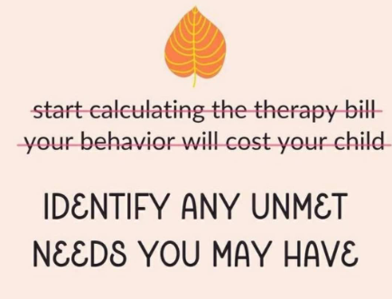

Slide 33


Slide 34
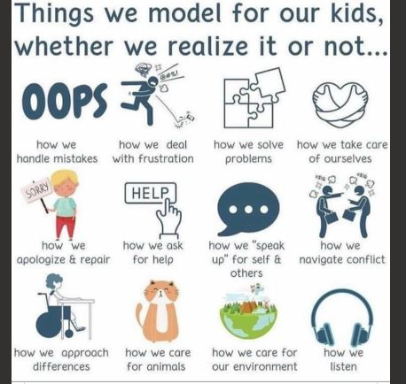

Slide 35


Slide 36


Slide 37
Useful links
Useful websites and books
Challenging Behaviour | Parents Guide To Support | YoungMinds
The Incredible years by Carolyn Webster-Stratton (book)
Helping my child with fears and worries by Cathy Creswell (book)
The Whole Brain Child by Daniel Siegel (book)
Behaviour Support for Parents |Behaviour Support Resources (behaviourhelp.com)
Behaviour - Support for Parents from Action For Children
Support for parents | NSPCC Lots of good topics to click on
https://holesinthewall.co.uk/resources/leaflets-and-information-for-parents/
https://connectivefamily.com/

Slide 38
Useful links
This free webinar is great, she also does free email newsletters with advice too
https://drvanessalapointe.teachable.com/courses/1422909/lectures/32681029
This is a fantastic Therapeutic training website I use for my Play Therapy and they have great online training which I highly recommend
https://beaconhouse.org.uk/training/parent-carer-seminar-how-to-support-your-dysregulated-child-3-hours/

Slide 39

Questions?

