Slide 1


Courage
Stepping out of your comfort zone.

Slide 2

Welcome words…
We have gathered in the name of God the Father, Son
and Holy Spirit, to worship together and think about our value of courage.

Slide 3
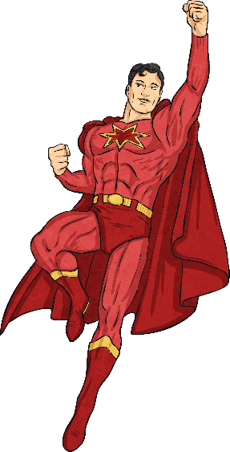
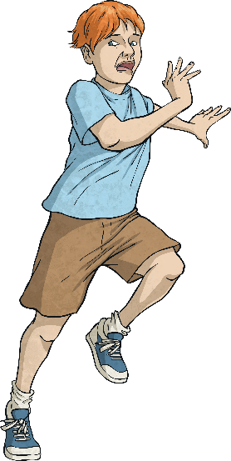
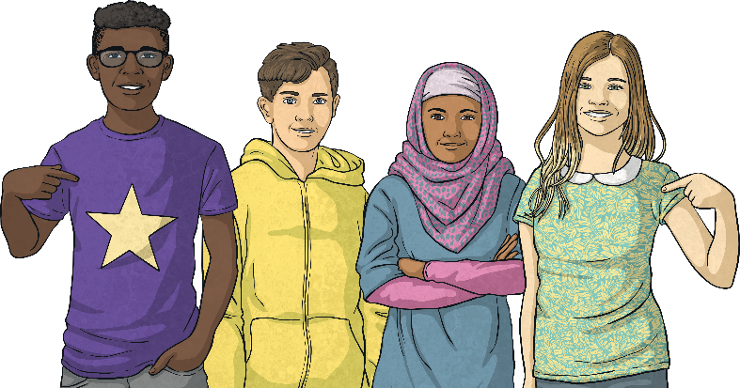
Courage
It can take great courage to do something new or challenging. We call it ‘stepping out of our comfort zone’.
Sometimes just small steps are needed, but they take us to new and exciting places!

Slide 4
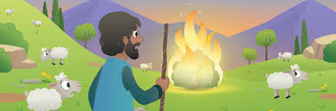
Today’s story tells a time in the life of Moses when his courage was really tested…

Slide 5

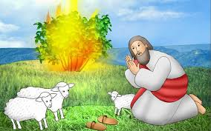
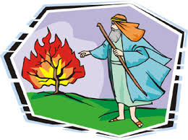

Slide 6
Reflection…
Courage is…
Carrying on when things get difficult
Overcoming fear
Understanding and facing challenge
Risking being out of your comfort zone
Always believing in God’s promises
Going for a goal
Empowered by encouragement

Slide 7
A Prayer about courage

