Slide 1

What is courage?
Courage is what we use to overcome our fears.

Slide 2



How Can We Show Courage in School?
Speak out when you see or hear something that isn't right.
Persevere with tasks that will help you to achieve your goals.
Ask for help if you need it.
Try new things.

Slide 3

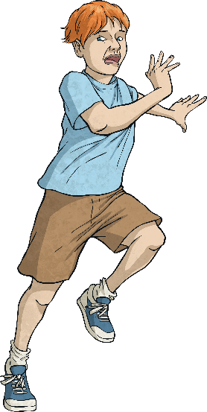
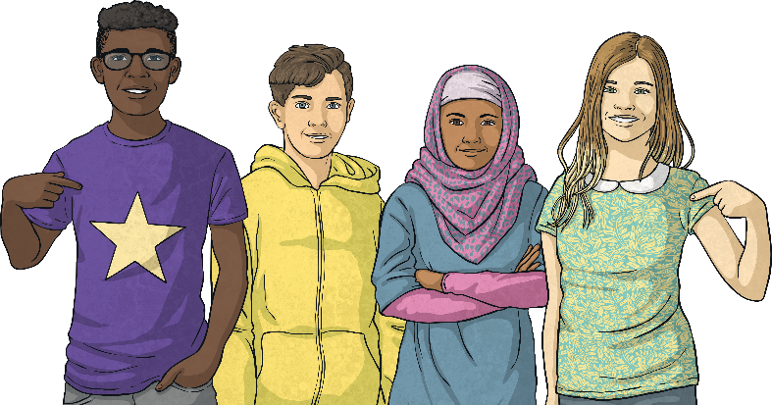
Courage
It is not just heroes who
have courage!
Think about a time when you felt a bit scared or worried about
doing something.
Whatever made you try anyway is what gave you courage!

Slide 4
Here is a story about a time when Jesus showed courage…

Slide 5


Slide 6
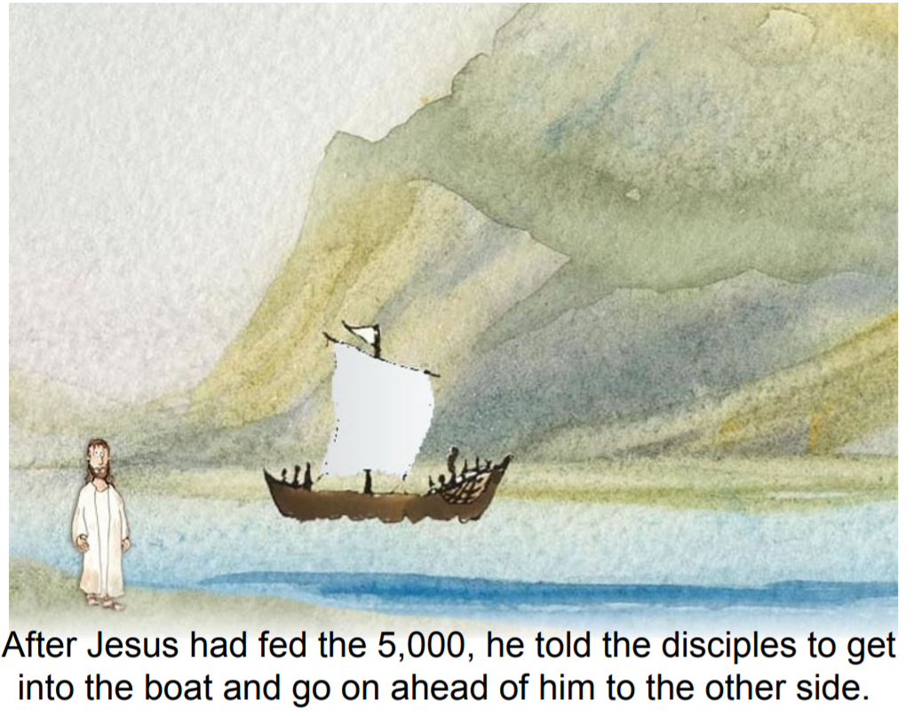

Slide 7
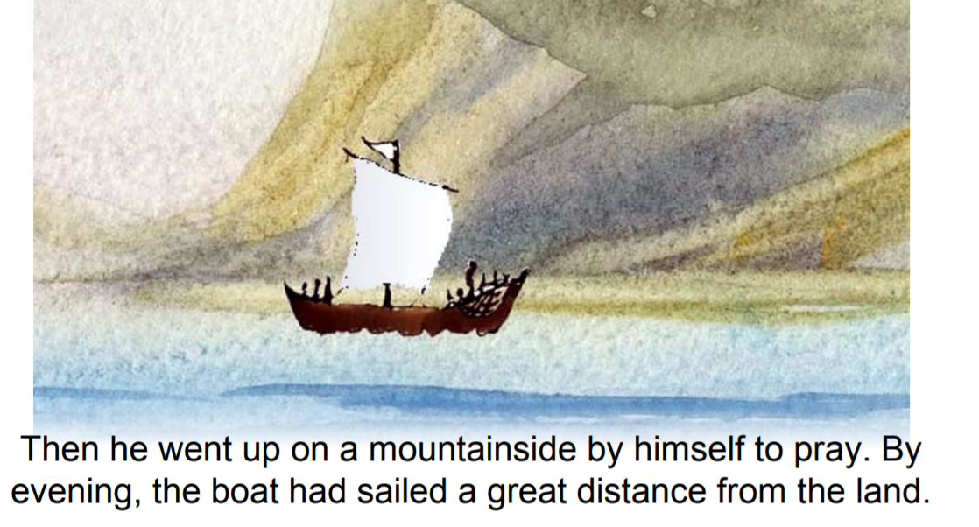

Slide 8
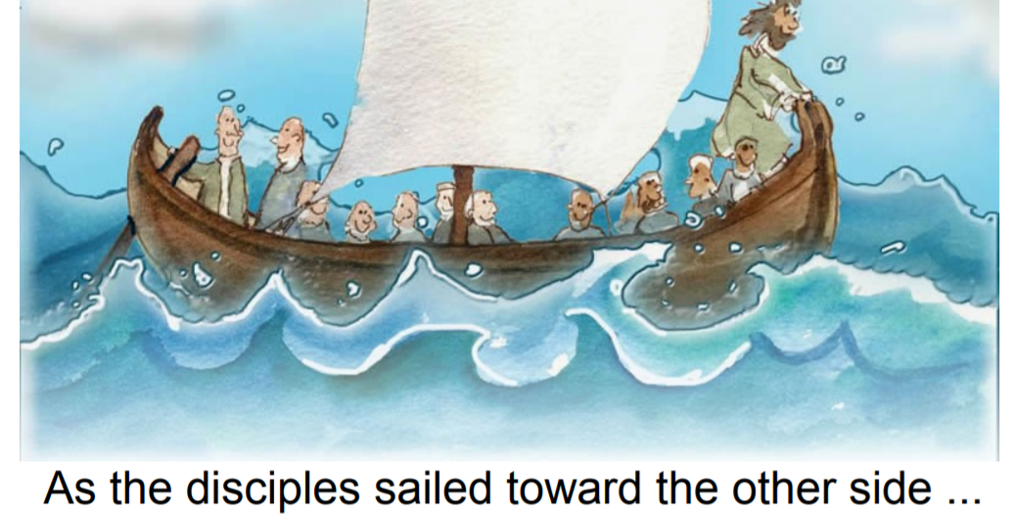

Slide 9
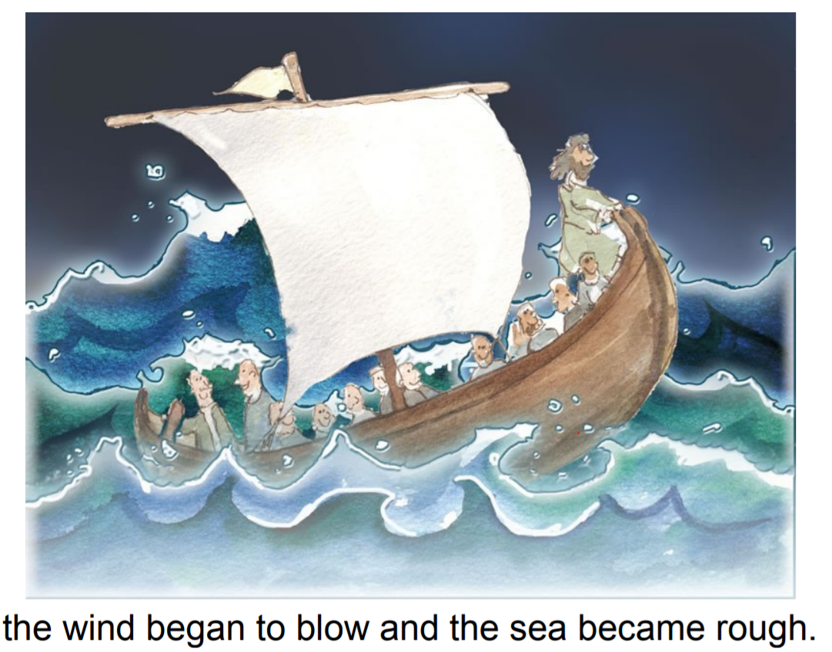

Slide 10
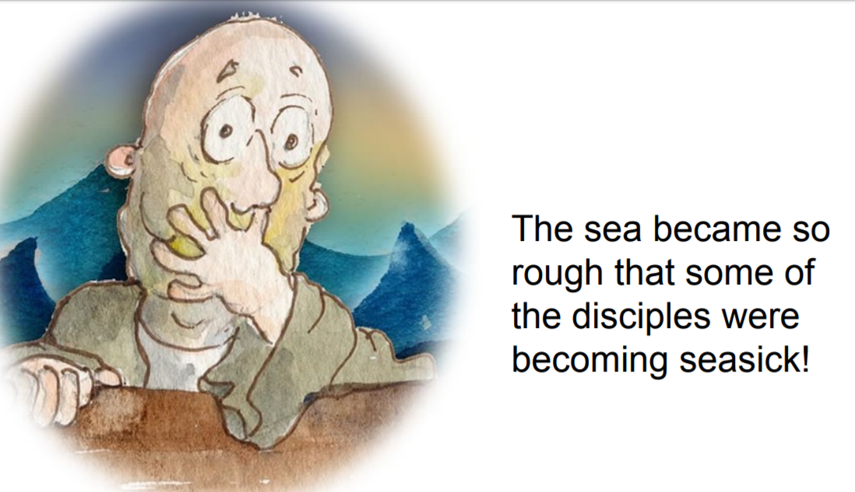

Slide 11
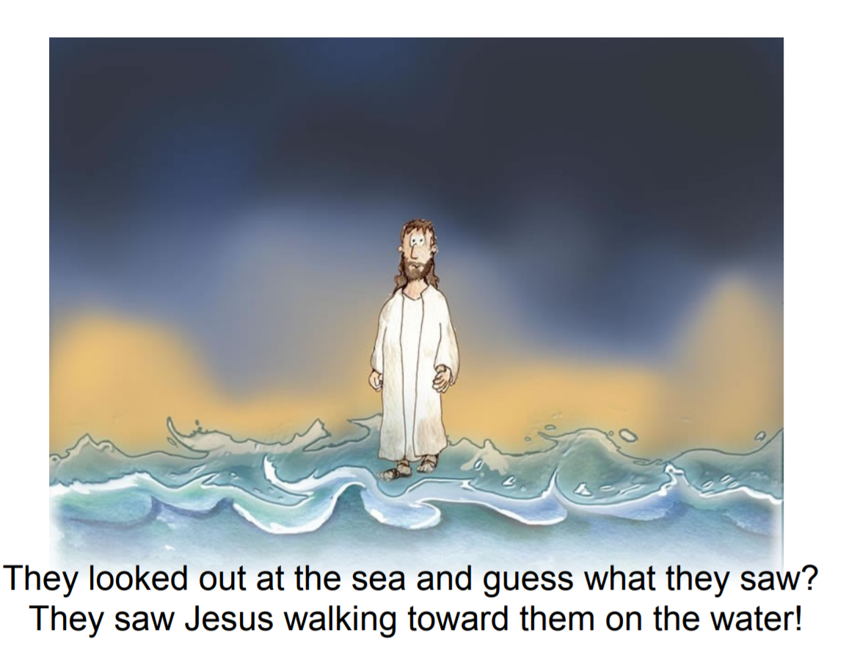

Slide 12
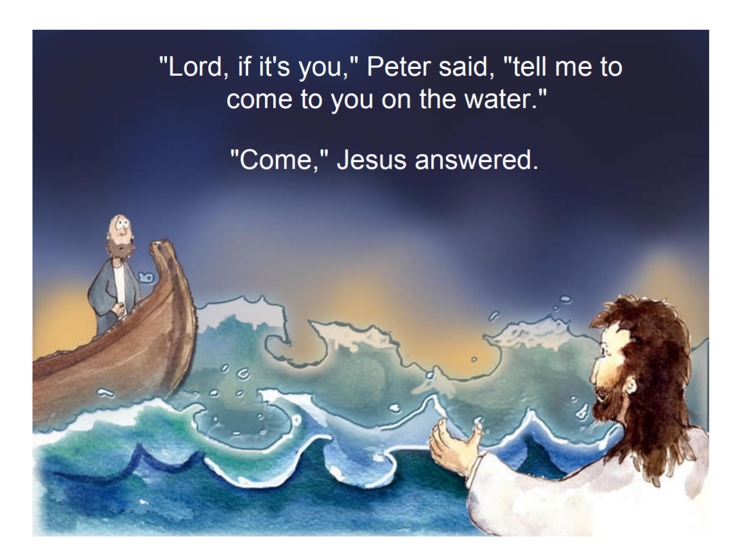

Slide 13
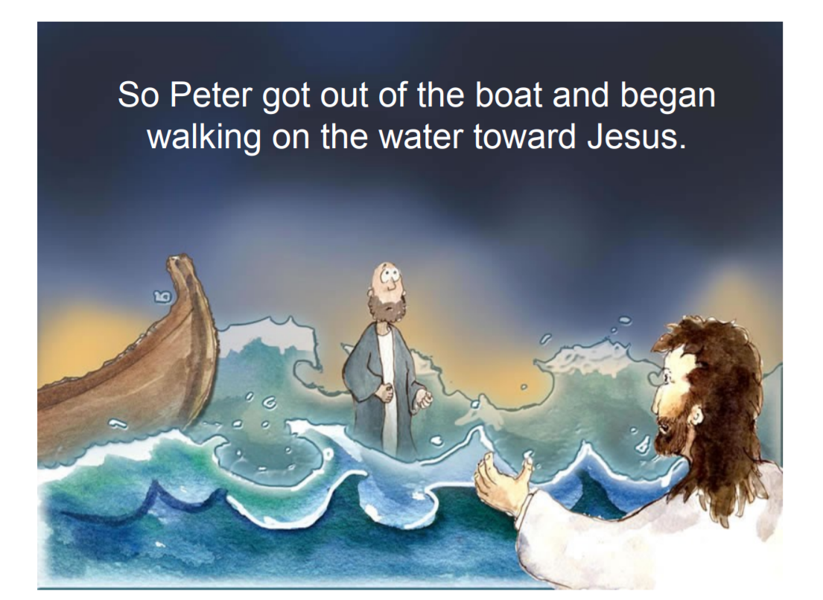

Slide 14
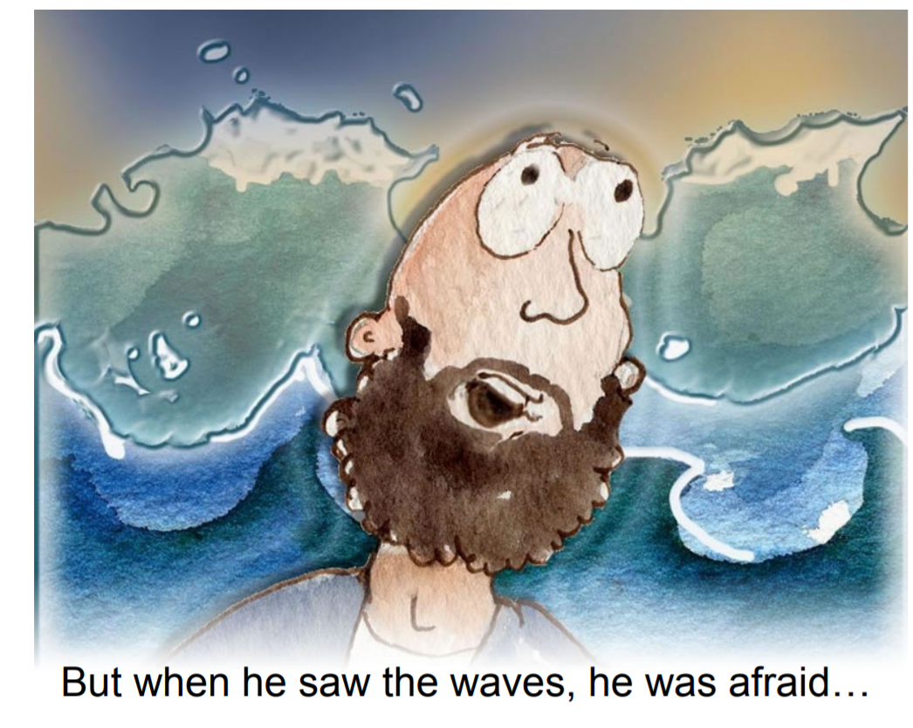

Slide 15
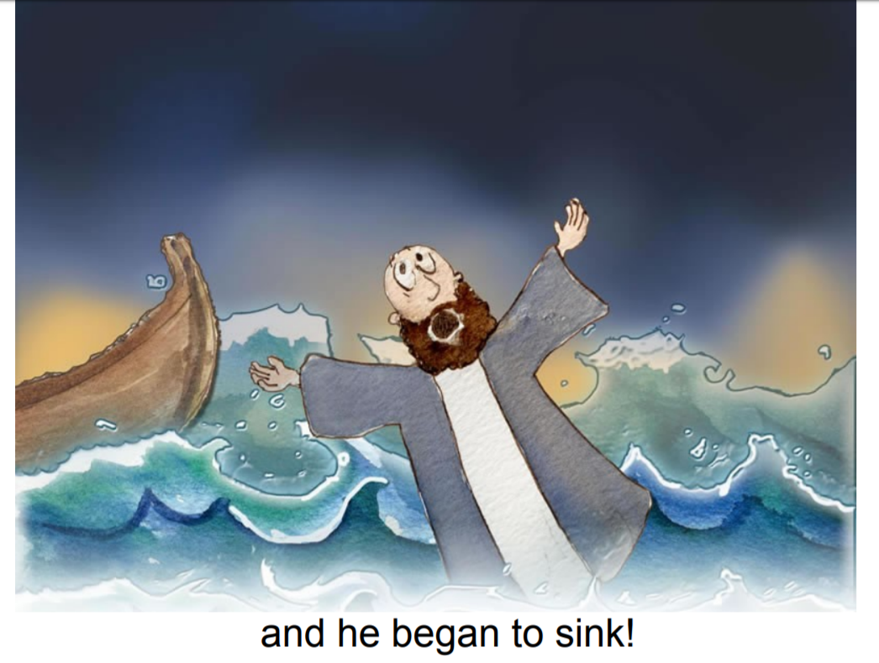

Slide 16
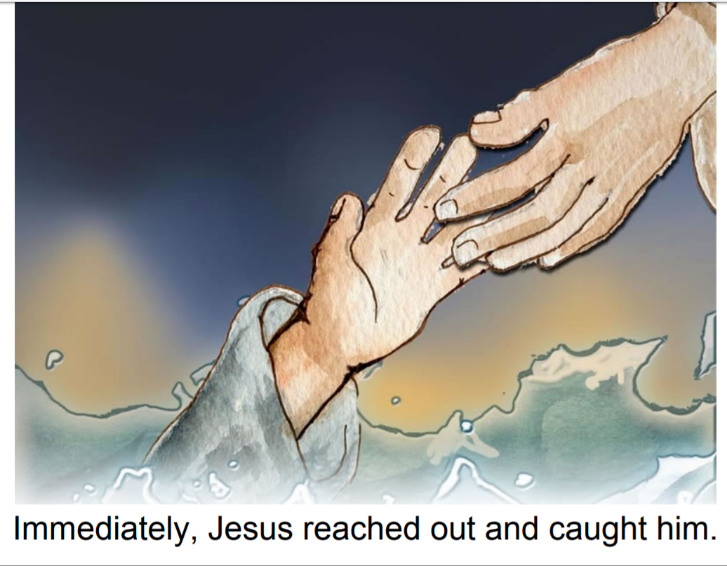

Slide 17
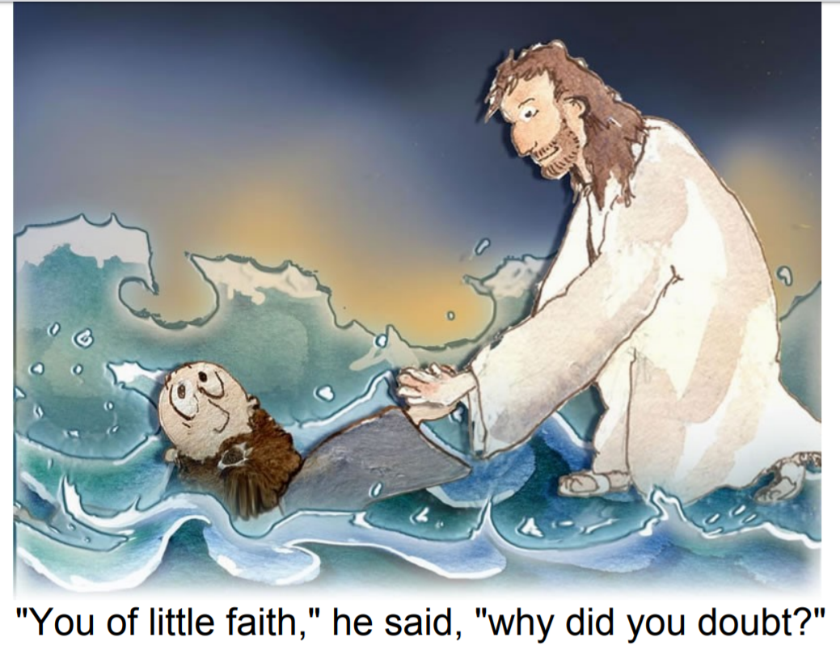

Slide 18


Slide 19


Slide 20

Reflection

Slide 21
A Prayer about courage

