Slide 1
Welcome to NJK’s World
Book Day
2017
Event News

Slide 2
Presented by
‘Fun with Books Club’

Slide 3

NJK Book Oscars

Slide 4
The real Oscars started in 1929
Yesterday was the 89th ceremony.
You might have see it in the news or on television. It celebrates great films.
This week will be NJK’s 1st Oscars!

Slide 5

What are the Oscars all about?
Our book Oscars are
all about sharing
our love and
enjoyment
of books.

Slide 6
How can I join in?
We want to find out about the books, stories and characters that you really love.

Slide 7

For the next 3 days there will be voting boxes in the school library.
Each box has a different category.
They will look like this.

Slide 8
The categories are:
Meanest character
Kindest character
Most embarrassing moment in a story
Most exciting moment in a story
Scariest story
Funniest story

Slide 9
You can write down and vote for a great example for each category and post it in the box.
E.g. Nastiest character – Mrs. Trunchball from Matilda
There will be paper and pencils in the library if you need them.
It is really important that you write your name on the back of the piece of paper because you might be lucky enough to be chosen to collect the award during our awards ceremony on Thursday.

Slide 10
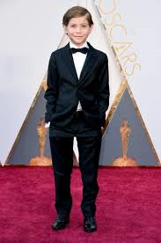
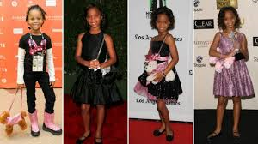
The winners for each category will be announced on Thursday in a special awards ceremony.
To make this extra special we would like you to dress up in something smart on World Book Day (NOT FANCY DRESS).
THURSDAY
Please wear school shoes.
More information on the school website.

