Slide 1
W/C 28th January
https://www.youtube.com/watch?v=_MVzXKfr6e8
Focus: Counting to 20 and crossing the midline.
https://www.youtube.com/watch?v=bt7-Hcy8JPs
Focus: Counting (on), following instructions.
https://www.youtube.com/watch?v=Woc5c8mePR4
Focus: Listening/tuning in to sounds, reciting 3 things in order
https://www.youtube.com/watch?v=Wbh1vOwI2Yo
Focus: Numberblocks number counting song (value of numbers)
The very selfish crocodile

Slide 2

Norton Juxta Kempsey Primary School
WC: 21.1.2020
Classroom Beliefs
Mistakes are valuable
Everyone can learn maths to the highest level.
Questions are really important.
Depth is more important than speed.
Maths is about making connections.

Slide 3
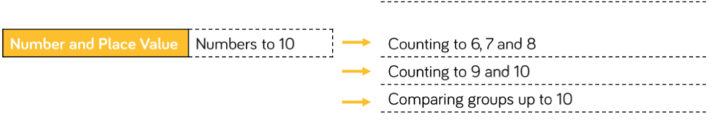
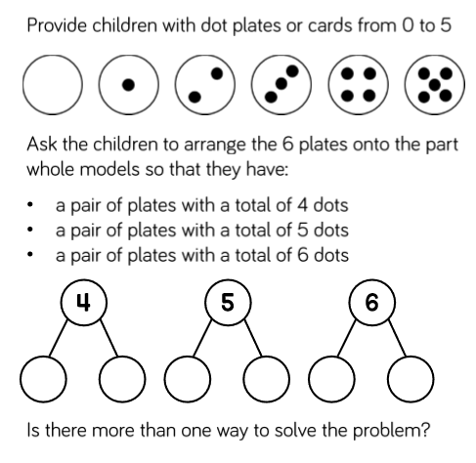
This weeks
Prior knowledge needed in order to complete investigation:
What a pair is
What subitising is
Part - part whole
Total
Zero
This weeks challenge
Theme: Number and Place Value

Slide 4
Monday 20th January
Theme: Number and place value - pairs
Teach it : What it is?
What is a pair?
Two similar, or corresponding things that are matched for use together: a pair of gloves; a pair of earrings. something consisting of or regarded as having two parts or pieces joined together: a pair of scissors; a pair of trousers.
Notes:
Ask children whether they agree that these images show pairs.
Do they agree- are there any that they think are not pairs? So what does pair mean? Give definition and then ask children to come up with other ideas of pairs of things.

Slide 5
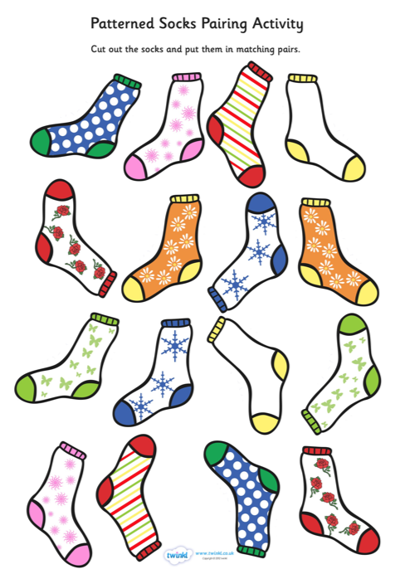
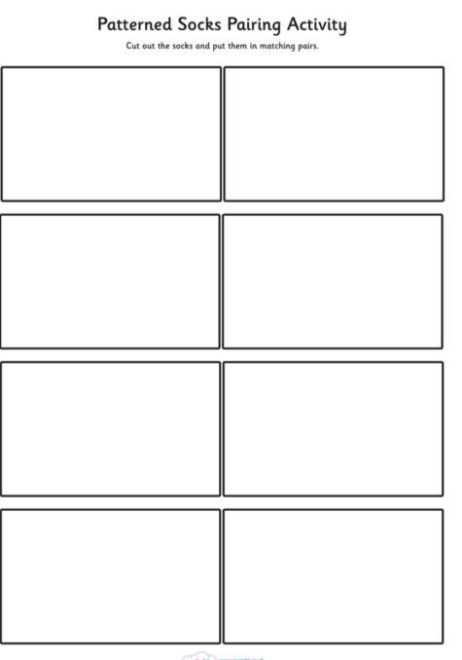
Monday 20th January
Do it - What it is ?
Notes:
Ask the children to find a matching pair of socks. Cut out socks and stick on to prepared sheet. They only need to find 2 pairs unless they are struggling and extra support needs to be given. If so, continue with activity until they understand.
DO NOT SAY PAIRS ARE IDENTICAL AS THIS IS A MISCONCEPTION. WE WILL BE TALKING ABOUT PAIRS OF NUMBERS THAT MAKE A PARTICULAR NUMBER AND THESE NUMBERS WON’T BE THE SAME. PAIRS ARE NOT THE SAME AS DOUBLES! A PAIR IS 2 THINGS THAT GO TOGETHER. IN THE CASE OF THE SOCKS THEY FO TOGETHER BECAUSE THEY HAVE THE SAME PATTERN.

Slide 6
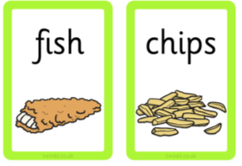
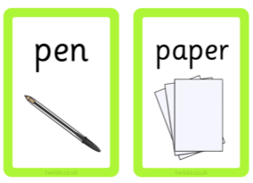
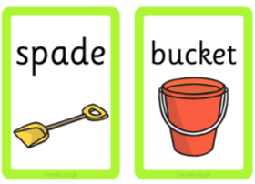
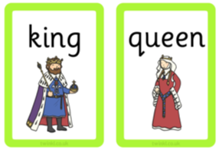
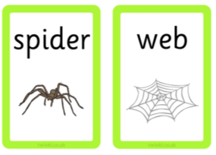
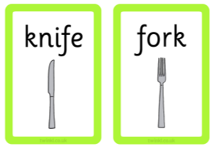
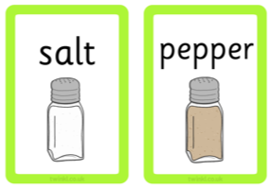
These are also pairs.
Why?
Notes:
A pair is 2 things that belong together. THEY DO NOT HAVE TO BE IDENTICAL.

Slide 7
Monday 20th January
Demonstrate how to play pairs game.
Put all pictures face down.
Turn over 2 – if they are a pair keep them if not turn them back over.
Take it in turns with the friends you are playing with.
Print off pairs cards and put in to continuous provision.

Slide 8
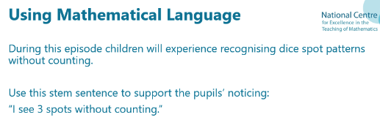
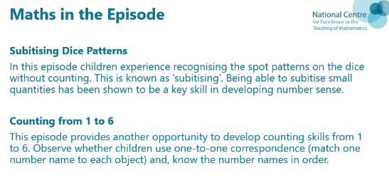
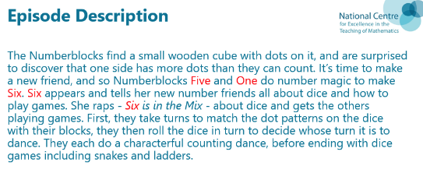
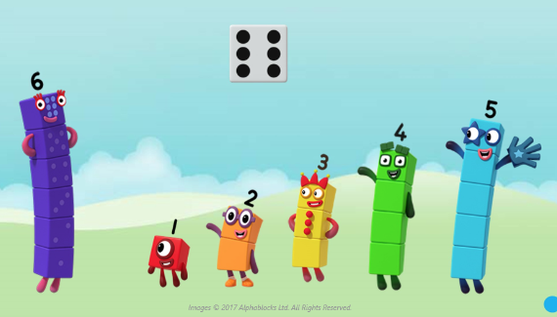
https://youtu.be/g6oeLjnM8Cw
Teach it : What it is?
Subitising

Slide 9

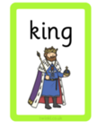




Monday 28th January
What it is not - Secure it..

Slide 10



Today we are looking for pairs of numbers that
make a total.
The numbers will not be written as numerals. We will need to subitise.
Deepen It

Slide 11
W/C 28.1.20
Choose a number between 1-12
Find all the dominoes that total your number.
6

Slide 12
Find all the dominoes that total
1
2
3
4
5
6
7
8
9
10
11
12
Continuous provision

Slide 13

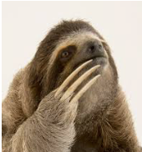
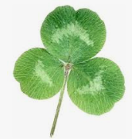

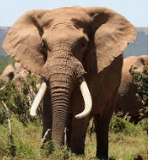





Quick reminder…

Slide 14
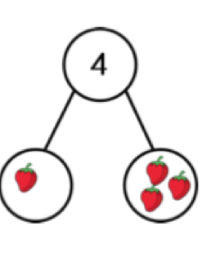
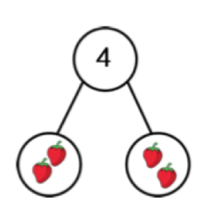
What do these pairs of numbers make?
I see …………… strawberries without counting and ………strawberries without counting.
..………. plus……….. makes……..
I see 1 strawberry without counting and I see 3 strawberries without counting.
1 plus 3 makes 4

Slide 15
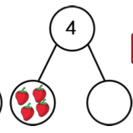
I see………..strawberries without counting and I see …………… strawberries without counting.
………… plus ……………..makes…….

Slide 16
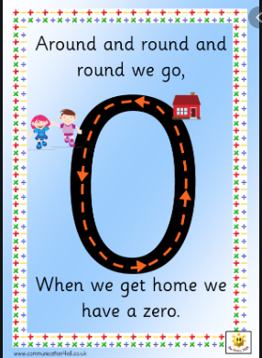
What is zero?
https://www.youtube.com/watch?v=H_2WAAjdrOo
Zero the hero
Read ‘None the Number’

Slide 17
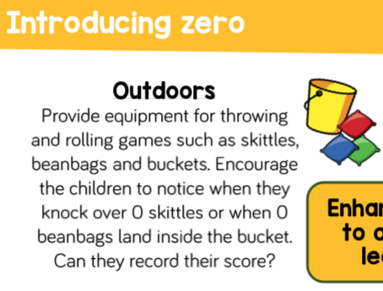
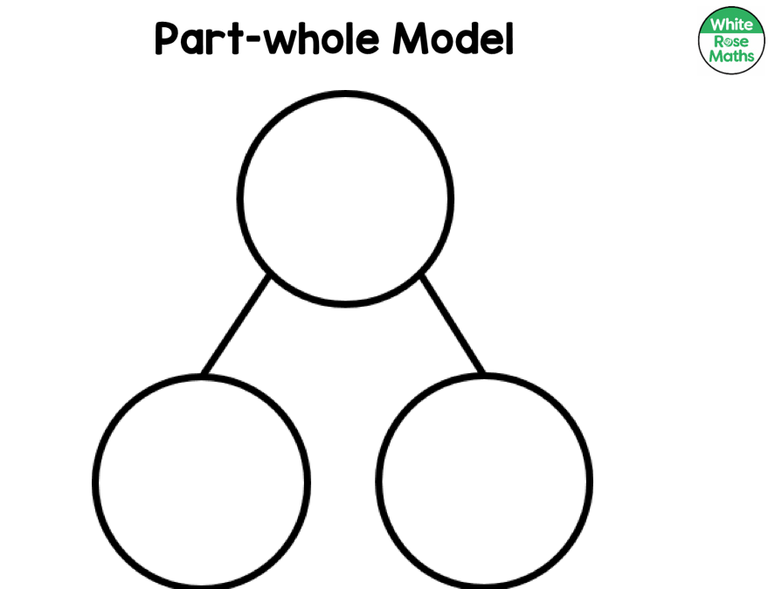
Theme: ……………
Review it : What have you learnt?
There are lots of different ways to show numbers and their value.
You can put different numbers together to make the same total (whole)
A pair is 2 things that go together.
Subitising is knowing a small quantity without counting.
Zero is the number one less than one. If you have 1 and you take it away you have
zero left.
There is a way of writing this ‘nothing’ ’nought’ ‘zero’ 0

Slide 19


