Slide 1

Maths Curriculum Meeting
Thursday 5th March 2020

Slide 2
EYFS Maths
Mathematics involves providing children with opportunities to develop and improve their skills in counting, understanding and using numbers, calculating simple addition and subtraction problems; and to describe shapes, spaces, and measure

Slide 3
End of Year Expectations for EYFS
Mathematics
Numbers:
children count reliably with numbers from 1 to 20, place them in order and say which number is one more or one less than a given number.
Using quantities and objects, they add and subtract two single-digit numbers and count on or back to find the answer.
They solve problems, including doubling, halving and sharing.
Shape, space and measures:
children use everyday language to talk about size, weight, capacity, position, distance, time and money to compare quantities and objects and to solve problems.
They recognise, create and describe patterns.
They explore characteristics of everyday objects and shapes and use mathematical language to describe them.
These end of year outcomes are taken from the EYFS Framework which all EYFS providers work towards.

Slide 4
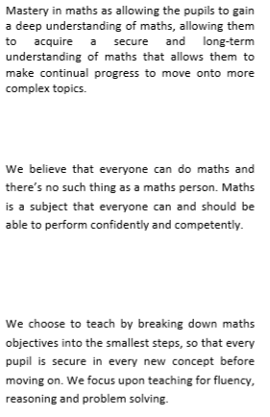
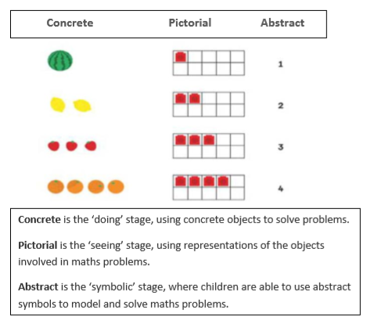
Maths is taught daily.
We practise maths to become fluent – we practise fluency in addition to our maths lesson.
We use classroom routines to put maths into context (how many children are here and how many are absent, numbered pots so the correct amount of equipment is stored in each one, counting the votes on the weekly book vote, plus many, many more)
NJK’s maths policy is CPA (concrete, pictorial, abstract) with a mastery approach.

Slide 5
Classroom Beliefs
This is the slide we start every Maths lesson with.
In every class at NJK.
They are important messages.
Mistakes are valuable
Everyone can learn maths to the highest level.
Questions are really important.
Depth is more important than speed.
Maths is about making connections.

Slide 6
Vocabulary is Key
Language and vocabulary is so important for maths understanding.
Read more here: https://mathsnoproblem.com/maths-as-a-language/
Subitise
Fewer
More
Plus
Equals
Subtract
Total
Children need maths language in order to reason
Reasoning
Reasoning in maths helps children to be able to explain their thinking, therefore making it easier for them to understand what is happening in the maths they are doing. It helps them to think about how to solve a problem, explain how they solved it and to think about what they could do differently.
In Reception, some examples of reasoning are:
• true and false statements eg adding one to a number always makes it smaller
• spotting incorrect maths eg 1, 2, 3, 4, 6, 5, 7, 8, 9, 10
• explaining how we know something or how we worked it out

Slide 7
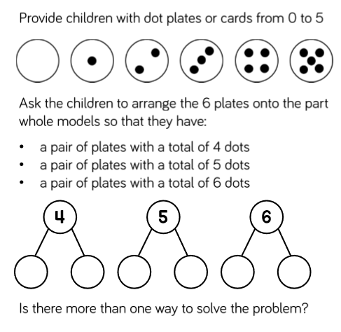
There’s far more to a maths challenge than meets the eye. This is an example of a maths challenge we undertook in January.
It is our job to unpick what children need to know and do in order to complete maths challenges such as this one.
Refer to the other link on the class webpage called ‘Maths Mastery’ to see the learning journey we took in order to solve this maths problem.
Problem Solving
Problem solving in maths allows children to use their maths skills in lots of contexts and in situations that are new to them. It allows them to seek solutions, spot patterns and think about the best way to do things rather than blindly following maths procedures.
In Reception, problem solving might include:
• spotting, following and creating patterns
• estimating amounts of objects
• predicting how many times they can do something in a minute
• sharing objects between different groups – particularly when the amount of groups change and the amount of objects stays the same
• finding different ways to partition numbers eg 5 could be 5+0, 4+1, 3+2
I can subitise
I can find the total of 2 groups
I can count using 1:1 correspondence
I understand the concept of zero

Slide 8
Resources that we use:
https://www.bbc.co.uk/cbeebies/shows/numberblocks
https://www.ncetm.org.uk/
https://whiterosemaths.com/
https://www.educationcity.com/
http://www.iseemaths.com/early-number/

Slide 9
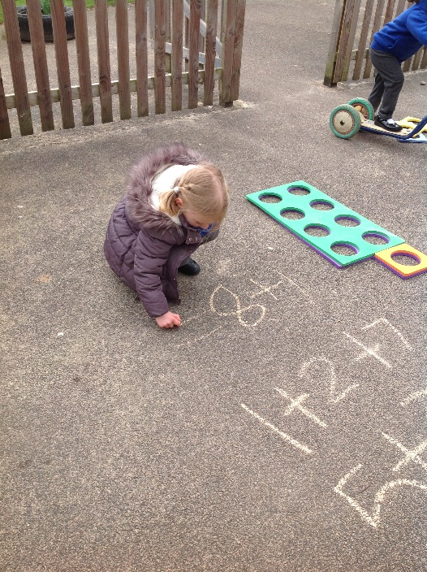
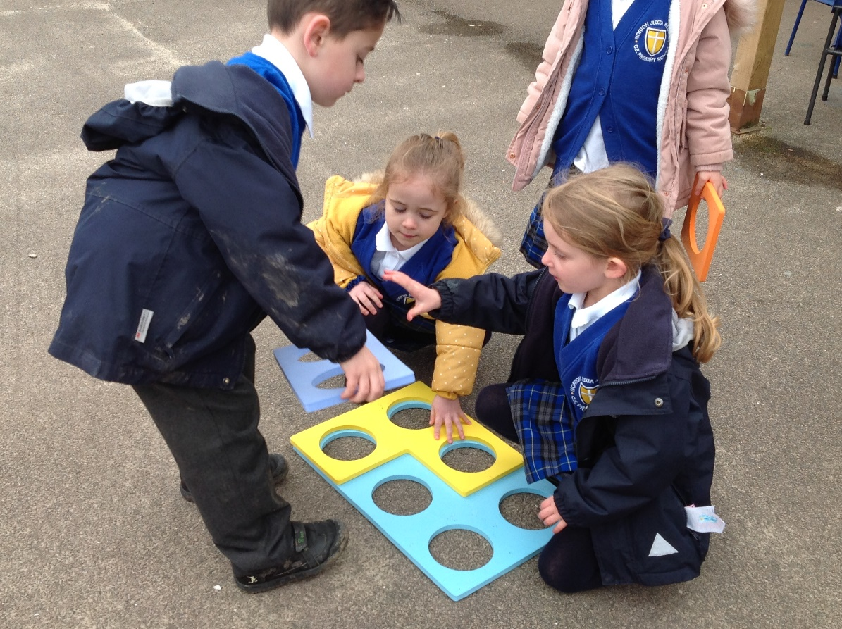
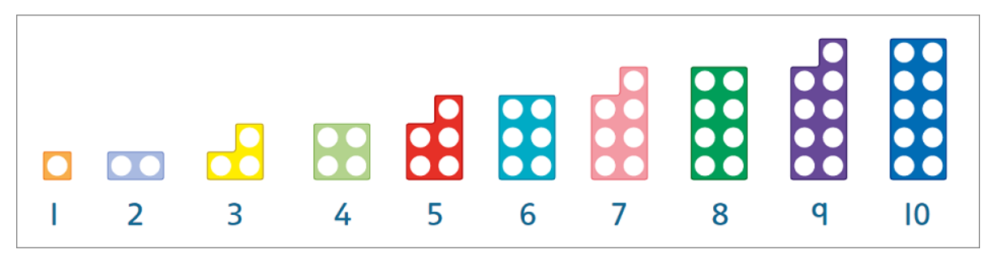
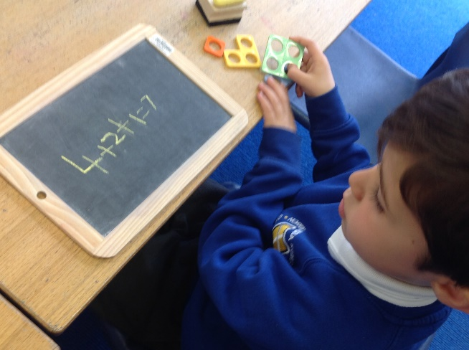
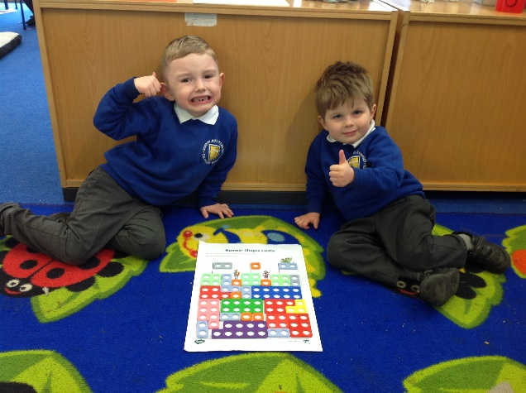
Outdoor Provision
Our maths learning is taken outside everyday.
Loose parts and ordinarily available resources are used to further develop
maths knowledge and skills.
We have also recently purchased some giant outdoor Numicon which has been a big hit!
To find out more about how Numicon is used follow the link below:
https://www.oxfordowl.co.uk/for-home/find-a-book/numicon-guide-for-parents/

Slide 10
NumBots Launch Lesson
Times Table Rock Stars has been a great success in Years 2-5. We will be launching Numbots for Reception and Yr1 children very soon!

Slide 11








Children will be able to earn points and upgrade their robot.
[Menu]
I’m BettyBot.
I’m KittyBot.
I’m NinjaBot.
Remember my friends?
Notes:
Before revealing each name you could get them to call out the name together.
e.g. “After 3, what’s the name of this bot [pointing to Betty]? 1…2…3…”

Slide 12
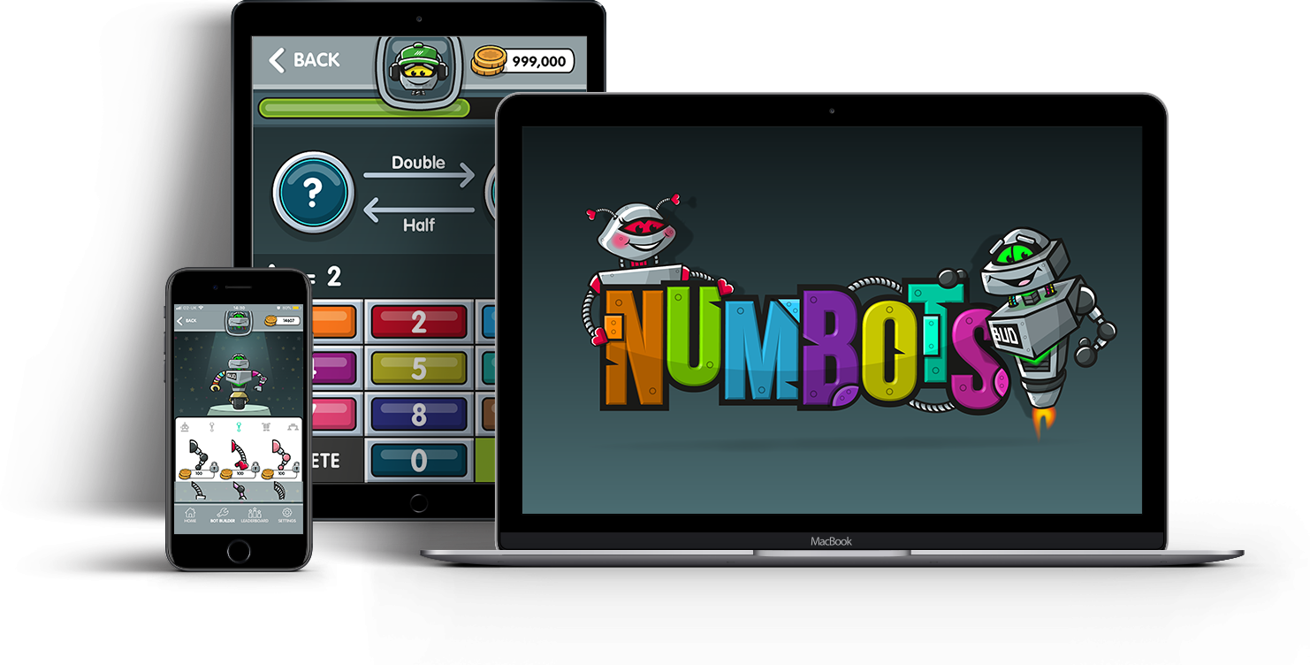


[Menu]
Like TTRockstars the app will be available for tablets, phones and desktops.
100
Notes:
Available on different devices.

Slide 13
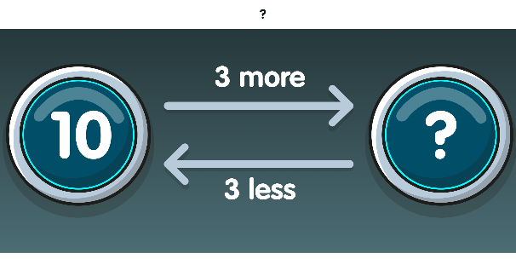
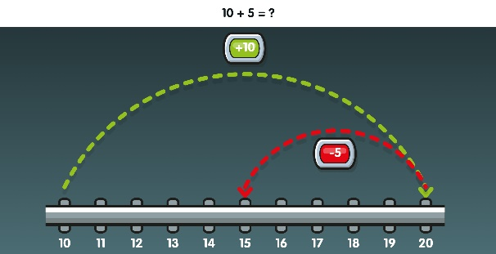
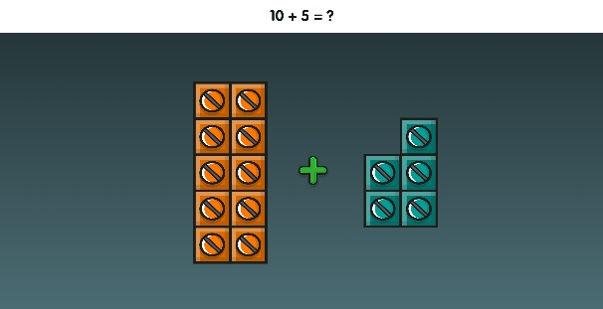
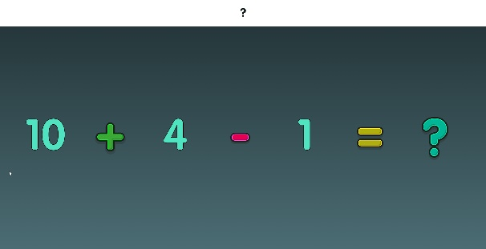
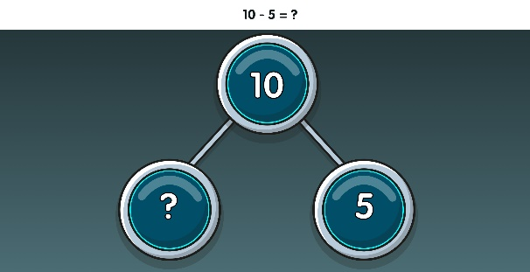
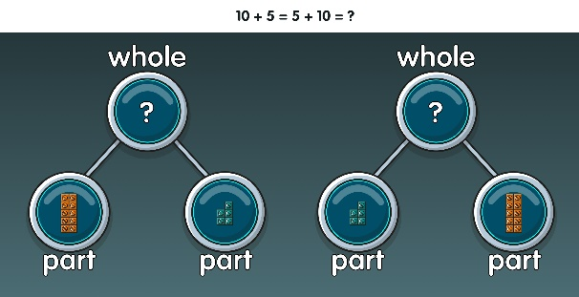
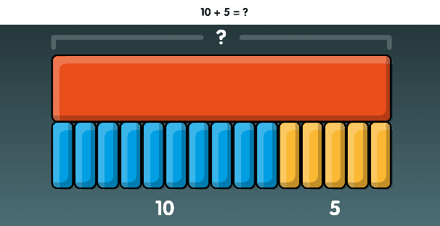
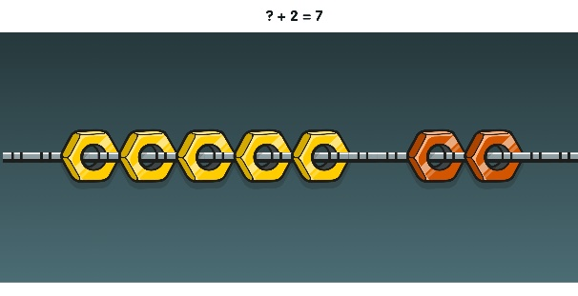
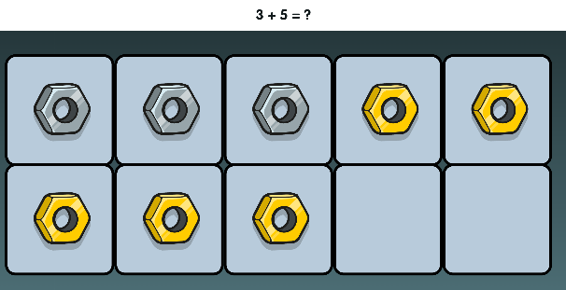
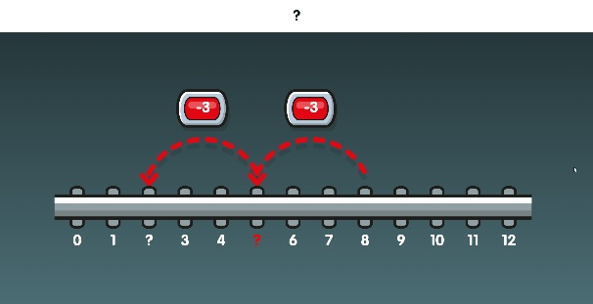
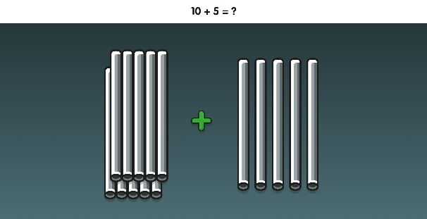
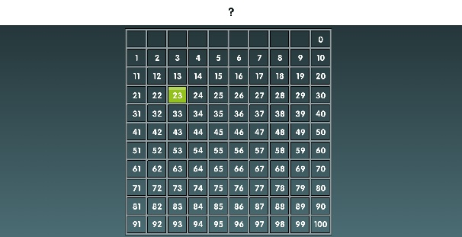
Maths will be presented using different representations, all of which we use at school.
[Menu]
ADDING & SUBTRACTING
Learning Intentions
NUMBER BONDS
COUNTING
100
Notes:
The three core strands of NumBots are subitising (“counting without counting”), number bonds and addition & subtraction.
Here are some screenshots of the representations we use.

Slide 14
Thank you for attending this curriculum meeting.
Any questions please do not hesitate to ask.
This presentation will be available to view on Willow Class page of the school website. https://norton-juxta-kempsey.secure-primarysite.net/willow/

