Slide 1

Norton Juxta Kempsey CE Primary School
Parent Information
Maple Class
2025 - 2026

Slide 2
Welcome to Maple Class
Year 5
Mrs Goddard (Monday – Tuesday)
Mrs Kingdon (Wednesday – Friday)
Mrs Soper (Monday – Friday mornings)

Slide 3
Daily Routine
9.00 – 9.10 | Registration and morning warm-ups
9.10 – 9.30 | Collective Worship
9.30 – 10.30 | Morning Sesson 1 (English or Maths)
10.30 – 10.45 | Maths fluency (including times tables)
10.45 – 11.00 | Breaktime
11.00 – 12.00 | Morning Session 2 (English or Maths)
12.00 – 1.00 | Lunchtime (lunch followed by OPAL playtime)
1.00 – 1.30 | Reading or Spelling activity
1.30 – 2.30 | Afternoon Session 1
2.30 – 2.40 | Movement Break (Daily Mile)
2.40 – 3.20 | Afternoon Session 2
3.20 – 3.30 | Story Time
Afternoon Sessions: History or Geography R.E Science Art or D&T P.S.H.E Computing French Music P.E
Notes:
Afternoons – topic pe re

Slide 4
Topics in Year 5
Ancient Greeks
Britain at War – World War 1
Sustainability
Age of steam and smoke (The Industrial Revolution)
The Galapagos Islands
Vikings and Anglo-Saxons

Slide 5
Reading
Shared reading – during lessons, every day, cross-curricular texts.
Accelerated Reading – Children are assessed regularly through the year using the Accelerated Reading scheme and they are given a ZPD range. They can choose books that are banded within this range. They quiz after each book to check their understanding of the text. They are aiming to score >80% on each quiz.
Class Read – Read at the end of the day.

Slide 6
Maths
All aspects of maths are covered (Place value, Four operations, Fractions, Shape, Measures, Time etc.)
Problem solving (Problem Solving Mondays!)
We complete oral, practical and written work
Children taught daily
CPA maths policy (concrete, pictorial, abstract)
Three part lesson structure (Do it, Secure it, Deepen it)
Mastery approach - learning approaches aim to ensure that all pupils have mastered key concepts before moving on to the next topic

Slide 7
School Christian Values
Love
Trust
Friendship
Respect
Compassion
Forgiveness
Courage

Slide 8
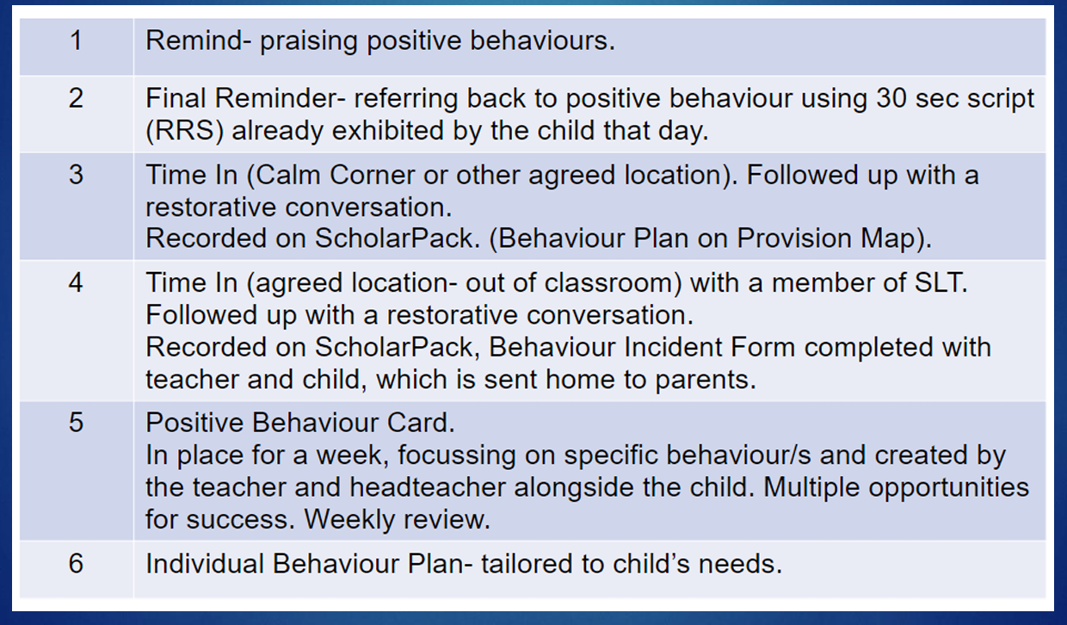
Behaviour Policy – a positive approach
Notes:
Introduction of stickers for bronze, silver, gold to reinforce good behaviour

Slide 9
Behaviour Policy – a positive approach
School expectations – RRS - Be Respectful, Be Responsible, Be Safe
Positive behaviour praised through:
  Green is Great chart (children devise behaviour focus linked to rules or something the class need to work on) Green Card is given to the child’s name once the behaviour has been shown in class. Class celebrate once all achieved green card. We aim for all pupils' name to be green by end of first session.
  Good News Cards - children going above and beyond expectations - sent home on same day stating which behaviour being shown.
  Congratulations Cards
  House Points
  Jar of Joy – jar filled up every time the School Value is demonstrated for that half term. Class decides on reward once full
Notes:
Introduction of stickers for bronze, silver, gold to reinforce good behaviour

Slide 10
Assessment
On going teacher assessment
Parents evening and mid-year conversations
End of year reports

Slide 11
Homework
Please read every day and record in the home school link book. In upper key stage two, we encourage the children to record what they read themselves, so it is their reading log.
Regular multiplication practise using TT Rockstars.
Weekly spelling review of spelling patterns and statutory year group words
English and Maths homework sheets alternate weekly
Ad hoc homework relating to History or Geography topics

Slide 12
Uniform
Uniform list on website
Years 5 and 6 wear clip on ties with V-neck jumper
PE kit – wear named PE kit on PE days (information to follow)
Winter kit – navy joggers, white t-shirt, school jumper or hoodie
Summer kit – navy shorts, white t-shirt, school jumper or hoodie
Water bottles
No jewellery and earrings must be removed or covered for PE. (please provide tape)

Slide 13
Communication
- Home School link book. Specific communication pages and reading record pages.
- School website
- Text Messages
- Newsletters emailed
- Other enquires via the school office
- Any worries – please make an appointment to speak to us in the first instance.

Slide 14
Questions
Please email any specific questions or enquiries that have not been answered to: office@nortonprimary.worcs.sch.uk

Slide 15
We look forward to working with you and getting to know your child even better.

