Slide 1


Separating Mixtures

Slide 2
LO:
To understand the processes used to separate mixtures of materials.
Success Criteria
I can identify different ways materials can be mixed together.
I can use sieving, filtering, evaporating and other processes to separate mixtures of materials.
I know when to use which processes to separate mixtures.

Slide 3
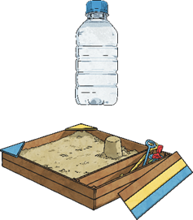
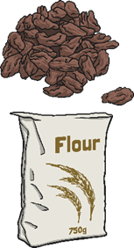
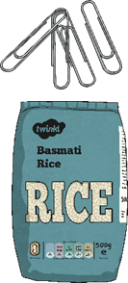
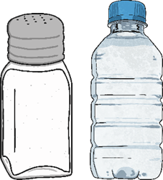
Mixed Materials
Materials can be mixed in different ways:
1. A suspension is a mixture of a liquid and solid particles that will not dissolve.
2. A mixture of two solids.
3. A solution is a solid dissolved in a liquid.
4. A mixture of two solids.
Eg. Sand and water.
Eg. Raisins and flour.
Eg. Salt and water.
Eg. Paper clips and rice.
Since each of these mixtures of materials has been mixed differently, you will need to use different processes to separate them.

Slide 4
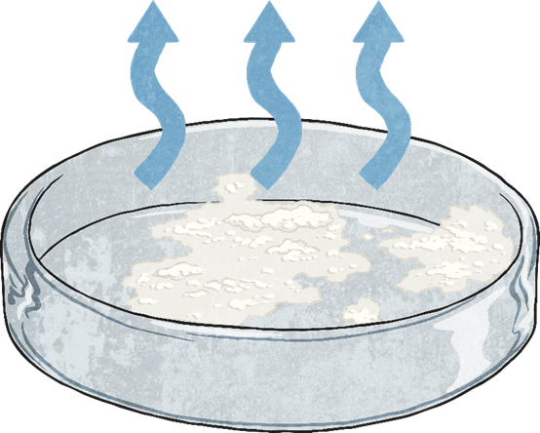
Separating Processes - Evaporation
How?
Boil the mixture, or leave it for a few days, so the liquid evaporates leaving the solid behind.
This process is best used to separate the salt and water solution.
As the salt has dissolved in the water, filtering would not separate the two materials. The salt particles would go through the filter paper along with the water.
When the salt water solution is evaporated, the water will turn into water vapour and leave the salt behind.

Slide 5
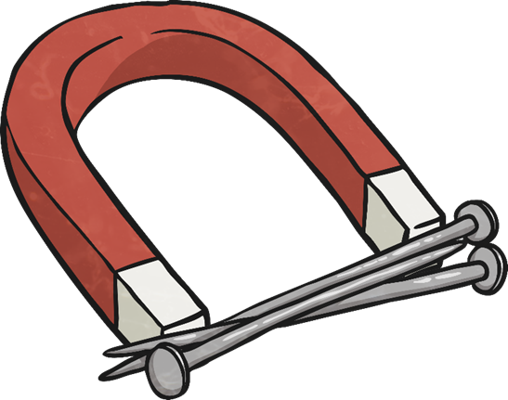
Separating Processes –
Magnetic Attraction
How?
Use a magnet to attract any magnetic materials and remove them from the mixture.
Use this process to separate the paper clips from the rice.
The paper clips are made of steel and will be attracted to the magnet.
The rice is not magnetic so will stay in the bowl.

Slide 6
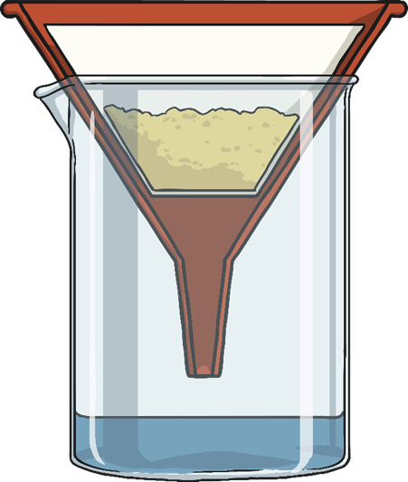
Separating Processes - Filtration
How?
Line a funnel with filter paper and place it over a beaker. Pour the mixture slowly into the filter paper. The liquid will get through and any insoluble solids will be caught in the filter paper.
This process should be used to separate the mixture of sand and water.
Sand is insoluble, so it has not dissolved in the water. The sand particles will not be able to get through the tiny holes in the filter paper, but the water particles will.
The sand will be caught in the filter paper while the water will get through to the bowl.

Slide 7
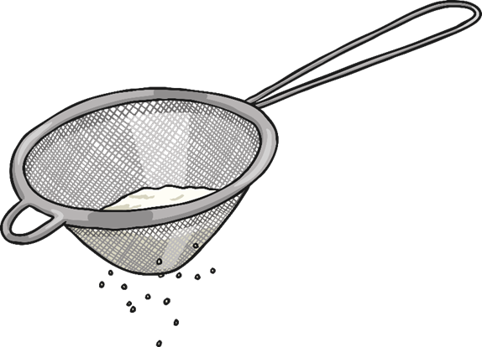
Separating Processes - Sieving
How?
Pour the mixture through a sieve held over a bowl. The smaller particles will get through it into the bowl and the larger particles will be caught in the sieve.
Use this process to separate the mixture of raisins and flour.
The grains of flour are much smaller than the raisins, so they will be able to go through the sieve into the bowl below.
The raisins are much bigger, and will get caught in the sieve.

