Slide 1
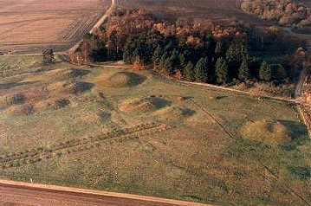
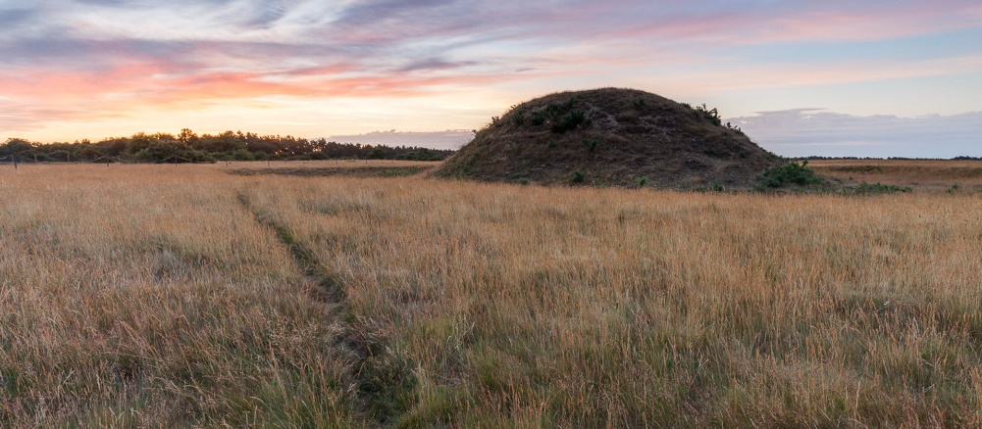
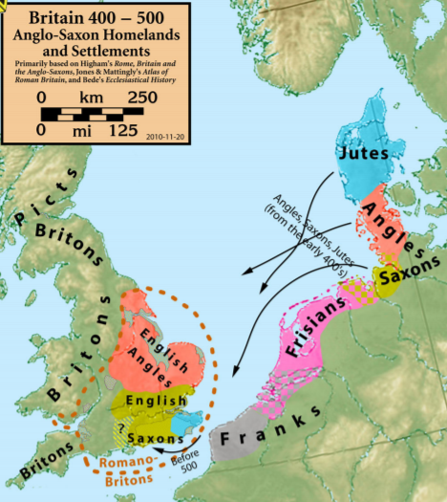
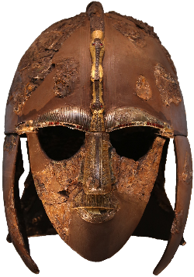
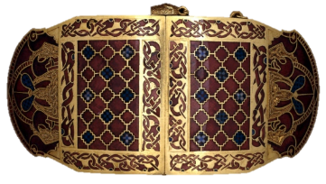
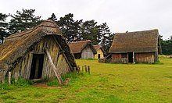
Topic Fact Sheet – Anglo Saxons and Scots
Key Terms
Angles | Tribes from modern day Northern Germany
Archaeologist | Someone who studies the past by exploring old remains
Invasion | To enter a country by force with the intention of taking over.
Jutes | The Jutes were believed to have come from Jutland, which in modern day Denmark
Missionary | A person from a religion sent to spread the faith.
Offa’s Dike | A large ditch between Wales and England used to mark the boarder.
Pagan | A religion that involves worshiping many gods and goddesses.
Picts | Tribes originally from Scotland
Saxons | German-Dutch tribes who settled in Britain from around 450 AD
Scots | People from Ireland, who were fierce and powerful fighters.
Sutton Hoo | The site of Anglo-Saxon cemeteries.
Ogham Alphabet | Letting used by the Picts
Sutton Hoo: A collection of mounds that were Anglo-Saxon cemeteries.
One mound was found to contain a ship burial.
The Jutes settled in Kent.
The Angles settled in East Anglia..
Artefacts found at Sutton Hoo.
The Saxons settles in the South of England.
The Jutes, Angles and Saxons came from Denmark, Germany and The Netherlands.
Anglo Saxons lived in villages like this.

Slide 2
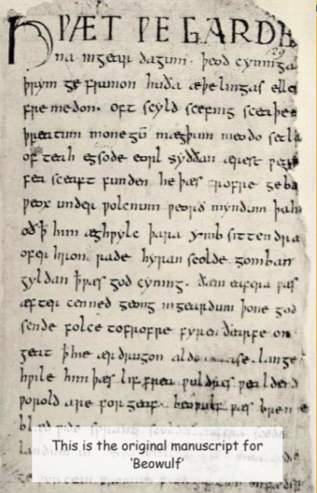
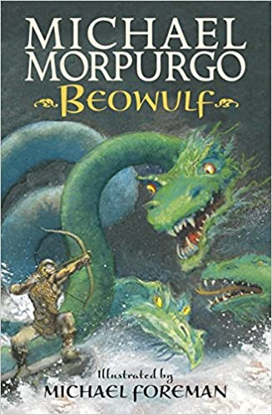
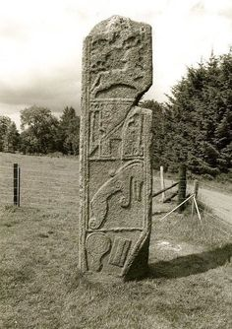
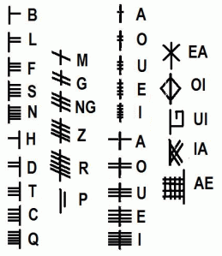
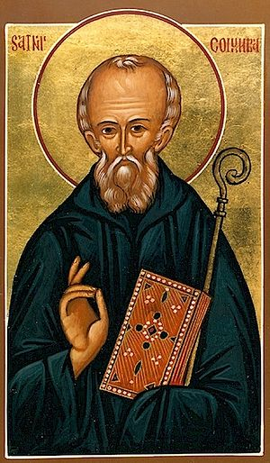
Topic Fact Sheet – Anglo Saxons and Scots
Key Dates
The story of Beowulf was written by an Anglo-Saxon and is set in Denmark in around 500 AD. It was originally written as a poem.
410 AD | Romans leave Britain.
449 – 550 AD | Arrival of Angles and Saxons to Britain.
450 AD | Saxons settle in Kent
477 – 586 AD | A further 6 Kingdoms are formed in England.
556 AD | Seven kingdoms are created across Britain.
597 AD | St Augustin brings Christianity to Britain from Rome and becomes Archbishop of Canterbury.
617 AD | Northumbria becomes the supreme kingdom
779 AD | Mercia becomes the supreme kingdom and King Offa builds a Dyke along the Welsh boarder.
793 AD | The Vickins invade.
1939 | Excavation of the Sutton Hoo burial ground.
Today there are many modern translations of the story.
St Columbia was an Irish missionary who helped to spread Christianity in Scotland.
The Picts were known for their elaborate carvings, but nobody is really sure what they were for.
The Ogham alphabet was made up of simple strokes for consonants - and strokes or dots for the vowels.

